Slide 1
New Mexico 911 Program
Understanding NM911 GIS Data Assessment Reports
New Mexico APCO Statewide Conference
Santa Fe, Apr 5, 2024

Slide 2
Earth Data Analysis Center, The University of New Mexico’s Role
Monthly Tasks
GIS Data acquisition, processing, assessment, and reporting
Technical support to Data Providers and PSAPs
Create statewide NM911 Master Database
Assisting data providers with corrections
Quarterly Tasks
MSAG-ALI-GIS data comparison, and reporting
Assisting data providers/PSAPs with corrections

Slide 3
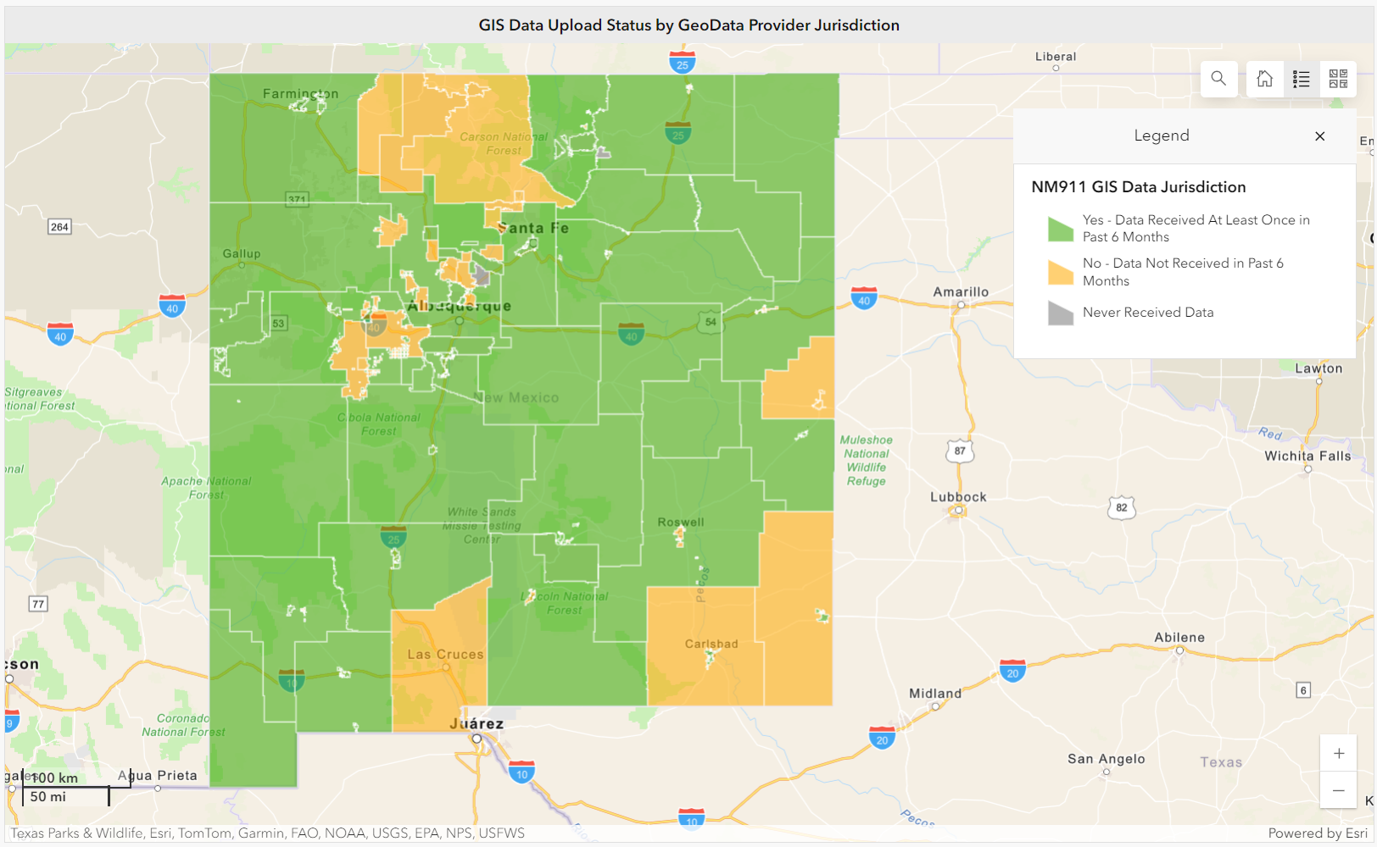
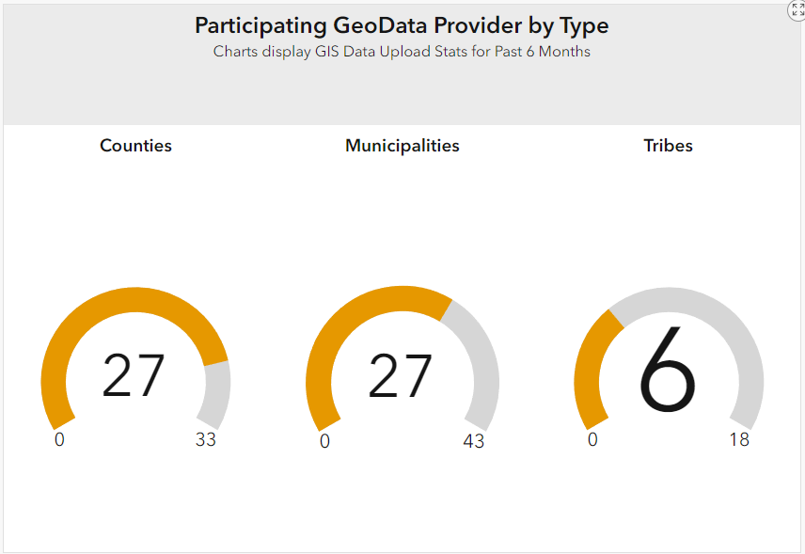
GIS Data Upload Status as of March 2024
NM911 GIS Data Status Dashboard https://nm911-hub.maps.arcgis.com

Slide 4
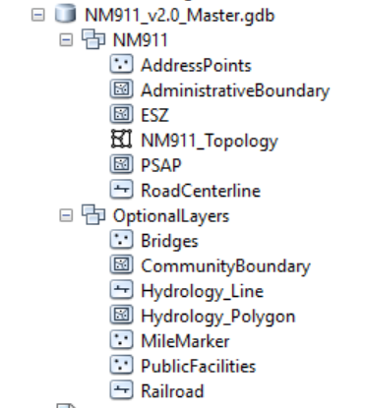
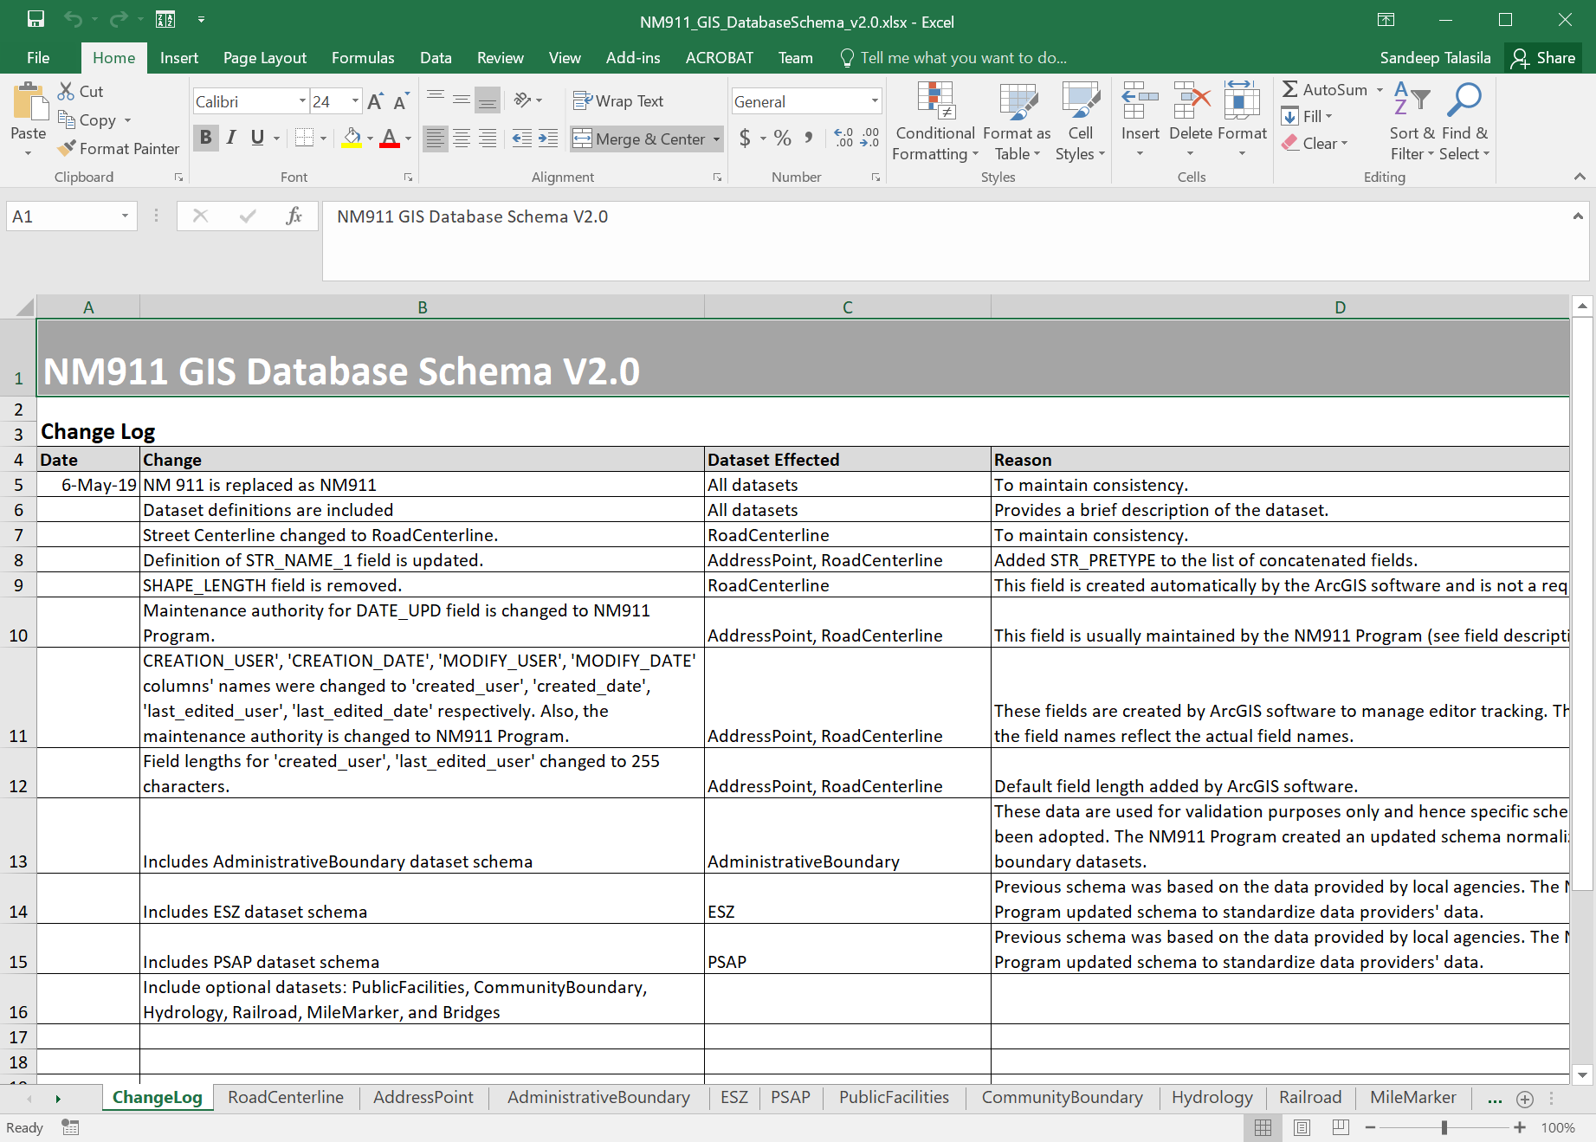
GIS Data Model (Current/Legacy)
Adopted in September 2019
Required Layers
Address Points
Road Centerlines
Addressing/Administrative Boundary*
Emergency Service Zone (ESZ) Boundary
Public Safety Answering Point (PSAP) Boundary
Optional Layers
Public Facilities, Community Boundary, Hydrology, Railroads, Mile Markers, Bridges
* Provisioning boundary will be used if available. Required for Next Gen 9-1-1

Slide 5
NG9-1-1 GIS Data Layers
Required | Strongly Recommended | Recommended
Road Centerlines | Other service boundary layers (ex: Coast guard, poison control, etc.) | Railroad centerline
Address Points | Street name alias table | Hydrology (streams & water bodies)
PSAP Boundary | Landmark name table | Cell sectors
Fire Boundary | Landmark name alias table | Location Markers
Police Boundary
EMS Boundary
Provisioning Boundary

Slide 6
Current NM911 Schema to NG911 Schema

Slide 7
Current NM911 Schema to NG911 Schema

Slide 8
Current NM911 Schema to NG911 Schema

Slide 9
NM911 Data Assessment Workflow
Collection
Conversion
Processing/ Assessment
Reporting
Aggregating & Delivery

Slide 10
New Mexico 911 (NM911) Program GIS Data Workflow
Monthly GIS Data Validation Workflow
Quarterly GIS-MSAG-ALI Comparison Workflow
Collection
Conversion
Processing/ Assessment
Reporting
Aggregating & Publishing
Data Upload to the NM911 Data Portal
Check data formats
Email notification to GIS POCs
If invalid
MSAG data download from Intrado (quarterly)
ALI data download from Intrado (once a year)
Check for valid data attributes
If invalid
Notify GIS POCs & Receive Feedback
Parse data to GIS tables
Crosswalk data to NM911 GIS Data Model
Create a version of NM911 geodatabase for each GIS data provider
Extract and aggregate recent address and road data for all local jurisdictions within each PSAP boundary area
Extract data per each PSAP boundary area
Spatial and Tabular checks
Topology Checks
Data Reviewer Checks
Create Fishbone lines
MSAG to GIS Data Comparison
ALI to GIS Data Comparison
Update monthly error statistics for each data provider on the NM911 GIS Dashboard
Generate Monthly Data Assessment Reports, Quarterly MSAG/ALI/GIS Comparison Reports and corresponding error geodatabases
Upload reports and error geodatabases to the NM911 Data Portal
Technical Assistance with Data upload, Understanding reports and error data & Data Correction
Deliver to NM DFA for PSAP updates & publish to RGIS data clearinghouse for public access
Aggregate address and road data to create a statewide master datasets

Slide 11
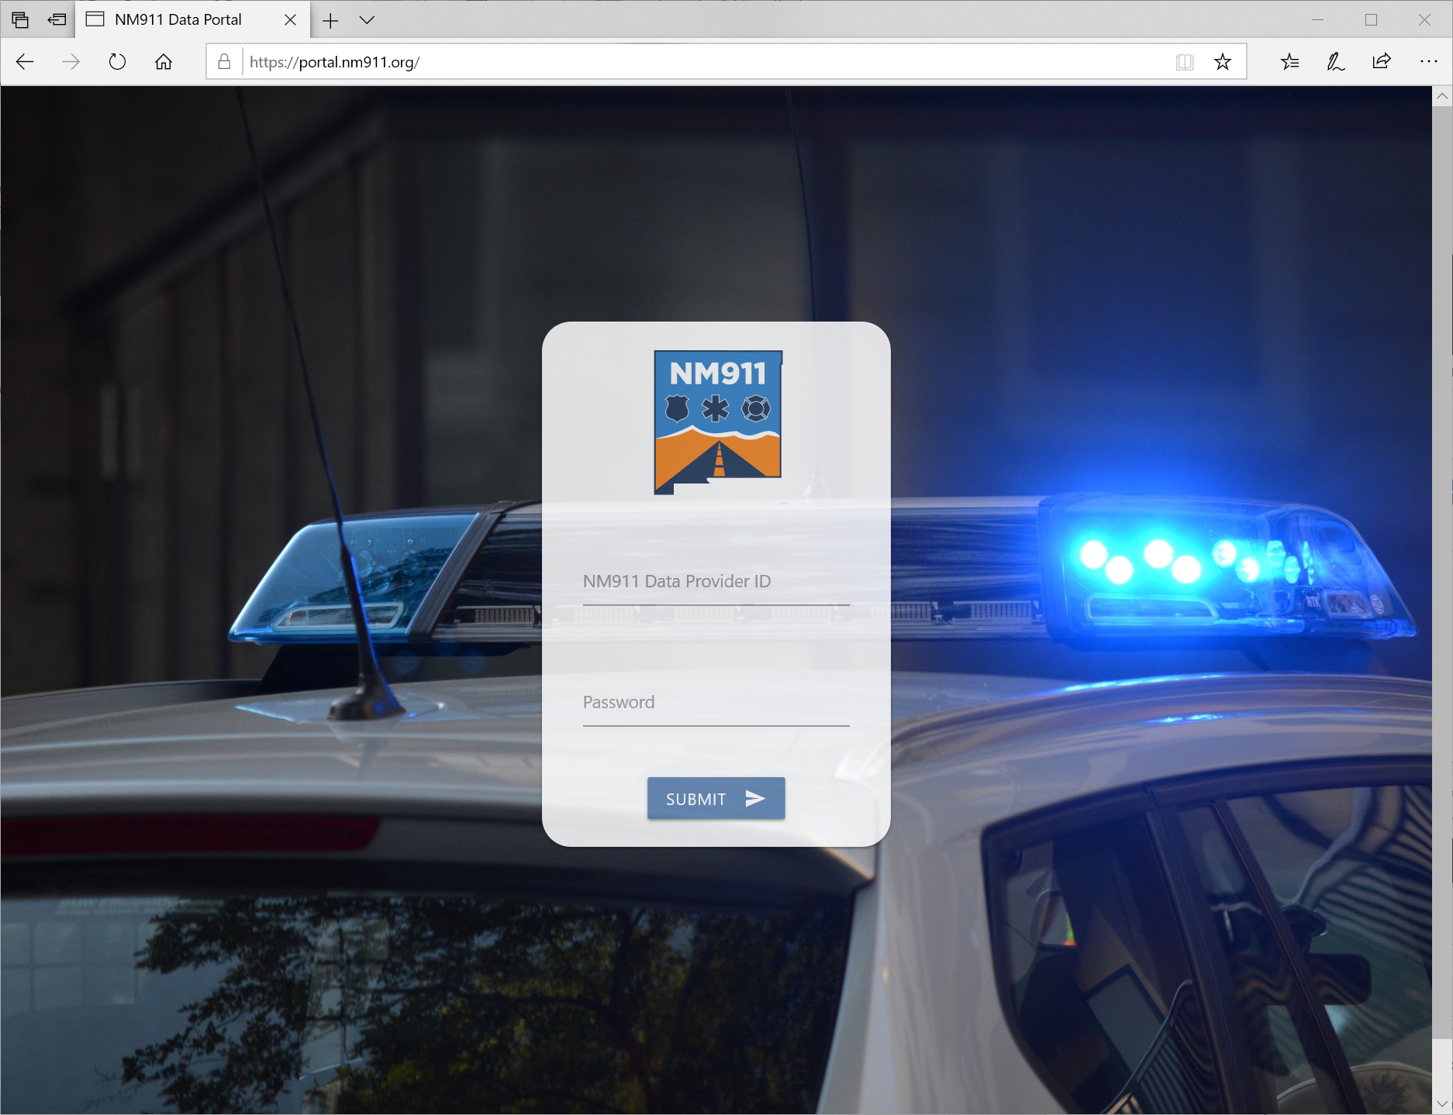
Data Collection
Data Providers were notified via e-mail each month
How: NM911 Data Portal https://portal.nm911.org/
When: 1st – 15th of each month
What: Address points, Road centerlines, and Boundaries
Accepted data formats: Shapefiles (zipped or unzipped), File geodatabases (zipped)
Notes:
If multiple uploads, duplicate data are resolved before data conversion process. Latest data are processed and all other previous uploads will be rejected.

Slide 12
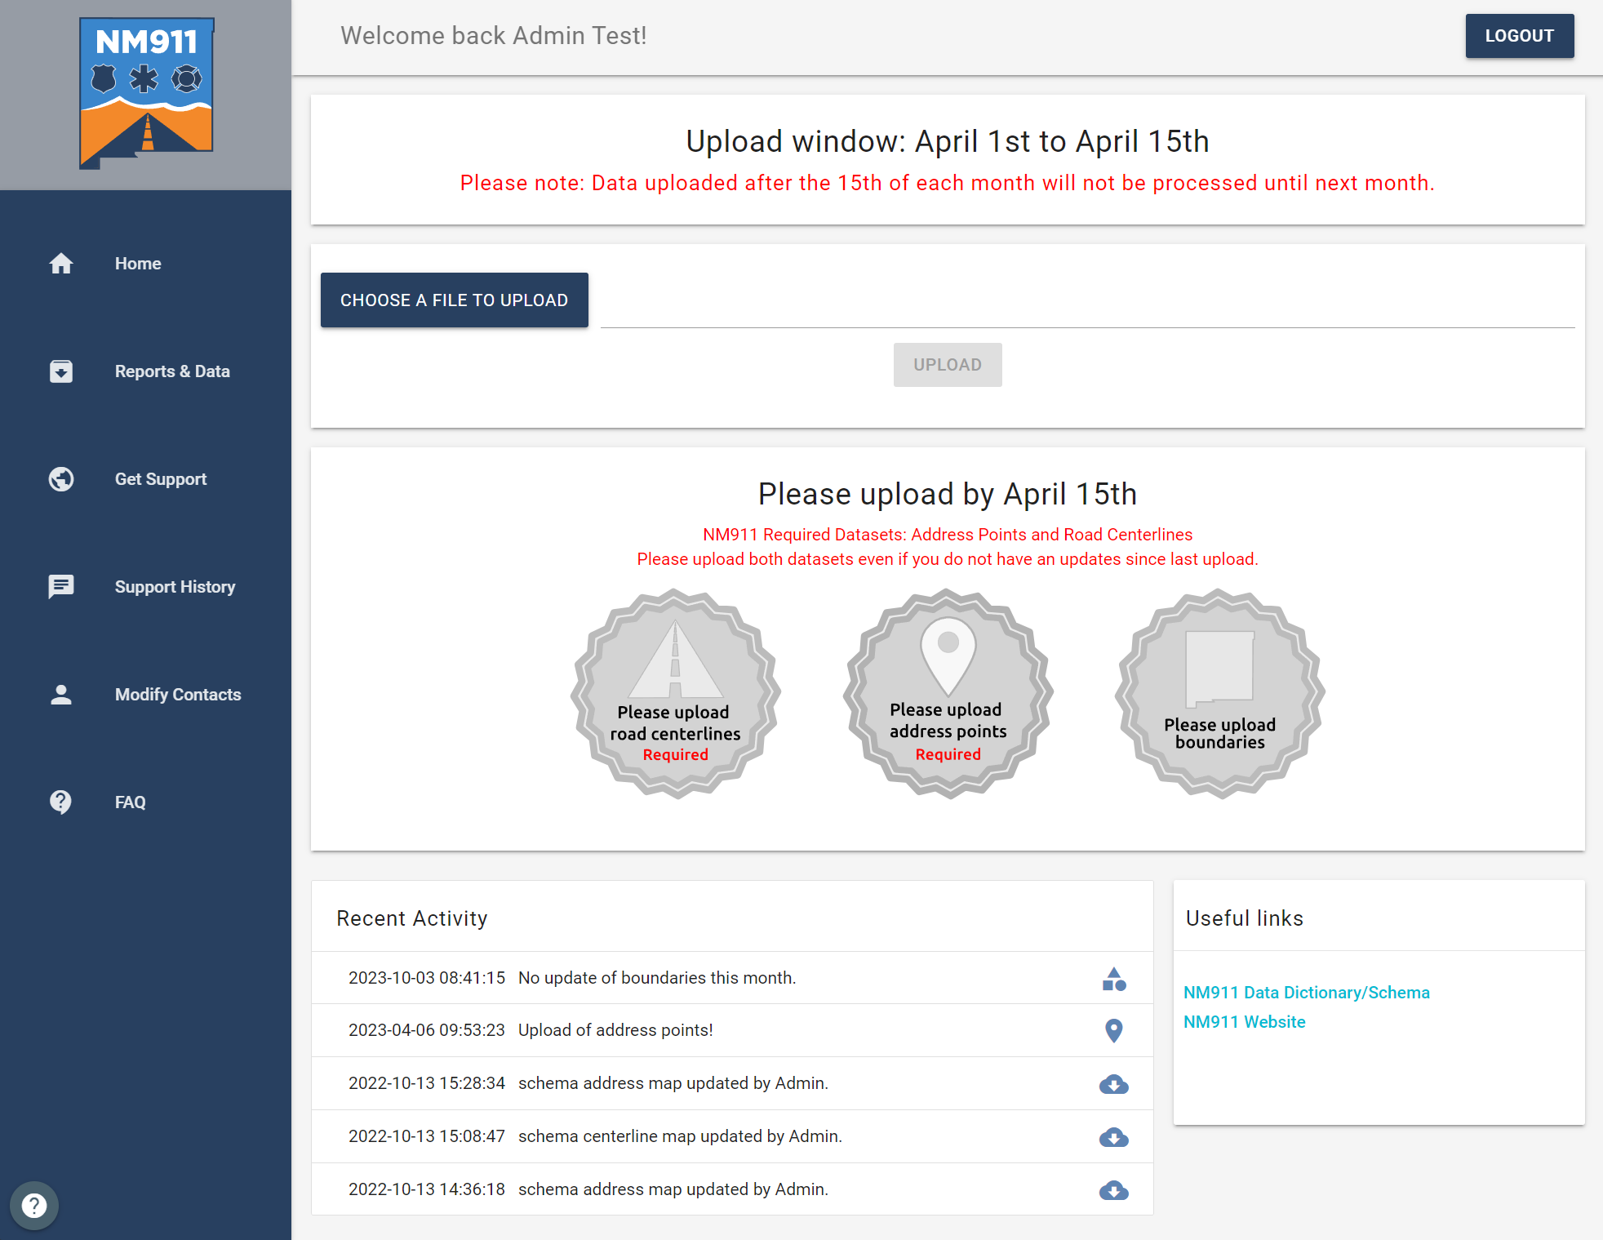
NM911 Data Portal
Acknowledgement if upload is a Success! No email – We try not to SPAM your inbox!!
As seen in the second half of each month.

Slide 13
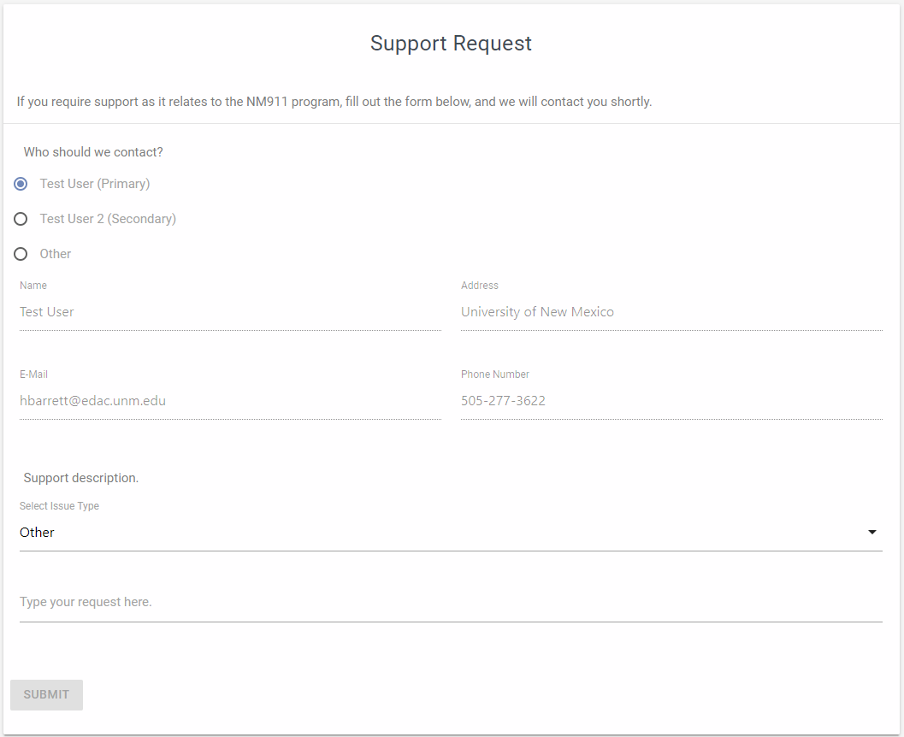
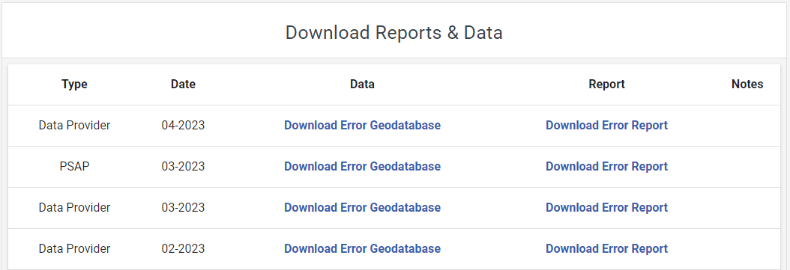
NM911 Data Portal

Slide 14
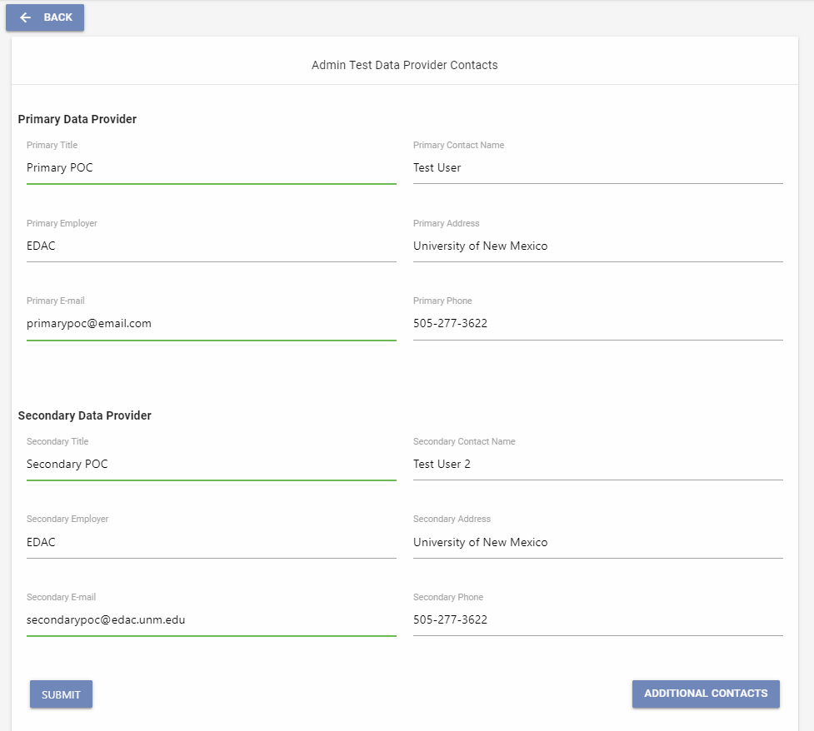
NM911 Data Portal

Slide 15
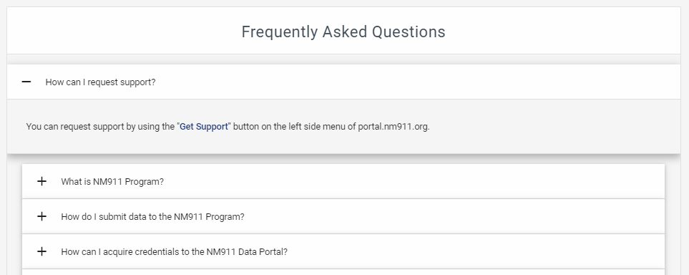
NM911 Data Portal

Slide 16
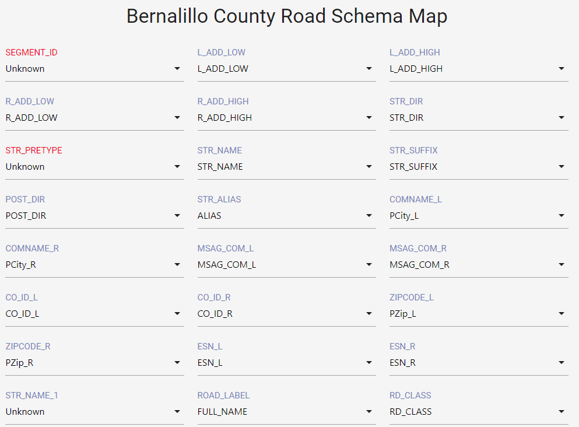
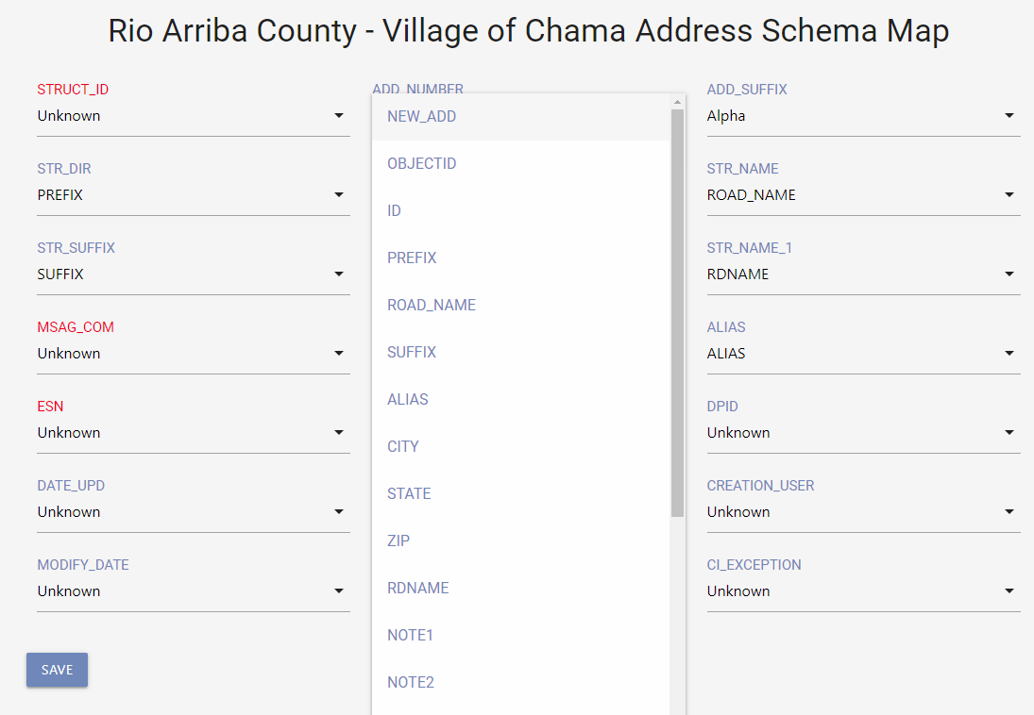
Data Conversion
NM911 Data Portal Admin Tools
NM911 Data Model
Field Mapping/Crosswalk between local schema to state schema
Data imported to State Schema
Error feature classes are created if exists

Slide 17
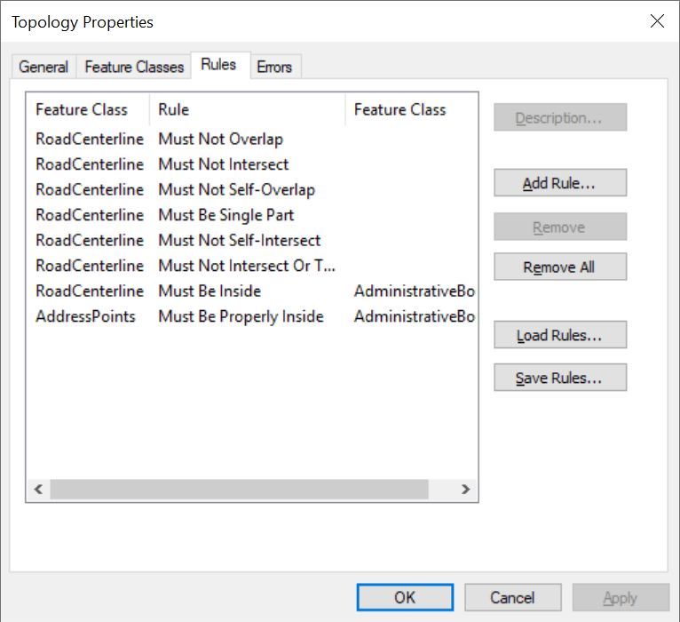
Data Assessment
QA/QC to ensure data integrity
Spatial & Tabular Accuracy Checks
Topology Checks
Data Reviewer Checks
Datasets: Road Centerlines, Address Points, Administrative/Addressing Boundary

Slide 18
Data Assessment
 |  | DATA REVIEWER CHECKS
1 |  | Address Point Address Number Cannot Be 0, Negative, NULL Or Blank
2 |  | Address Point Address Number Should Be Within Road Centerline Address Range
3 |  | Address Point Full Road Name Must Match Road Centerline Full Road Name
4 |  | Address Point Has Invalid Geometry
5 |  | Address Point Must Not Have Duplicate Geometry
6 |  | Address Point Street Name Cannot Be Blank Or NULL
7 |  | NM911 Topology Checks
8 |  | Road Centerline Has Invalid Geometry
9 |  | Road Centerline Left High Address Must Be Odd
10 |  | Road Centerline Left Low Address Is Greater Than Left High Address
11 |  | Road Centerline Left Low Address Must Be Odd
12 |  | Road Centerline Length Must Not Be Less than 15 ft.
13 |  | Road Centerline Must Be Broken And Snapped At Road Intersections
14 |  | Road Centerline Must Not Have Dangles
15 |  | Road Centerline Must Not Have Duplicate Geometry
16 |  | Road Centerline Must Not Have Left Side Overlapping Address Range
17 |  | Road Centerline Must Not Have Right Side Overlapping Address Range
18 |  | Road Centerline Right High Address Must Be Even
19 |  | Road Centerline Right Low Address Is Greater Than Right High Address
20 |  | Road Centerline Right Low Address Must Be Even
21 |  | Road Centerline Should Not Be Multipart

Slide 19
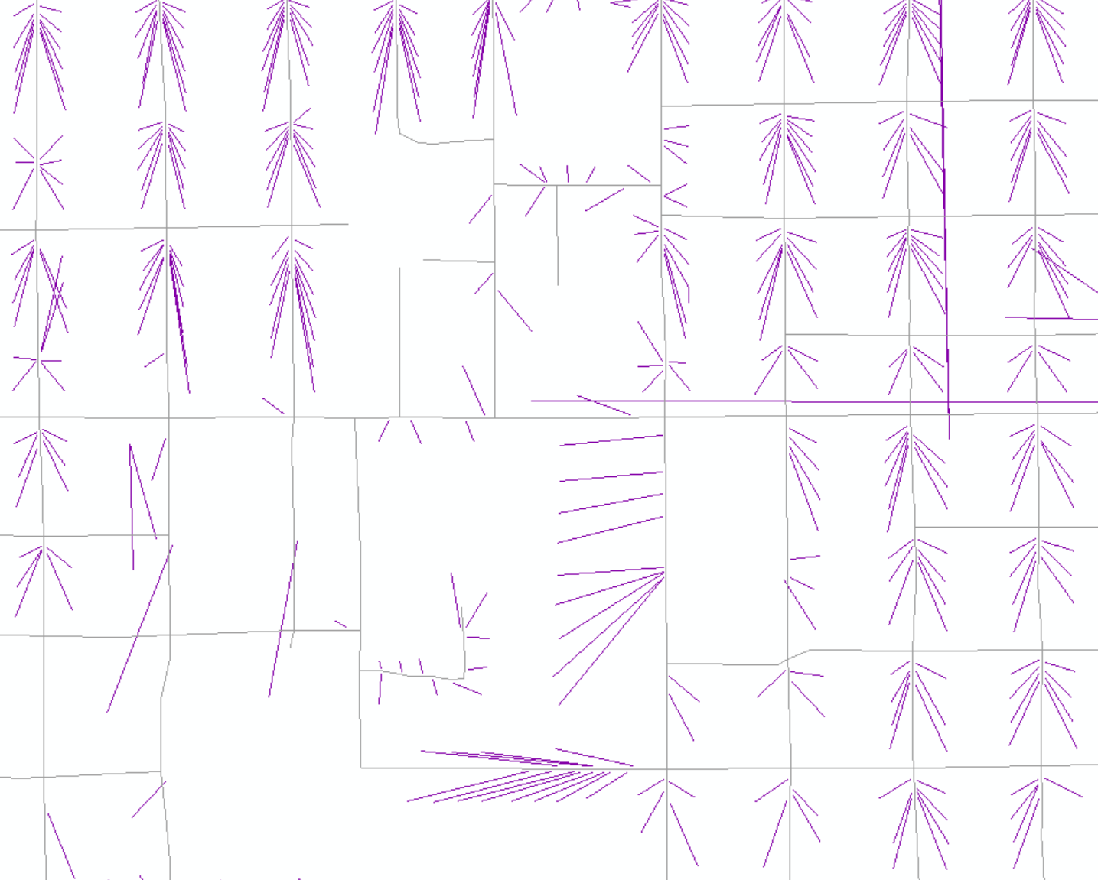
Data Analysis – Fishbone
Visually Compare road centerlines to address points
Out of numerical order
On the wrong side of the street
On the wrong block
Only generated if the address point and road centerline data contains Community Name and ZipCodes

Slide 20
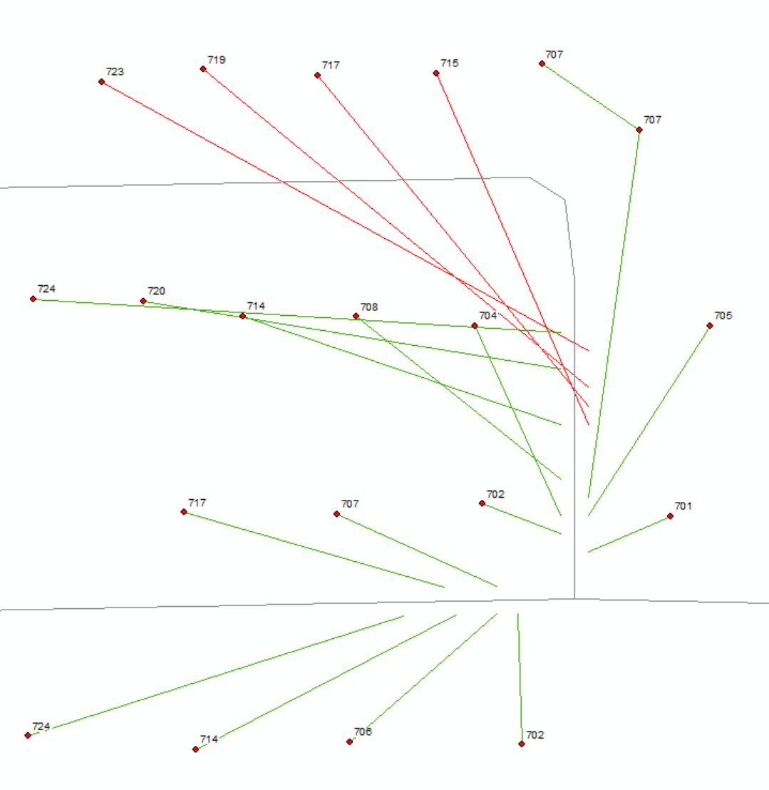
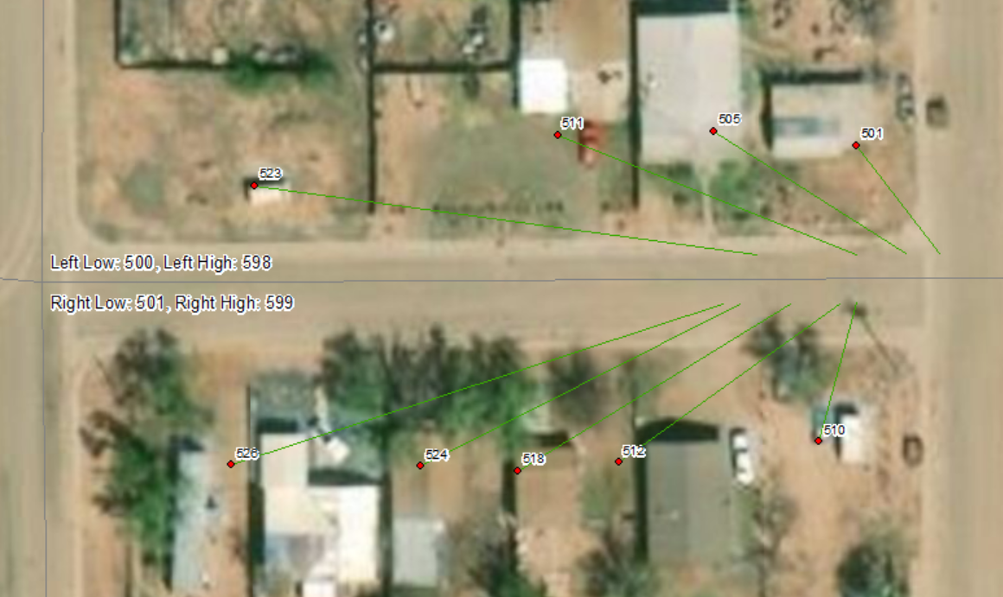
Fishbone Analysis
GOOD

Slide 21
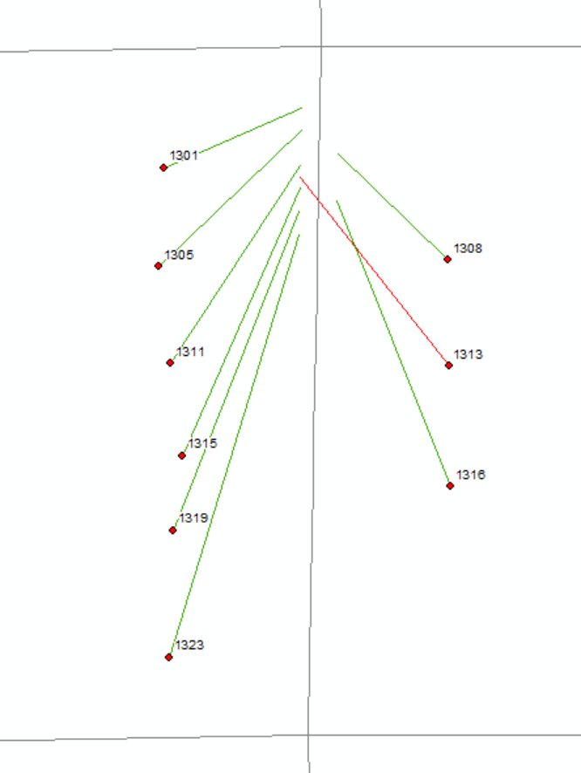
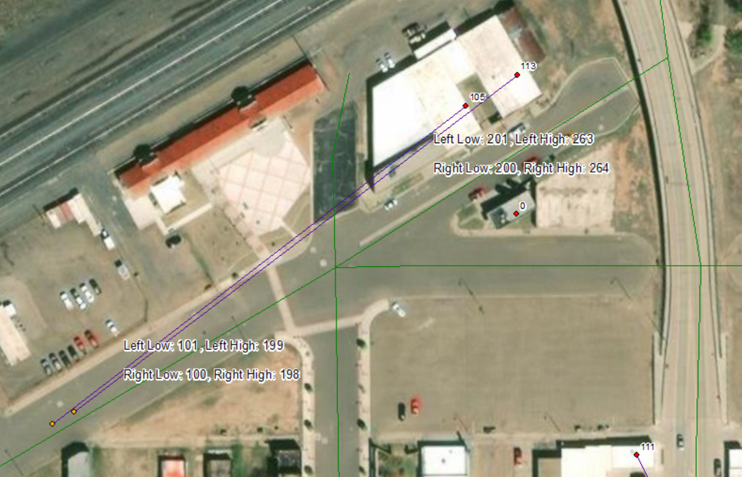
Fishbone Analysis
BAD
Notes:
Query data to identify data inaccuracies
Ex: Wrong side of the street or Block: show every fishbone that intersects a street centerline

Slide 22
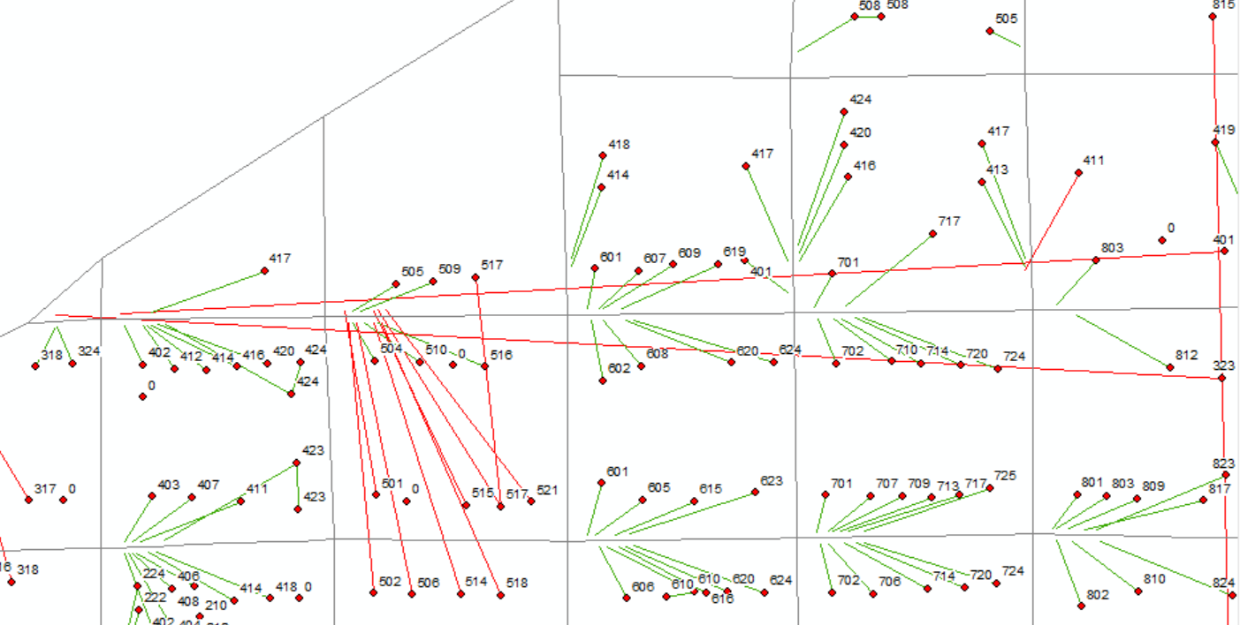
Fishbone Analysis
Notes:
Red: Incorrect data. Longer lines indicate more serious error. i.e. valid address points are miles from where they should be

Slide 23
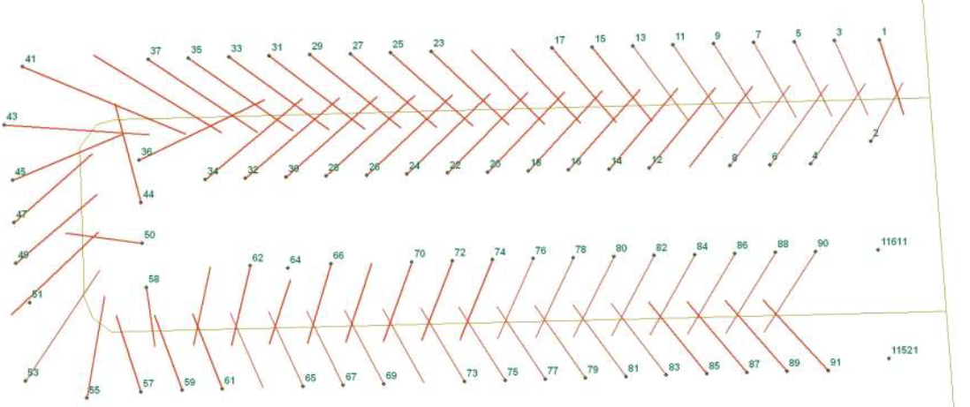
Fishbone Analysis
Fix: Address range of the road centerline needs to be flipped odd/even

Slide 24
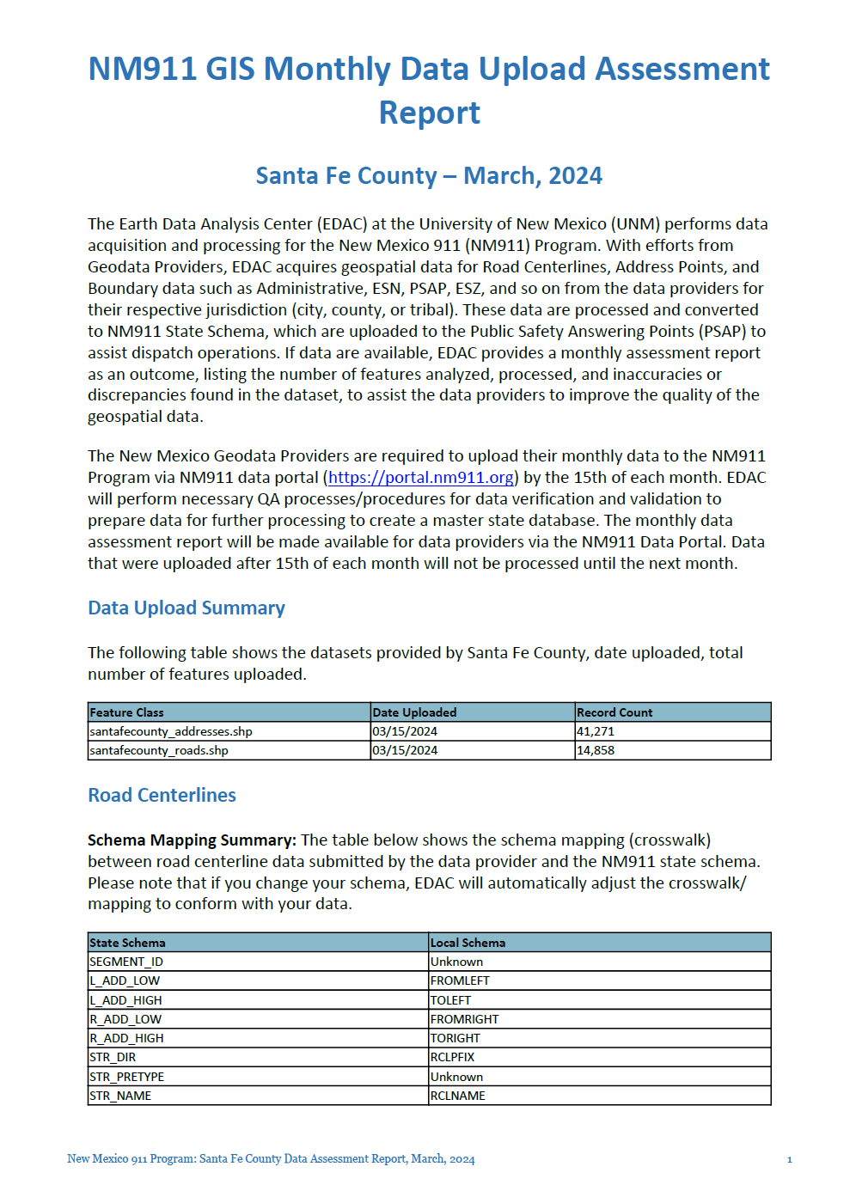
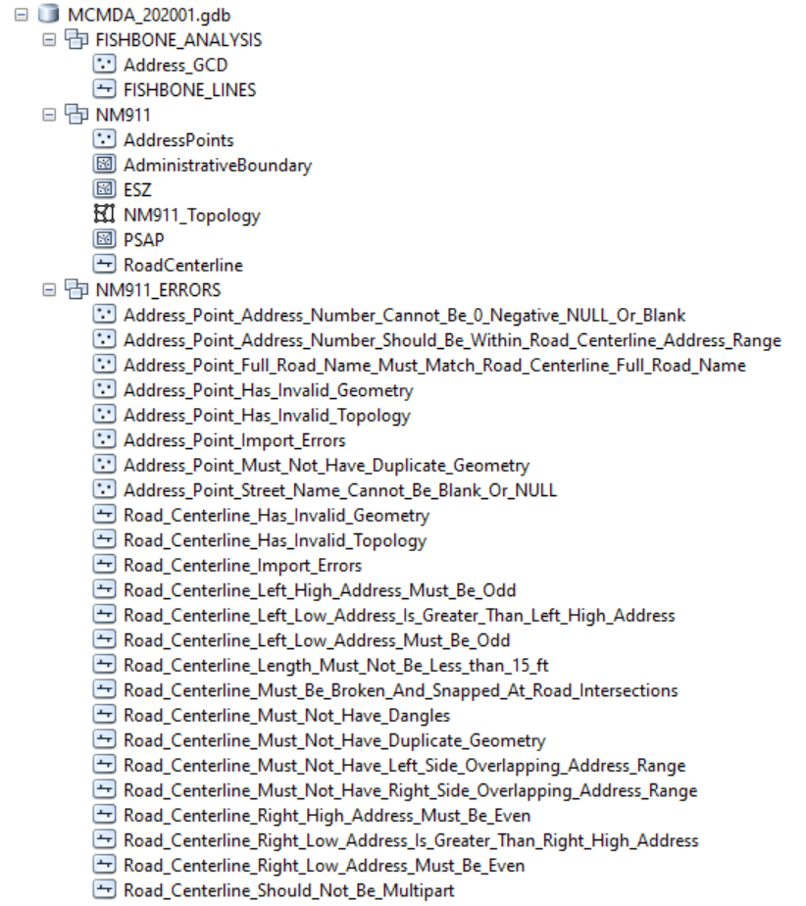
Data Reporting

Slide 25
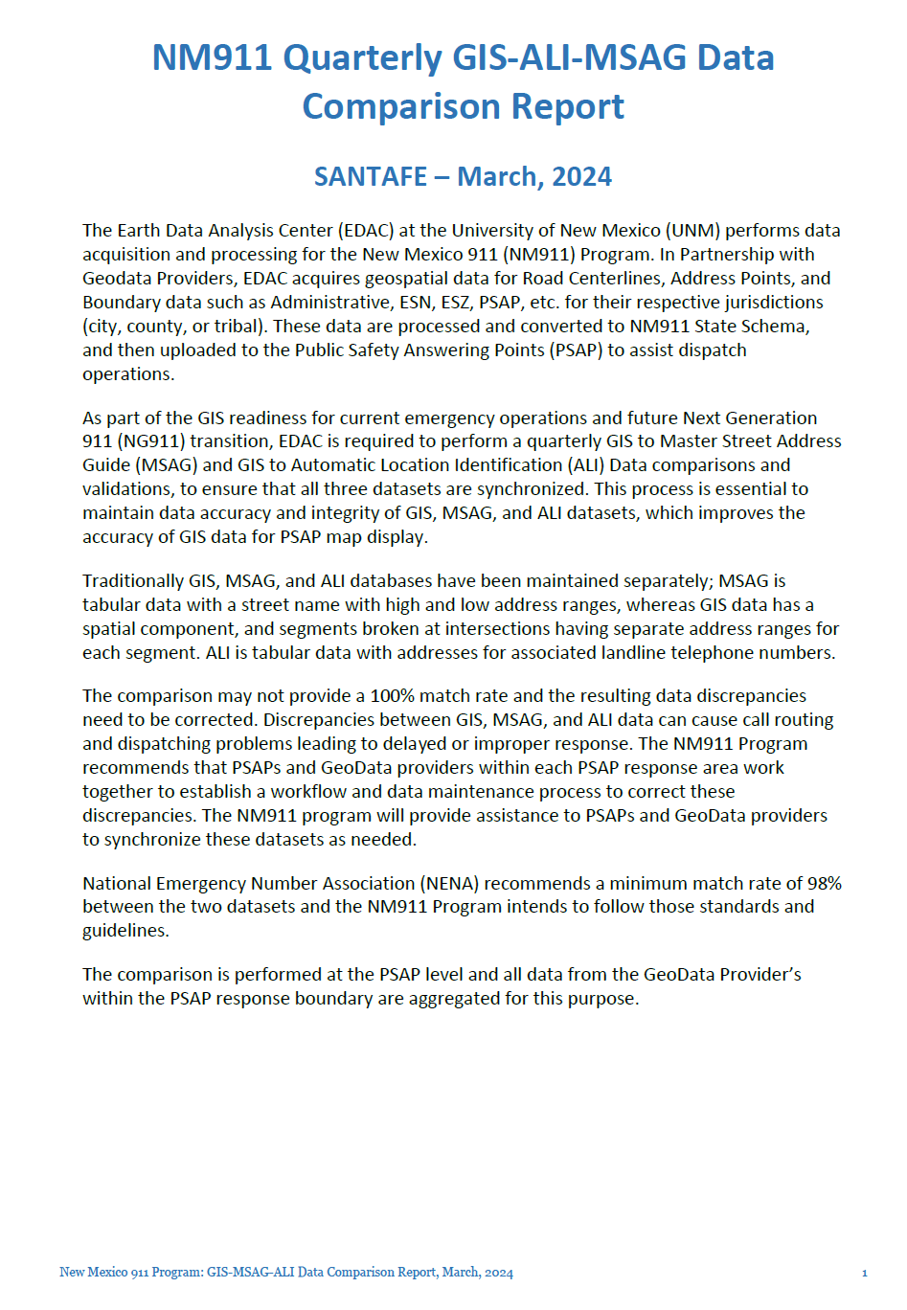
Data Reporting

Slide 26
Data Correction – Exceptions
What are acceptable exceptions?
Road Centerline Left Low & High Address Must Be Odd
Road Centerline Right Low & High Address Must Be Even
Road Centerline Left Low Address is Greater than Left High Address
Road Centerline Right Low Address is Greater than Right High Address
Can be marked as Exceptions based on ground conditions
Exception data column. Mark “Y” or “1” (based on the field data type: TEXT, INTEGER) if there is an exception and leave the column blank if no exception

Slide 27
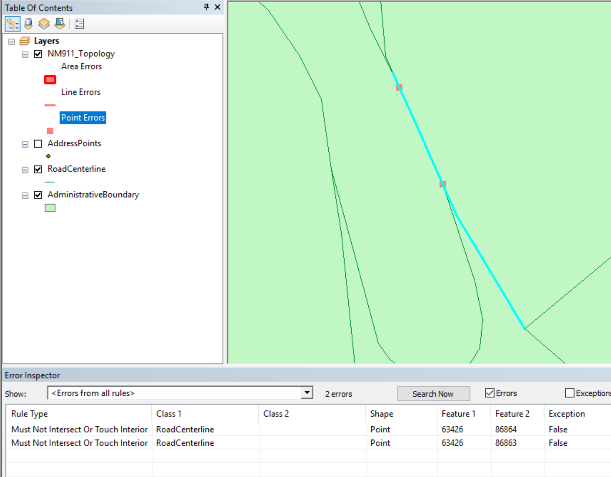
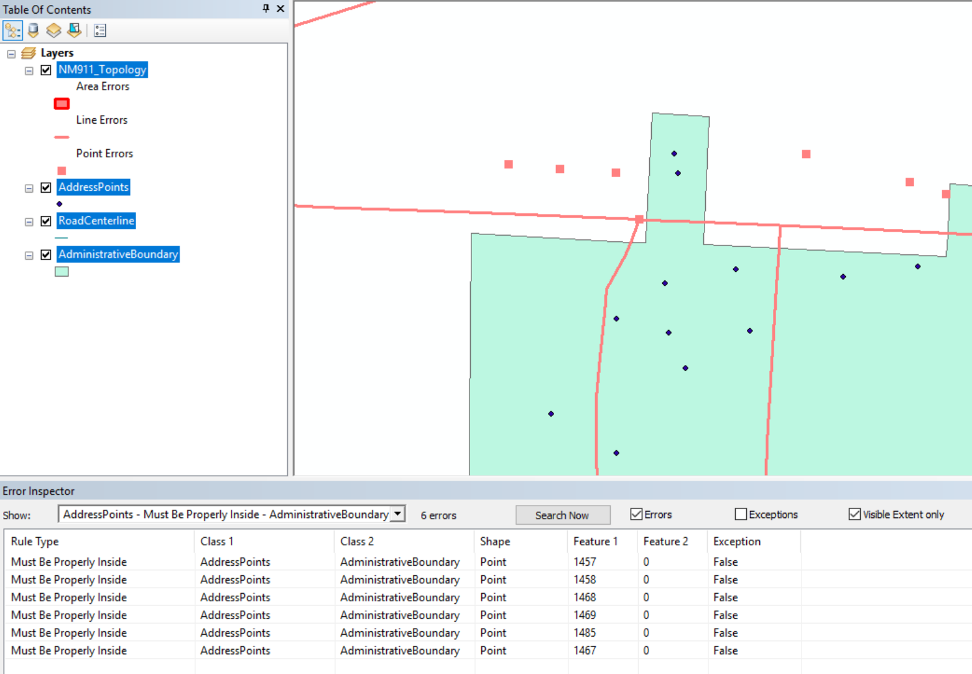
Data Correction – Topology
Roads Must Not Intersect or Touch Interior
Road Centerline Must Be Broken and Snapped at the Intersection with an exception for overpass/underpass.
Address Point Must Be Properly Inside the Administrative Boundary
Administrative Boundary can be replaced with Addressing Boundary of validation, if available.

Slide 28
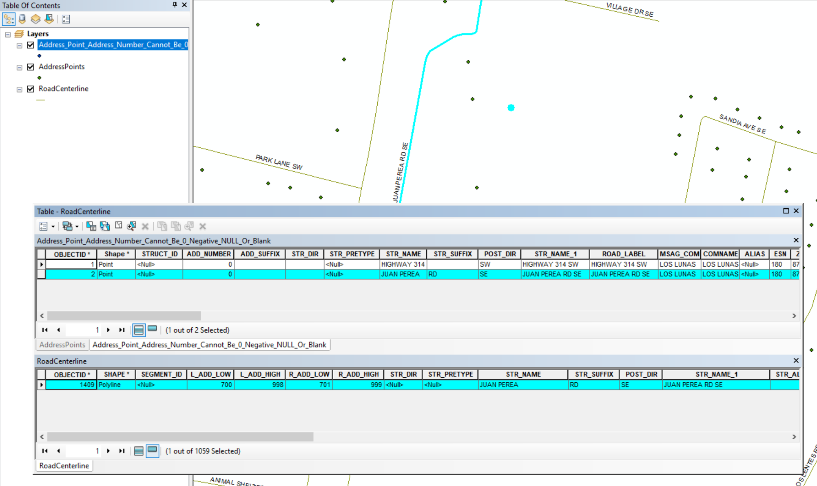
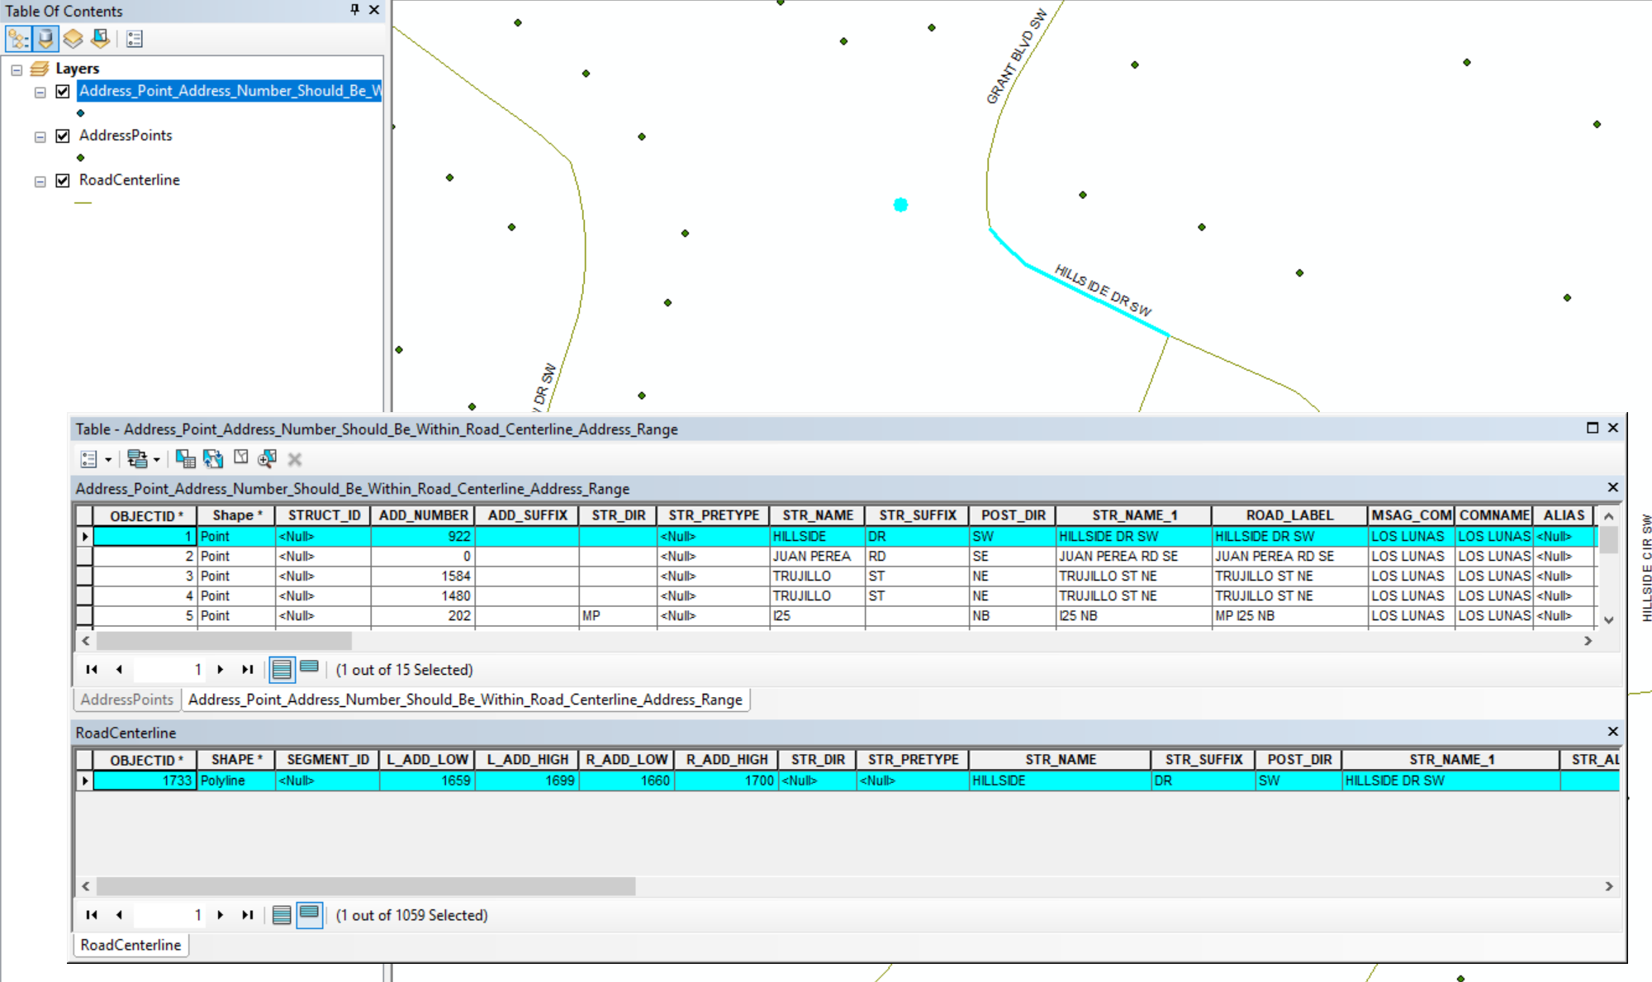
Data Correction – Address Points Examples
Address Point Address Number Cannot Be 0, Negative, Null or Blank
Ex: 0 JUAN PEREA RD SE
Address Point Address Number Should Be Within Road Centerline Address Range
Ex: 922 HILLSIDE DR SW

Slide 29
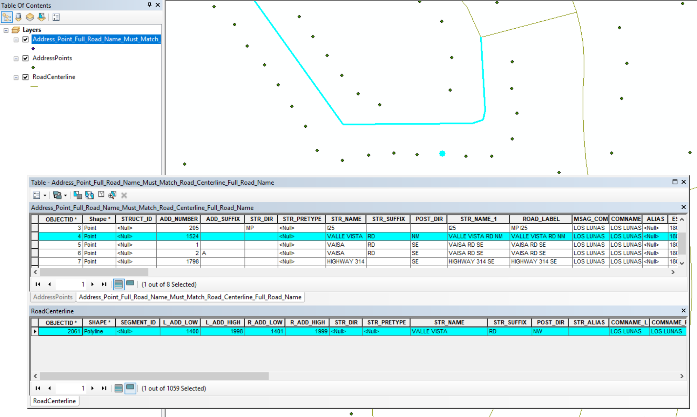
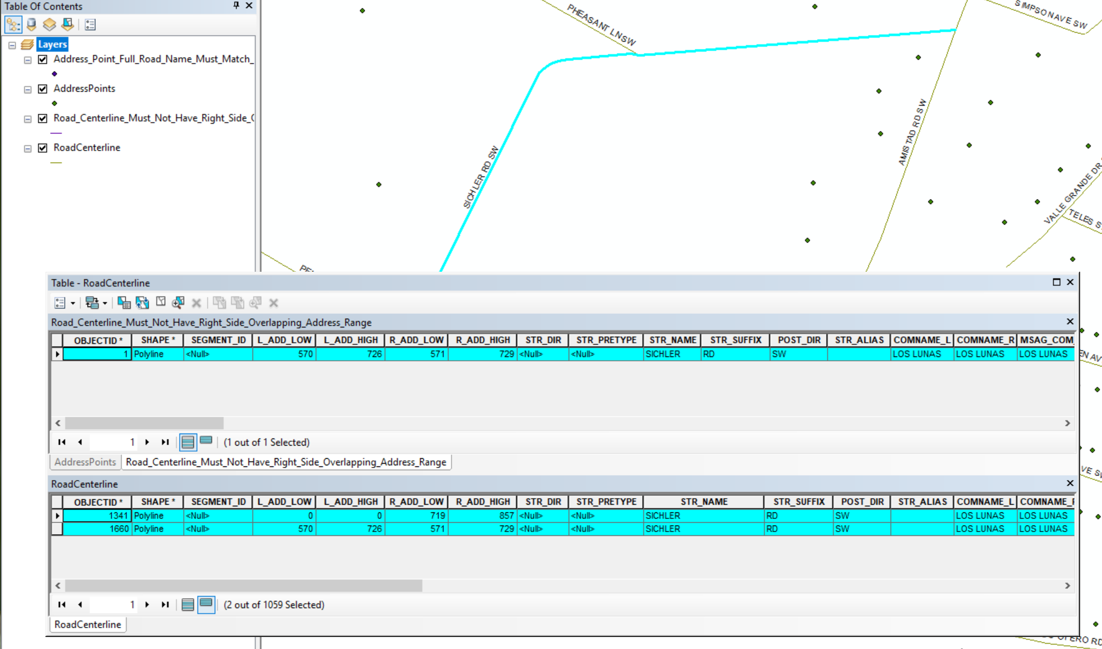
Data Correction – Road Centerline Examples
Address Point Full Road Name Must Match Road Centerline Full Road Name
Ex: VALLE VISTA RD NW
Road Centerline Must Not Have Right Side Overlapping Address Range
Ex: SICHLER RD SW

Slide 30
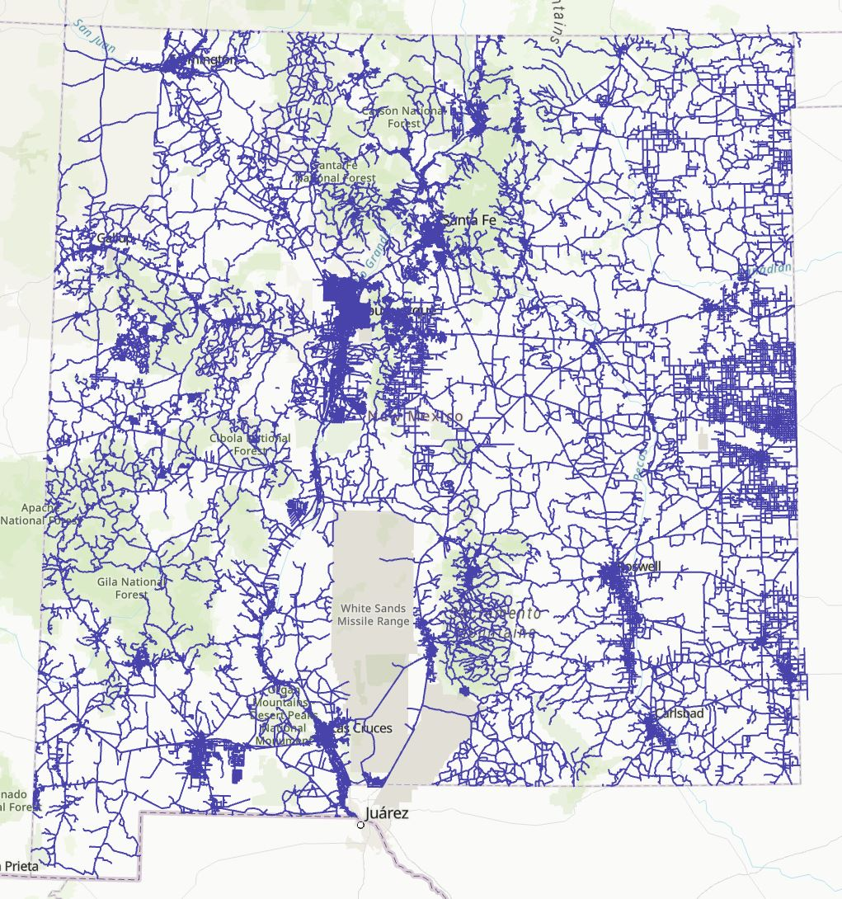
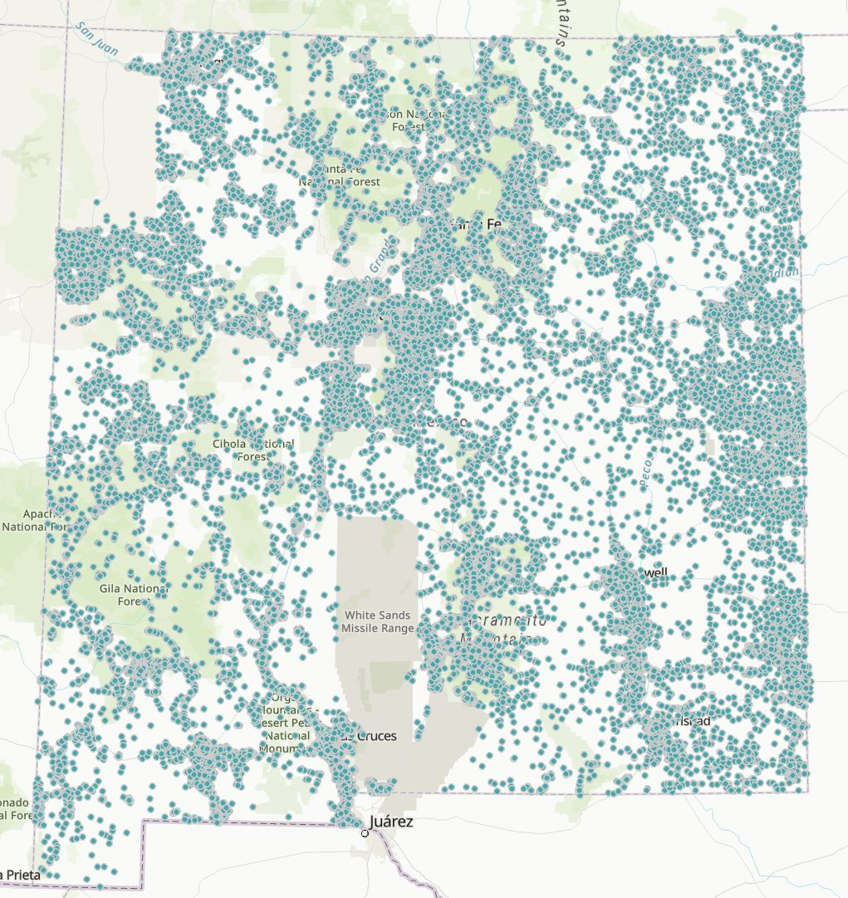
NM911 Master Database
Import data submitted by data providers after validation
Run geometry checks
Share data (road centerlines, address points)
DFA for PSAP Map Updates
Public on RGIS Geospatial Data Clearinghouse (shapefiles)
Road Centerlines,
Address Points - NM911 Master Database (Apr 2024)

Slide 31
GIS-MSAG-ALI Comparison
Quarterly Assessments
Essential for Next Generation 911 (NG 9-1-1) data transition
NENA recommends a 98% match rate between the datasets
Data Providers and PSAPs must prioritize to improve data accuracy
Data for Comparison
GIS – monthly data uploads from GIS Data Providers
MSAG – quarterly data downloads from Intrado
ALI – yearly data download from Lumen (formerly CenturyLink)

Slide 32
The 9-1-1 Database(s)
MSAG – Master Street Address Guide – Influence and control E9-1-1
ALI – Automated Location Information – Each landline telephone number in a PSAP’s response area is loaded from each serving phone company, scrubbed against the MSAG to obtain ESN and Community information, and loaded into the ALI database. When a 9-1-1 landline call is initiated, the ten digit phone number dips into this database to obtain the location info sent to the PSAP with the voice call
ELT – English Language Translation – a table which translates each ESN to the names of the public safety providers
GIS Data – Geospatial data used to be an “add-on” and is now considered critical to control all or most of the above

Slide 33
The 9-1-1 Database(s)
A snapshot of MSAG database, Guadalupe County, NM – May 2022
A snapshot of ALI database for Portales, NM - 2021

Slide 34
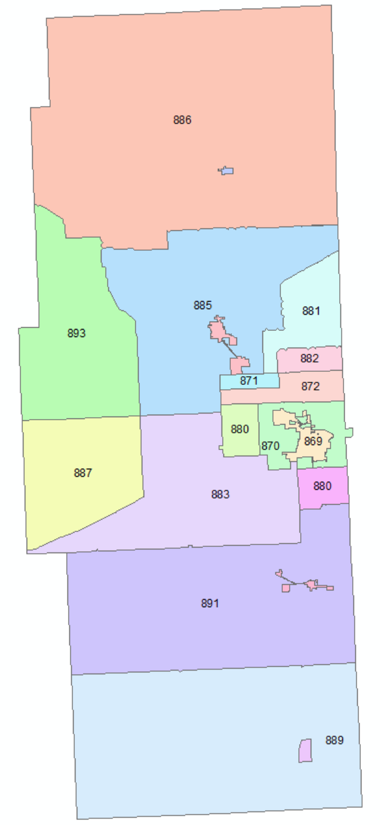
The 9-1-1 Database(s)
ESN | POLICE | FIRE | AMBULANCE
869 | HOBBS PD | HOBBS FD | HOBBS EMS
870 | LEA COUNTY SHERIFF | HOBBS FD | HOBBS EMS
870 | LEA COUNTY SHERIFF | HOBBS FD | HOBBS EMS
870 | LEA COUNTY SHERIFF | HOBBS FD | HOBBS EMS
870 | LEA COUNTY SHERIFF | HOBBS FD | HOBBS EMS
871 | LEA COUNTY SHERIFF | KNOWLES FD | LOVINGTON EMS
872 | LEA COUNTY SHERIFF | KNOWLES FD | HOBBS EMS
880 | LEA COUNTY SHERIFF | HOBBS FD | HOBBS EMS
880 | LEA COUNTY SHERIFF | HOBBS FD | HOBBS EMS
881 | LEA COUNTY SHERIFF | KNOWLES FD | LOVINGTON EMS
882 | LEA COUNTY SHERIFF | KNOWLES FD | HOBBS EMS
883 | LEA COUNTY SHERIFF | MONUMENT FD | HOBBS EMS
884 | LOVINGTON PD | LOVINGTON FD | LOVINGTON EMS
885 | LEA COUNTY SHERIFF | LOVINGTON FD | LOVINGTON EMS
886 | LEA COUNTY SHERIFF | TATUM FD | TATUM EMS
887 | LEA COUNTY SHERIFF | MALJAMAR FD | HOBBS EMS
888 | JAL PD | JAL FD | JAL EMS
889 | LEA COUNTY SHERIFF | JAL FD | JAL EMS
890 | EUNICE PD | EUNICE FD | EUNICE EMS
891 | LEA COUNTY SHERIFF | EUNICE FD | EUNICE EMS
892 | TATUM PD | TATUM FD | TATUM EMS
893 | LEA COUNTY SHERIFF | MALJAMAR FD | LOVINGTON EMS
ESNs for Lea County, NM
When a resident calls 9-1-1, the emergency providers dispatched are the same in a given ESN.
In 869, a resident is served by Hobbs Police Dept., Hobbs Fire Dept., and Hobbs EMS
A snapshot of ESNs for Lea County, NM (old screenshot)

Slide 35
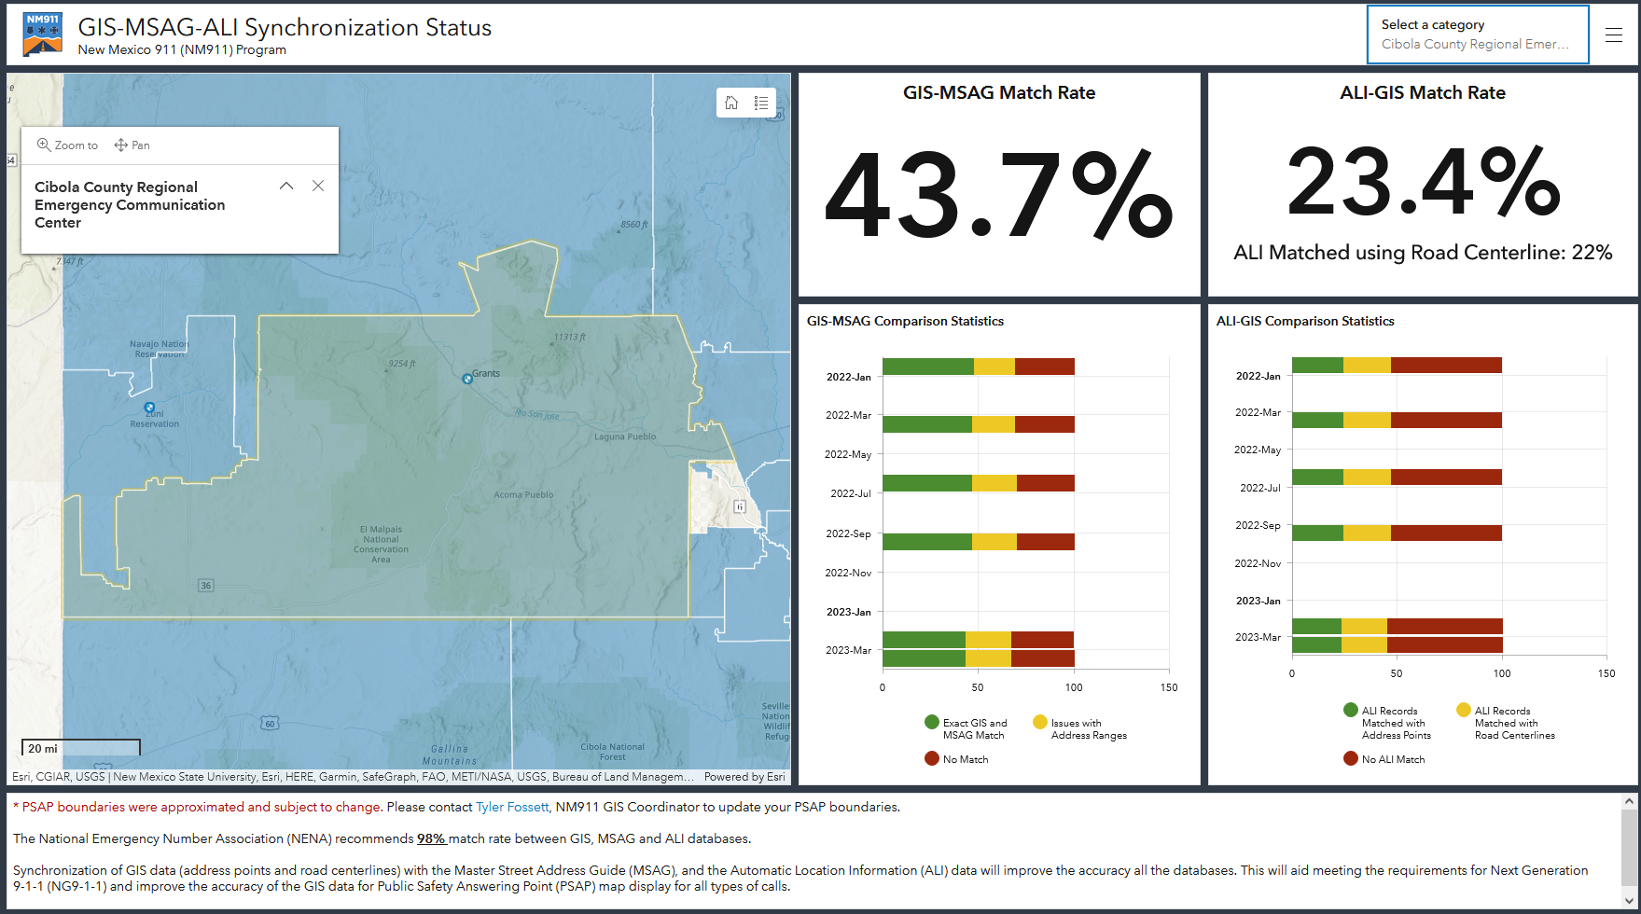
GIS-MSAG-ALI Comparison
https://www.arcgis.com/apps/dashboards/ba1e3e23a1f24a299fec935a2751c6e2

Slide 36
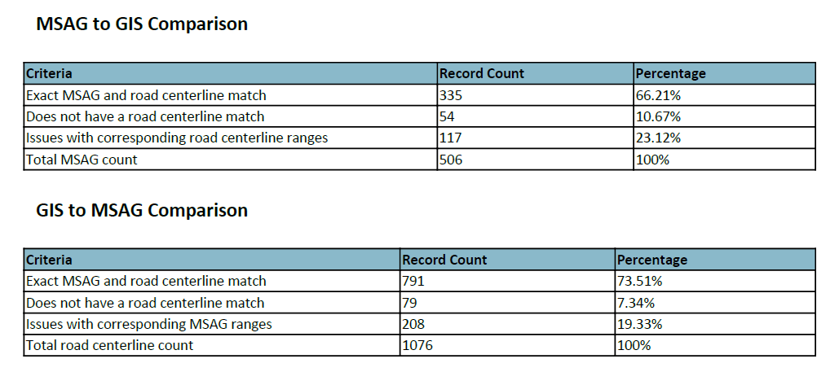
GIS-MSAG-ALI Comparison
MSAG and GIS Datasets used for Comparison
Snapshot of Quarterly GIS-MSAG-ALI Comparison Stats, De Baca County – March 2024
Notes:
MSAG Record count – Source Data: 509 and GIS: 506 – eliminated Wireless or VOIP calls rows

Slide 37
GIS-MSAG Comparison
Road Centerline data compared with MSAG records
Address columns, Community name, and ESN (Concatenated for left and right side of each segment to create unique identifier)
Results are generated in geodatabase and spreadsheet formats
Notes:
Address range comparisons were performed on entire road segments and are reported as such. For example, consider a road segment CENTRALAVE|ALBUQUERQUE|00111. In the MSAG, this segment has a low of 100 and a high of 249. In the road centerline file, there are two segments, one with a low of 100 and a high of 149, and another with a low of 200 and a high of 299. In this case, the MSAG segment will report that it does not have the range 250-299. In the road centerline, both segments will report that they are missing the range 150-199.

Slide 38
GIS-MSAG Comparison – Interpreting Results
REPORT | COMPARISON
Exact MSAG match | 13THMILERD|FORTSUMNER|00940
Does not have an MSAG match | ANTELOPERD|ROSWELL|00940
Does not have a road centerline match | LYNXRD|FORTSUMNER|00940
Not in NM911 road- Rng: 3466-3968 | BILLYTHEKIDDR|FORTSUMNER|00942
Not in NM911 road- Val: 3097 | CLAYFLATRD|FORTSUMNER|00940
Not in MSAG- Rng: 800-1299, Val: 1499 | EDUNNHL|FORTSUMNER|00943
Not in MSAG- Val: 1300 | EFOLEYAVE|FORTSUMNER|00943

Slide 39
GIS-MSAG Comparison – Interpreting Results
BILLYTHEKIDDR|FORTSUMNER|00942 – Not in NM911 road- Rng: 3466-3968
Derived from GIS data (road centerlines)
Derived from MSAG from 911NET
In GIS data, address range 3466-3968 is part of ESN 943.
In MSAG data, address range 3466 – 3969 is duplicated for ESN 942 & 943
Fix: Data Providers & PSAPs must coordinate to establish the authoritative dataset and update the non-authoritative dataset!

Slide 40
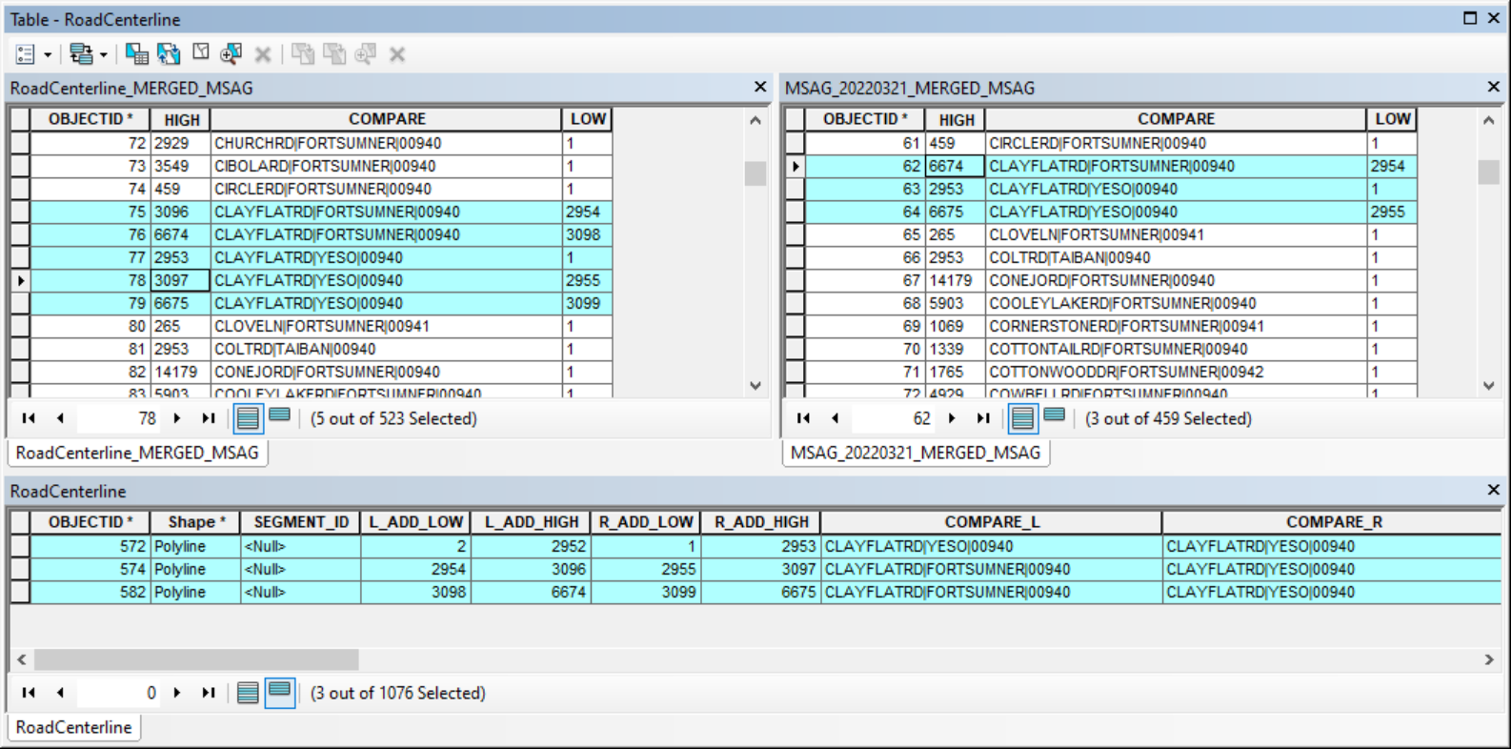
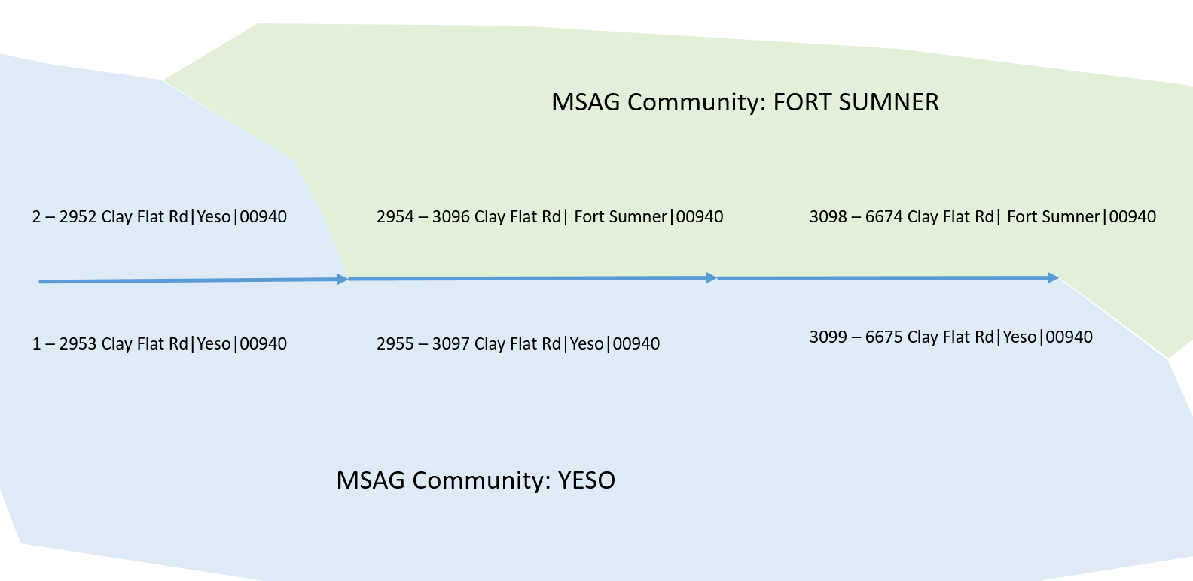
GIS-MSAG Comparison – Interpreting Results
CLAYFLATRD|FORTSUMNER|00940 – Not in NM911 road- Val: 3097
In GIS data, Value 3097 is part of YESO and not in FORT SUMNER. This is a valid error & No Correction Needed!

Slide 41
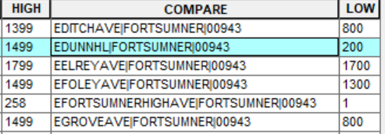
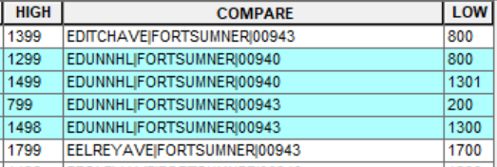
GIS-MSAG Comparison – Interpreting Results
EDUNNHL|FORTSUMNER|00943 – Not in MSAG- Rng: 800-1299, Val: 1499
EDUNNHL|FORTSUMNER|00940 - Does not have a road centerline match
Derived from GIS data (road centerlines)
Derived from MSAG from 911NET
Fix: Data Providers & PSAPs must coordinate to establish the authoritative dataset and update the non-authoritative dataset!

Slide 42
GIS-MSAG Comparison – Interpreting Results
EFOLEYAVE|FORTSUMNER|00943 – Not in MSAG- Val: 1300
EFOLEYAVE|FORTSUMNER|00940 – Does not have a road centerline match
Derived from GIS data (road centerlines)
Derived from MSAG from 911NET
Fix: Data Providers & PSAPs must coordinate to establish the authoritative dataset and update the non-authoritative dataset!

Slide 43
GIS-ALI Comparison
Tabular ALI data are compared with GIS address point data
If no exact matches found in the addresses then those records will be compared with Road Centerline data to see if the address fits within the address range of the corresponding segment
Address Number, Road Name columns (STR_DIR, STR_PRETYPE, STR_NAME, STR_SUFFIX, POST_DIR), MSAG Community, and ESN

Slide 44
GIS-ALI Comparison – Interpreting Results
Exact NM911 Address Point Match
Address Points Where Clause
ADD_NUMBER=1115 AND MSAG_COM='FORT SUMNER' AND (ADD_SUFFIX IS NULL or ADD_SUFFIX='') AND (STR_DIR IS NULL or STR_DIR='N') AND STR_NAME_1 = '10TH HL' and ( ESN = '943' OR ESN= '00943')
PHONE_NUMBER | ADD_NUMBER | ADD_SUFFIX | STR_DIR | STR_NAME_1 | COMMUNITY | ESN | DPID
5753552218 | 1115 |  | N | 10TH HL | FORT SUMNER | 00943 | DB_CO

Slide 45
GIS-ALI Comparison – Interpreting Results
No Match found in NM911 Address Points
Address Point Where Clause:
ADD_NUMBER=709 AND MSAG_COM='FORT SUMNER' AND (ADD_SUFFIX IS NULL or ADD_SUFFIX='') AND (STR_DIR IS NULL or STR_DIR='N') AND STR_NAME_1 = '2ND ST' and ( ESN = '943' OR ESN= '00943')
Road Centerline Where Clause:
COMPARE ='N2NDST|FORTSUMNER|00943' AND CAST(HIGH AS INTEGER) >= 709 AND CAST(LOW AS INTEGER) <=709
PHONE_NUMBER | ADD_NUMBER | ADD_SUFFIX | STR_DIR | STR_NAME_1 | COMMUNITY | ESN | DPID
5753557131 | 709 |  | N | 2ND ST | FORT SUMNER | 00943 | DB_CO

Slide 46
GIS-ALI Comparison – Interpreting Results
No Match found in NM911 Address Points or Road Centerlines
Address Point Where Clause:
ADD_NUMBER=339 AND MSAG_COM='FORT SUMNER' AND (ADD_SUFFIX IS NULL or ADD_SUFFIX='') AND (STR_DIR IS NULL or STR_DIR='S') AND STR_NAME_1 = '14TH ST' and ( ESN = '941' OR ESN= '00941')
Road Centerline Where Clause:
COMPARE ='S14THST|FORTSUMNER|00941' AND CAST(HIGH AS INTEGER) >= 339 AND CAST(LOW AS INTEGER) <=339
PHONE_NUMBER | ADD_NUMBER | ADD_SUFFIX | STR_DIR | STR_NAME_1 | COMMUNITY | ESN | DPID
5753556204 | 339 |  | S | 14TH ST | FORT SUMNER | 00941 | DB_CO

Slide 47
MSAG Updates: How?
Intrado Integrated User Portal (9-1-1 NET) Portal
You’re not changing the MSAG – you’re submitting a change which must be accepted by Intrado
Intrado then notifies you through the system if the change is accepted
Unaccepted edits may need additional review and verification
9-1-1net.intrado.com

Slide 48
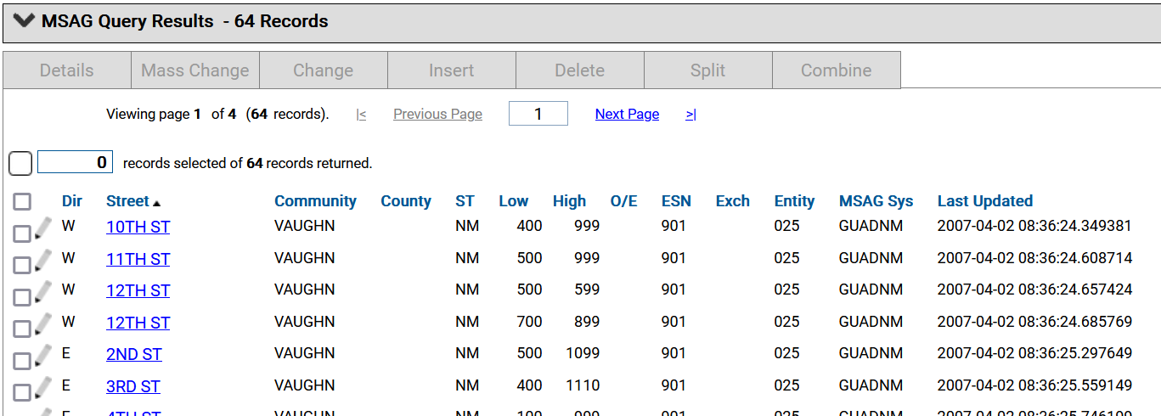
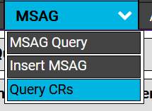
MSAG Updates: Tools/Functions
MSAG Tools
MSAG Query
MSAG Insert
Query CR
Notes:
Glenn – some info from your personal experience will be helpful.

Slide 49
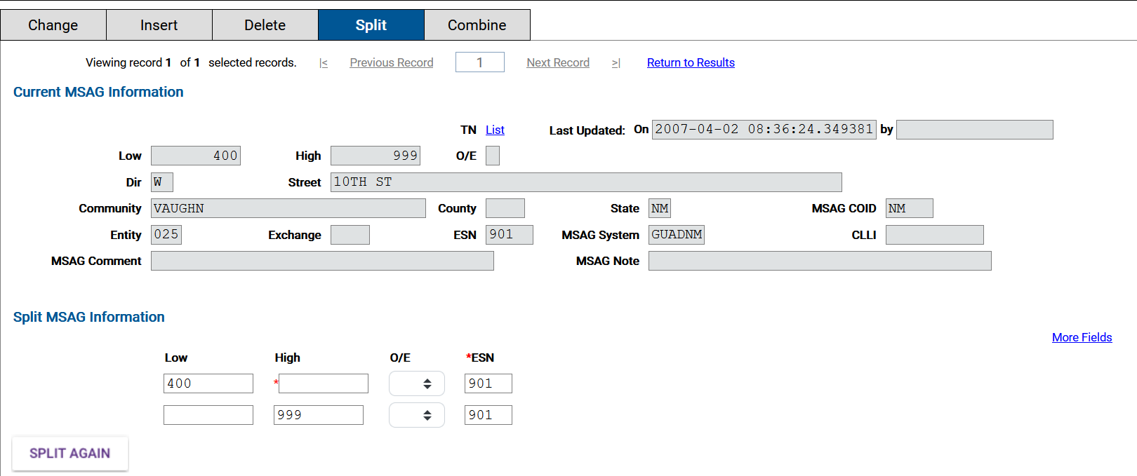
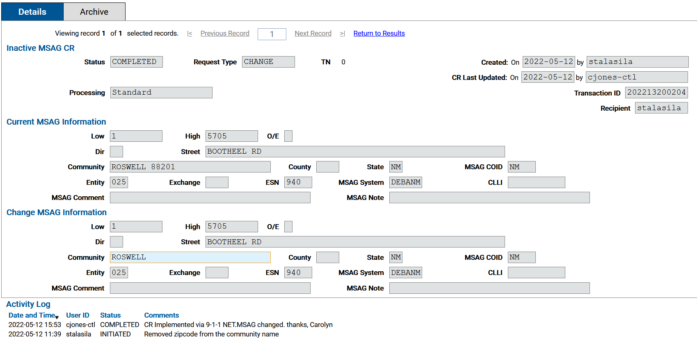
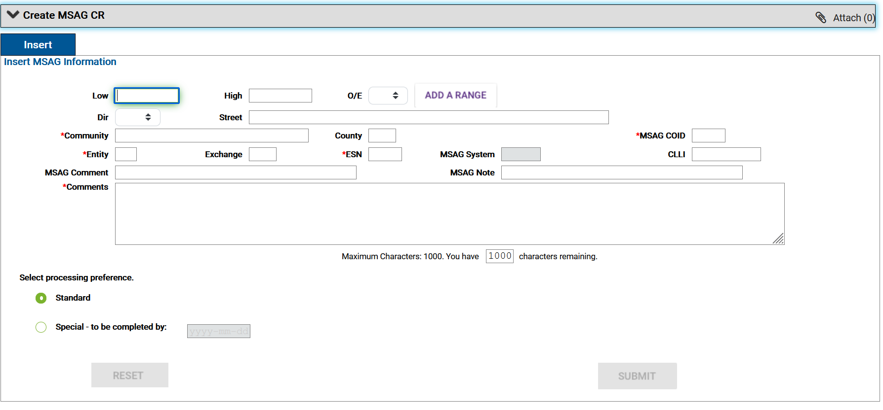
MSAG Split
Query Change Request
MSAG Insert

Slide 50
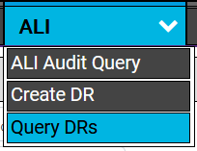
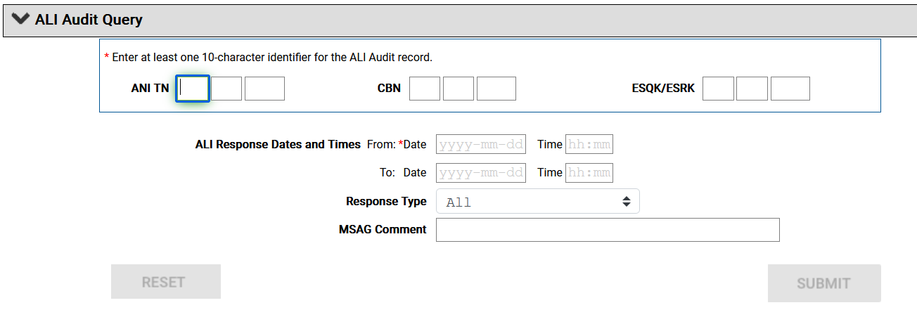
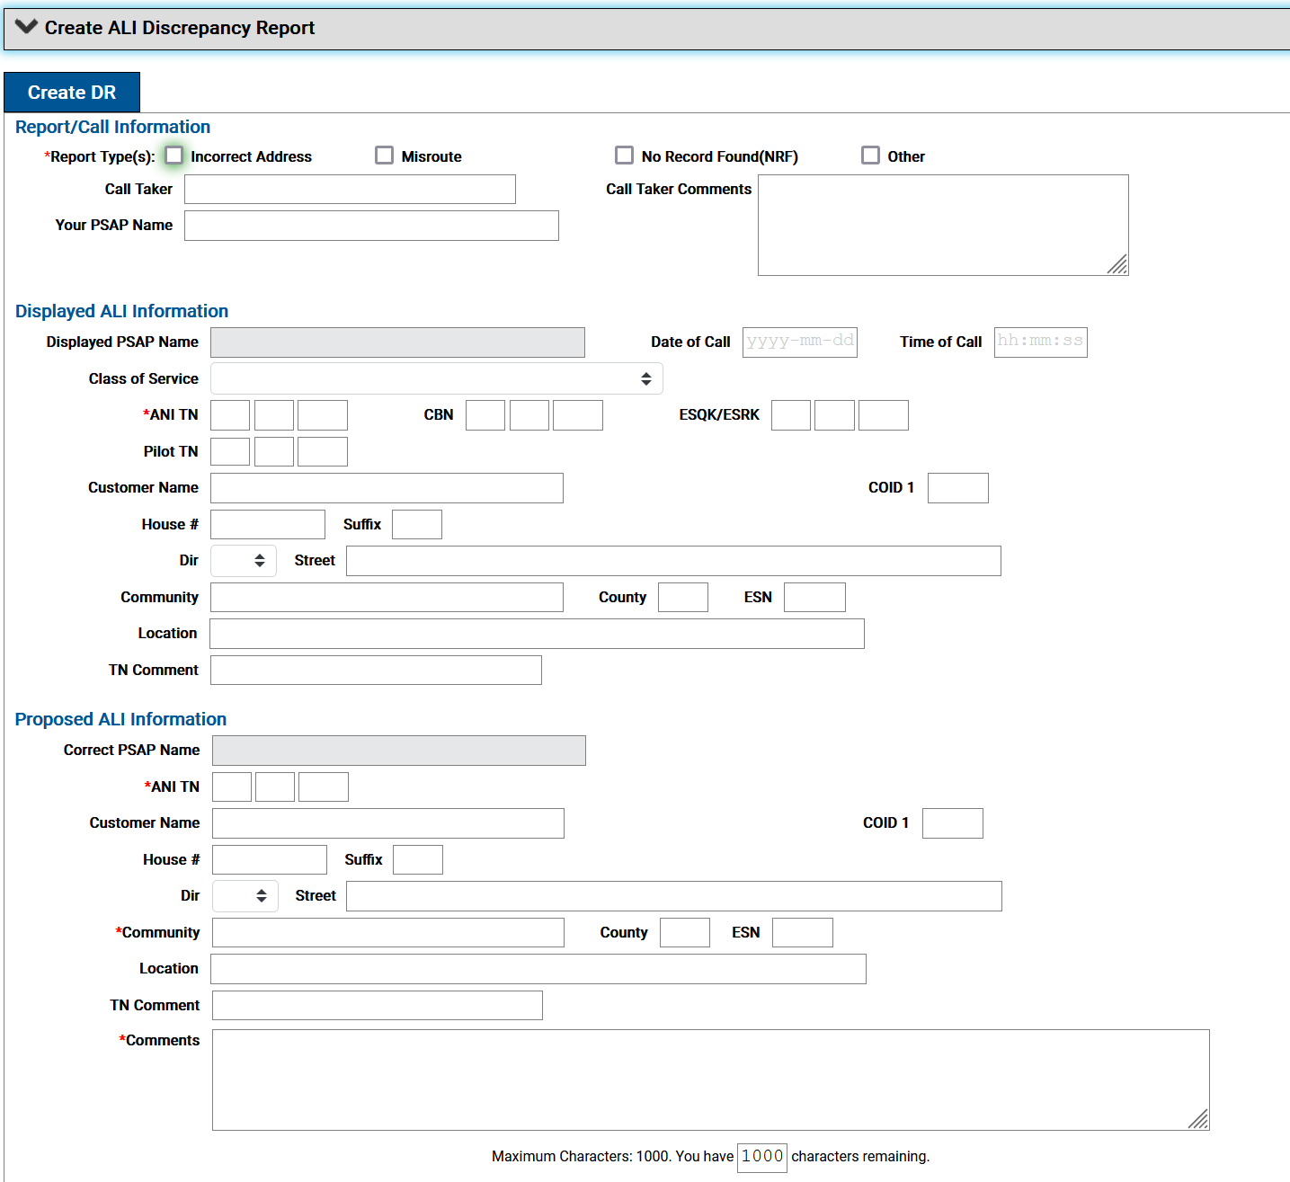
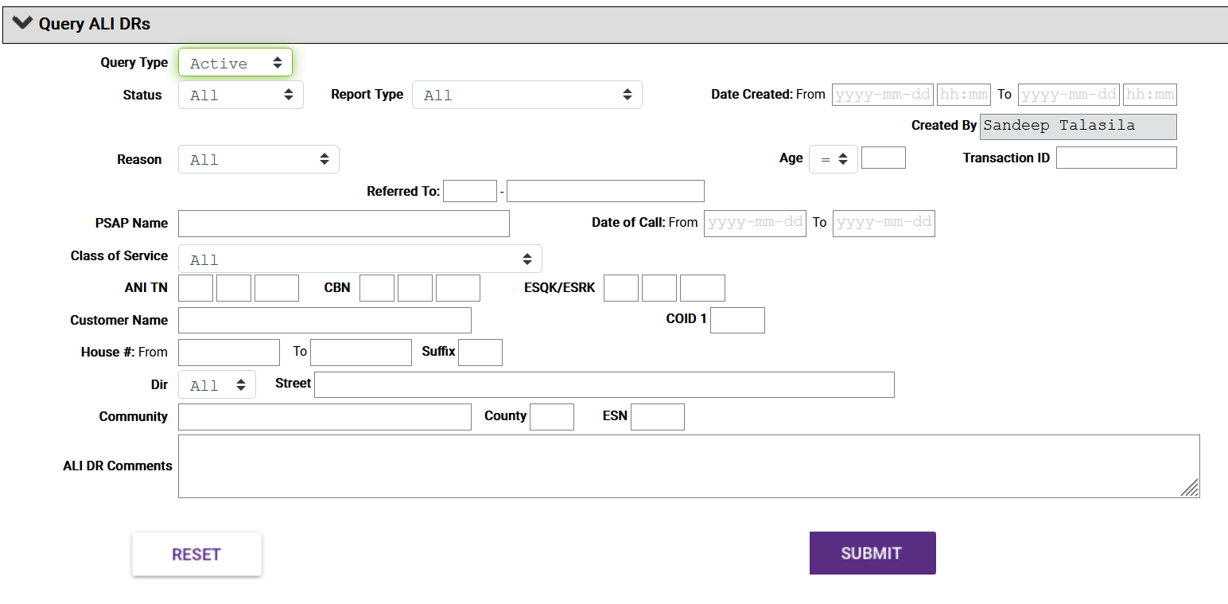

Slide 51
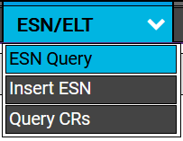
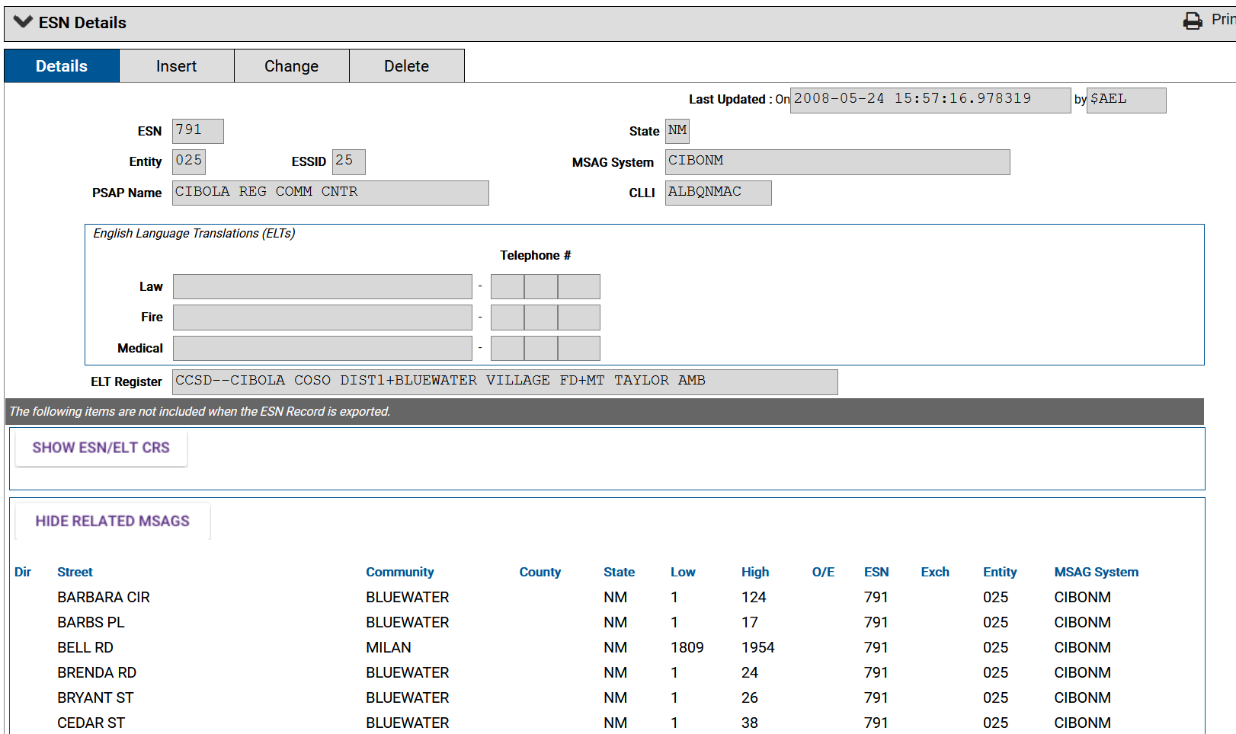

Slide 52
9-1-1 NET: Request Status(es)
Active Request Statuses
Inactive Request Statuses
Initiated
Pending
Referred
Requested
Suspended
Updated
Approved
Completed
Denied
Rejected
Notes:
A MSAG Request, ANI/ALI Discrepancy Report, TN Change Request, or ESN Change Request report will have one of the following statuses:
Referred – request as been referred to a Service Provider for update by the Intrado Data analyst.
Requested - request is submitted by the Intrado Data Analyst and is being investigated/processed by the County Coordinator. In this case, the County Coordinator has the authority to INITIATE or DENY the request made by the Intrado Data Analyst but does not have the authority to delete the request. If the County Coordinator initiates the request, the request follows Initiated status procedures.
Suspended - The investigation/processing of the request by the assigned Intrado Data Analyst is paused pending the retrieval of additional information from the user who submitted the request. If a request lists with this status, you should expect to find a related message from the Intrado Data Analyst. This message is in the Comments field of the request. This field is viewed by performing an Active Request Status function on the request. Requests that have this status cannot be deleted or archived, and they must be updated by the submitting County Coordinator before they can be processed further (refer to the 9-1-1 NET Users Guide for more information.)
Updated - This request has been updated by the submitting County Coordinator to contain additional information that was requested by an Intrado Data Analyst. Requests that have this status cannot be deleted or archived.

Slide 53
Local Exchange Carrier (LECs) & MSAG Updates
While Lumen (formerly CenturyLink) holds the 9-1-1 Database contract for the state, and contracts with Intrado, there are a dozen or more other phone companies in New Mexico
Each maintains customer service records with valid 9-1-1 addresses
Every time one of those records changes, the local phone company updates its records with Intrado through an SOI (Service Order Input)
These are done every day, and pass all adds/changes/deletes in their systems to Intrado for the 9-1-1 database
Making a change with Intrado does not make a change with the local phone company. And their data will overwrite what’s in the 9-1-1 database, so must be accurate too!

Slide 54
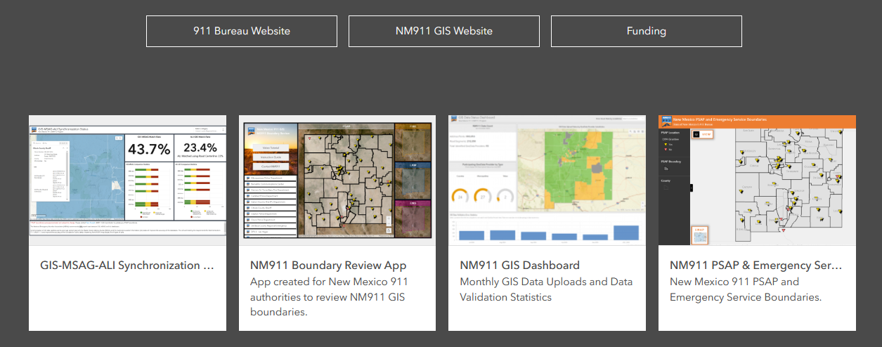
NM911 ArcGIS Hub
https://nm911-hub.maps.arcgis.com/

Slide 55
NMDPS CAD GIS Support
EDAC is under contract with Department of Public Safety (NMDPS) for GIS Support of their Computer Aided Dispatch (CAD) System
This contract is not related to the New Mexico 911 Program GIS Support
Routable Road Network Data – Available of Request
For questions regarding their data, workflow, or other inquires, please contact:
Brian Keller
GIS Manager, EDAC
Email: bkeller@edac.unm.edu
Phone: (505) 277-3622 x228

Slide 56
Contact Us
Technical Questions
Sandeep Talasila
Earth Data Analysis Center, UNM
Email: nm911@edac.unm.edu
Phone: (505) 277-3622 x250
NM911 Data Portal: Submit a support request
General Questions
Tyler Fossett
NM911 GIS Coordinator
NM Department of Finance & Administration
Email: Tyler.Fossett@dfa.nm.gov
Phone: (505) 500-5587

