Slide 1
EDAC Support to the Oil Conservation Division
Agenda
18 June 2019
10:00 - 10:05 Opening
10:05 - 10:10 EDAC Introduction
10:10 - 10:30 EDAC / RGIS Overview (Shirley / Su)
History
Contracts, Partners, Collaborators
Projects
10:30 – 11:00 OCD’s Data
11:00 – 12:00 Discussion / Q&A
12 PM - Adjourn

Slide 2
EDAC’s IT Core Competencies
High Performance Computing Services
Geospatial raster imagery (e.g., aerial photos and satellite imagery) processing
Spatial statistics, analysis, and modeling
Database Design, Management & Administration
Data Management
Data management plan development assistance
Data management training
Collaboration Tools
Research project reporting platform development
Research data cloud hosting and computing
Data, Backup, Servers, and Storage
Statewide geospatial data storage and backup
Geospatial data computations and simulations
Custom Applications/Software
Web applications development
18 June 2019

Slide 3
EDAC’s Geospatial Core Competencies
Geospatial Design, Development, Maintenance & Support
Design and develop to ensure compatibility and scalability for possible future spatial database and software
Development can include database development, data conversion, and software development and/or customization
Implementation, maintenance and support
Maintenance and support services ensure long-term success and help maintain or transition intellectual and physical ownership of the system to the client
Custom Geospatial Applications/Software
Geospatial Web applications development
Geospatial data visualization and analytics applications development
Training and Workshops
GIS training
Remote sensing training
Unmanned Aircraft Systems (UAS) training
18 June 2019

Slide 4
Center for Applied Geospatial Information Science &Technology
Applied Geospatial Research, Training, IT, Big Data and Programing Services
In 1964 the Technology Application Center was created to facilitate transfer of NASA technologies . . .
100% Self-Supporting since inception
Remote Sensing / Image Processing / NASA Satellite Image Archive
NM Historical Image Archive – from the mid-1930s
Geographic Information System (GIS)
Global Positioning System (GPS)
Light Detection and Ranging (LiDAR)
Drone Imagery and Mapping
18 June 2019

Slide 5
EDAC Contracts, Partners, Collaborators
NM Bureau of Geology & Mineral Resources, Department of Finance & Administration, Department of Game & Fish, Department of Homeland Security and Emergency Management, Department of Health, Department of Information Technology, Department of Public Safety, Department of Transportation, Economic Development Department, Energy, Minerals and Natural Resources Department, Office of the State Engineer/Interstate Stream Commission, Office of Superintendent of Insurance, New Mexico Public School Facilities Authority, Secretary of State of New Mexico, New Mexico Taxation and Revenue Department; NM Counties; Middle Rio Grande Council of Governments, Middle Rio Grande Conservancy District; Legislature; Congressional Delegates
Federal BLM, CDC, EPA, FEMA, NARA, NASA, NSF, NARA, USFS, USGS, USACE
National CMC; ESIP Federation; LANL, National Geographic Society, National States Geographic Information Council, Open Geospatial Consortium, SNL
International Charter on Space and Major Disasters, International Court of Justice
18 June 2019

Slide 6
EDAC Contracts, Partners, Collaborators
Private/Public Bohannan Huston Inc., Smith Engineering, Hexagon Geospatial
Tribal Mescalero Apache, Navajo Nation, Southwestern Indian Polytechnic Institute
UNM Natural Heritage Program; Office of Government & Community Relations;
Economics, Bureau of Business and Economic Research, College of Arts &
Sciences, School of Engineering, School of Medicine, Health Sciences Center, University Libraries, UNM Foundation, Established Program to Stimulate Competitive Research (EPSCoR)
New Mexico Institute of Mining and Technology, New Mexico Highlands University, New Mexico State University
18 June 2019

Slide 7
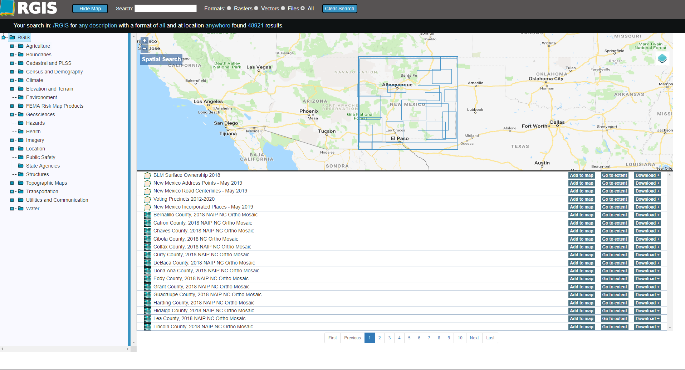
New Mexico Resource Geographic Information System (RGIS)
http://rgis.unm.edu
18 June 2019

Slide 8
New Mexico Resource Geographic Information System (RGIS)
Statutory Designation in 2013 as The State Digital Geospatial Data Clearinghouse
Partnerships and Leveraged Acquisition, Sharing & Collaborations
http://rgis.unm.edu
Statewide Geospatial Data available for download:
LiDAR
Political and administrative boundaries
Place names, locations & census data
30 years of digital orthophotography
85 years of historic aerial photography
Satellite imagery
Elevation & transportation
Wildfire & flood boundaries
Natural resource data
New Mexico’s Core Geospatial Elements GAC, RGIS and NMGIC
18 June 2019

Slide 9
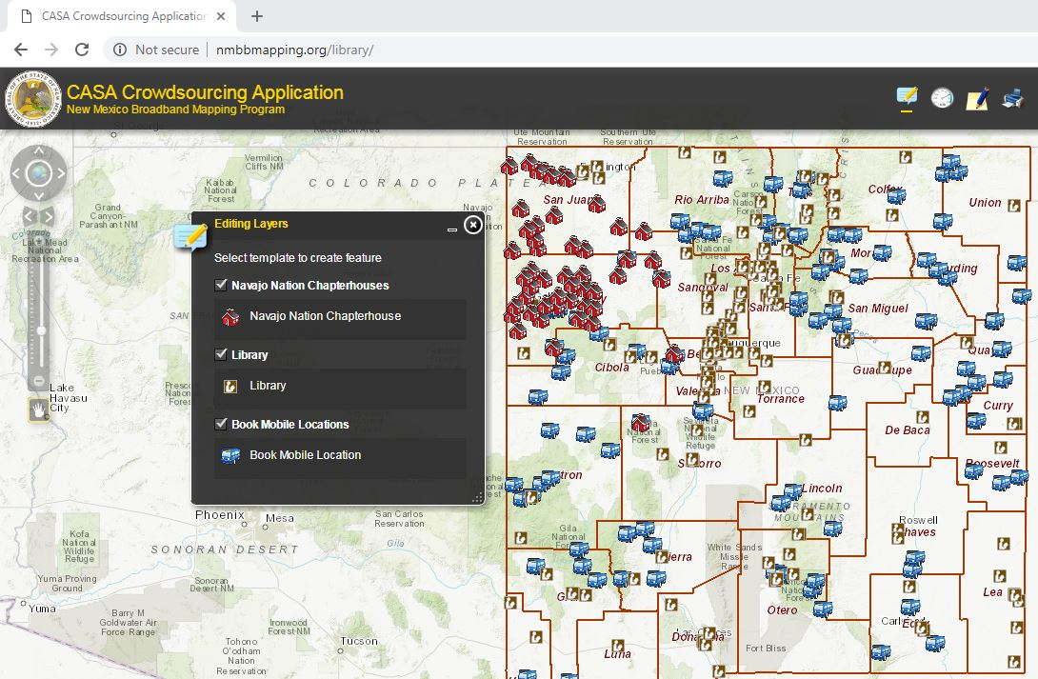
CASA Crowdsourcing Application Prototype
https://nmbbmapping.org/mapping/
18 June 2019

Slide 10
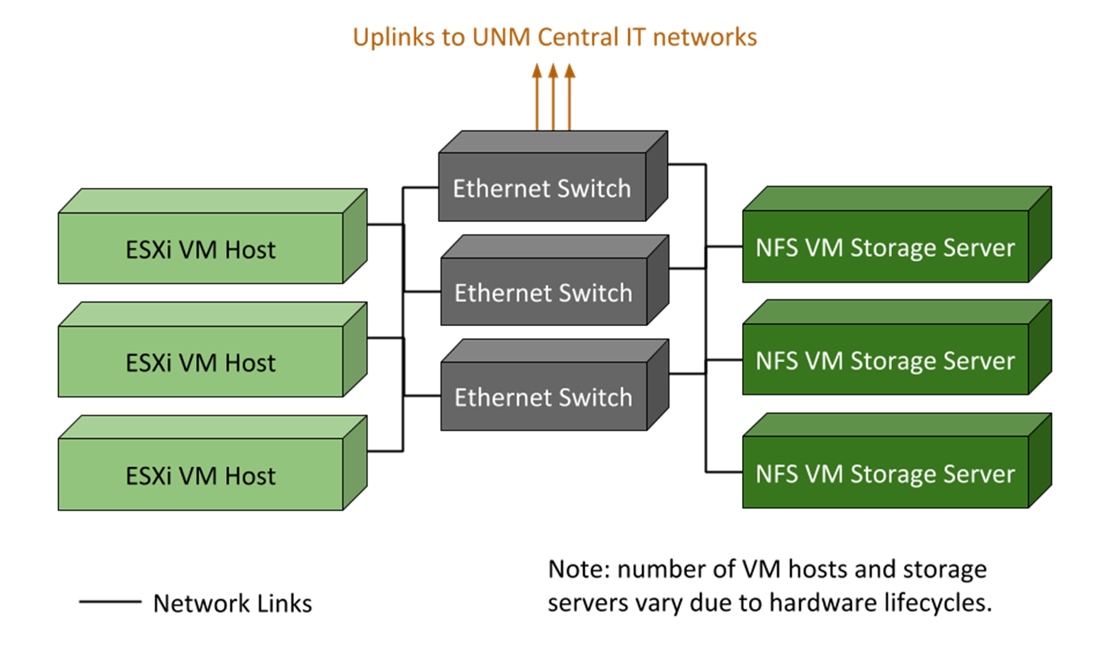
EDAC Virtualization Hardware Architecture
June 2019
18 June 2019

Slide 11
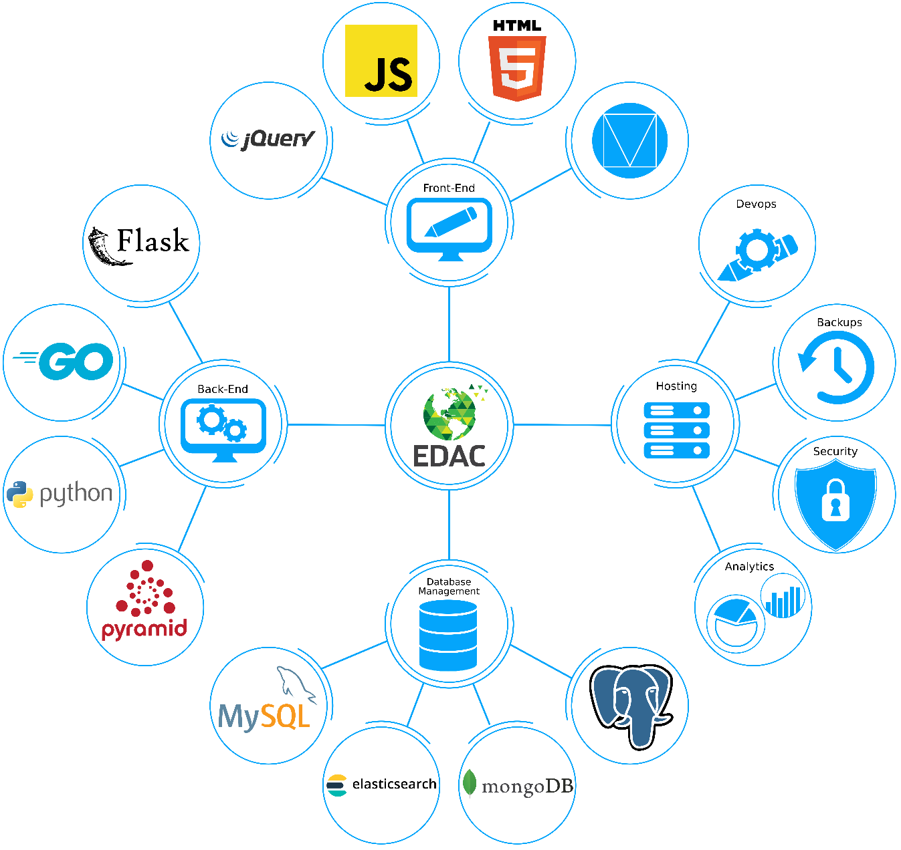
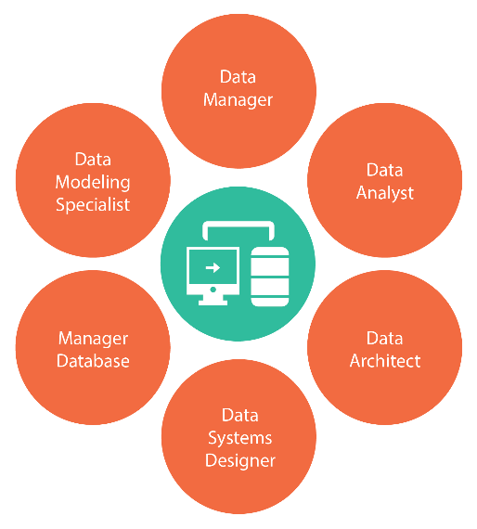
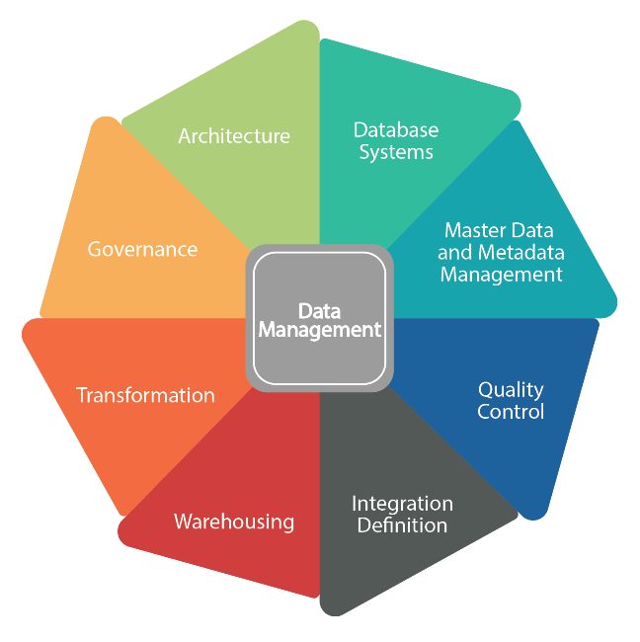
Data Management / Database Design and Development
18 June 2019

Slide 12
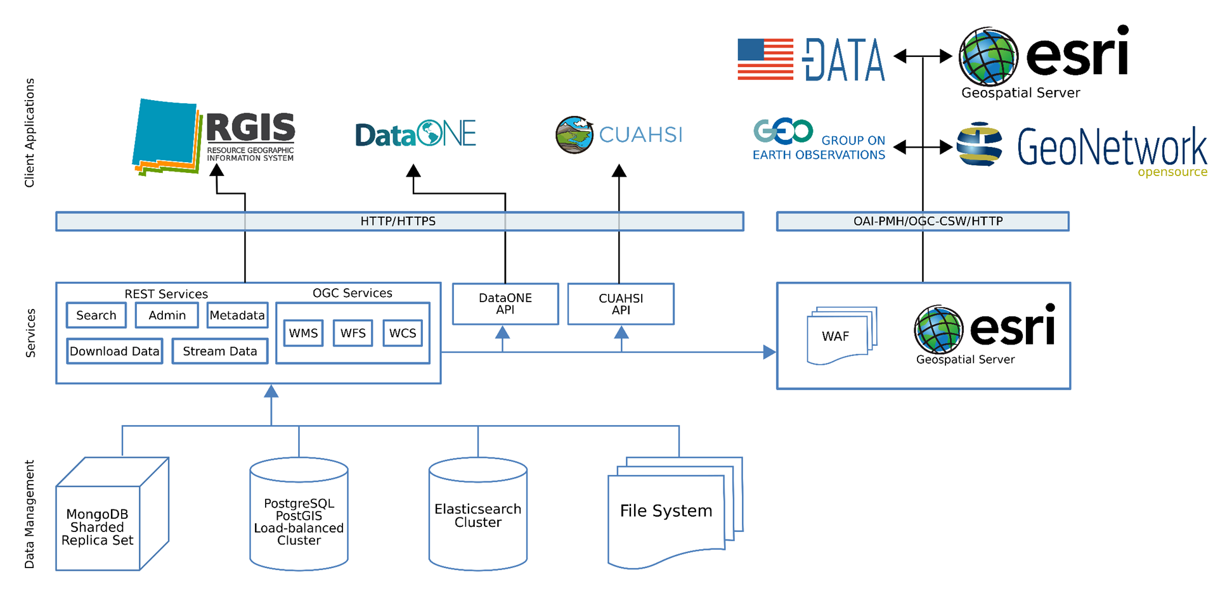
18 June 2019

Slide 13
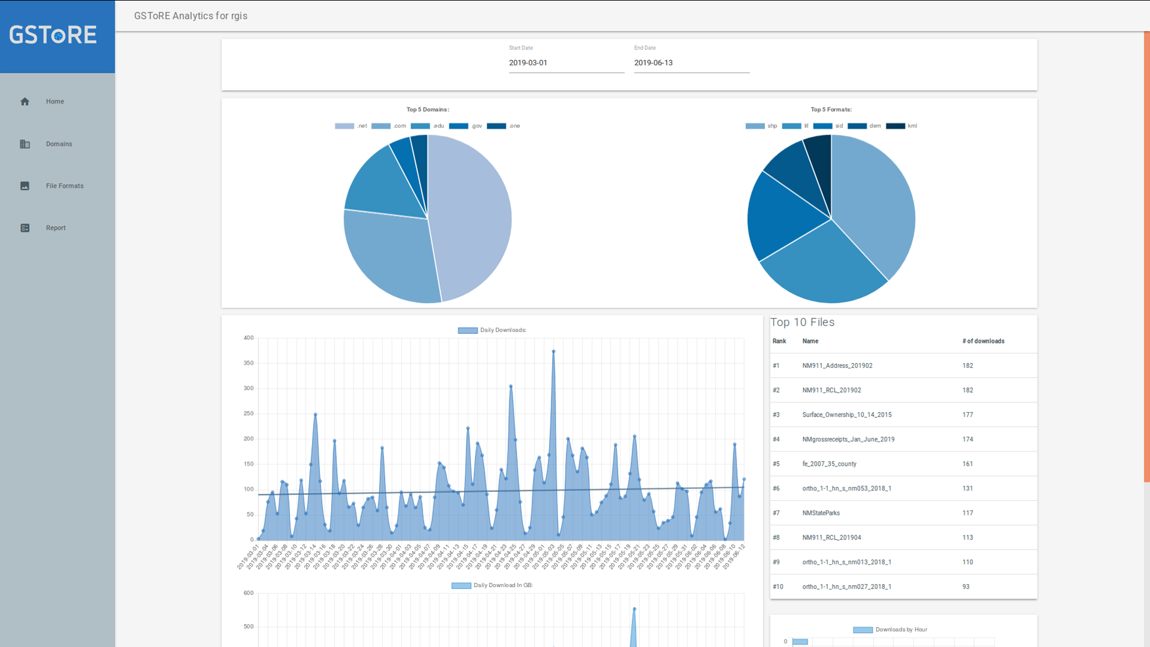
GSToRE Analysis for the RGIS Portal
18 June 2019

Slide 14
Innovations at the Nexus of Food, Energy and Water Systems
NM INFEWS - https://nminfews.org/node/4
18 June 2019

Slide 15
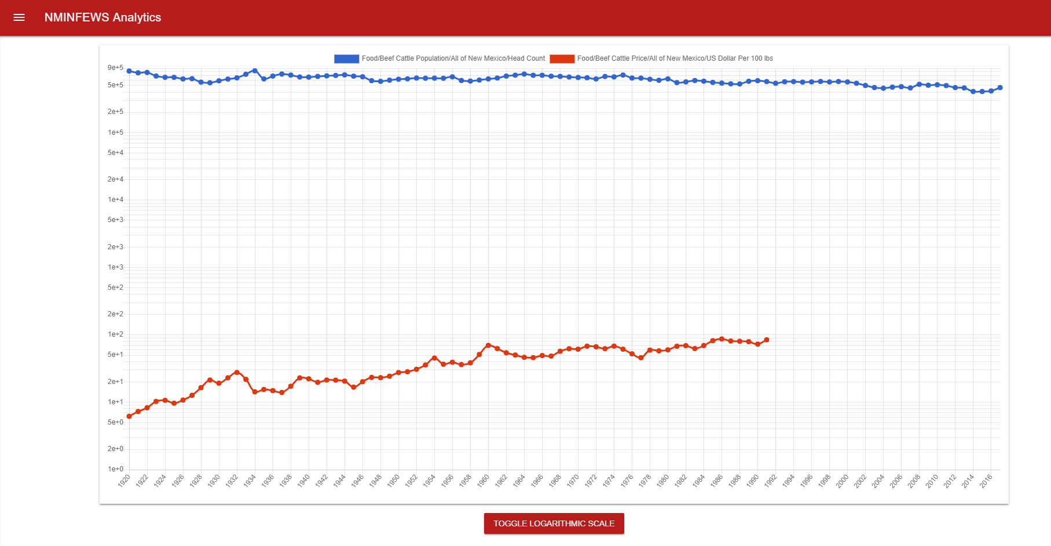
NM INFEWS Analytics
18 June 2019

Slide 16
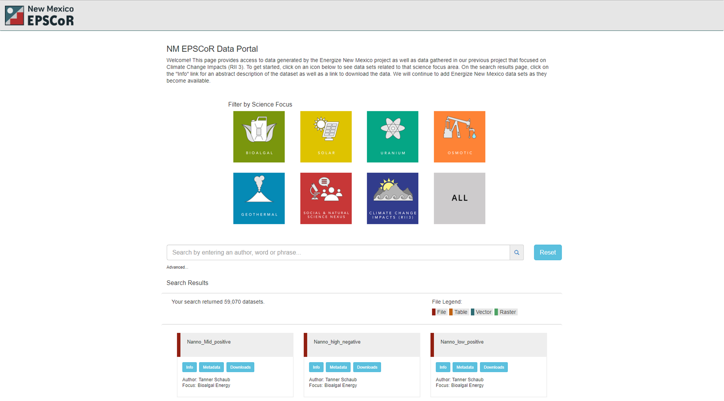
Established Program to Stimulate Competitive Research
NM EPSCoR
18 June 2019

Slide 17
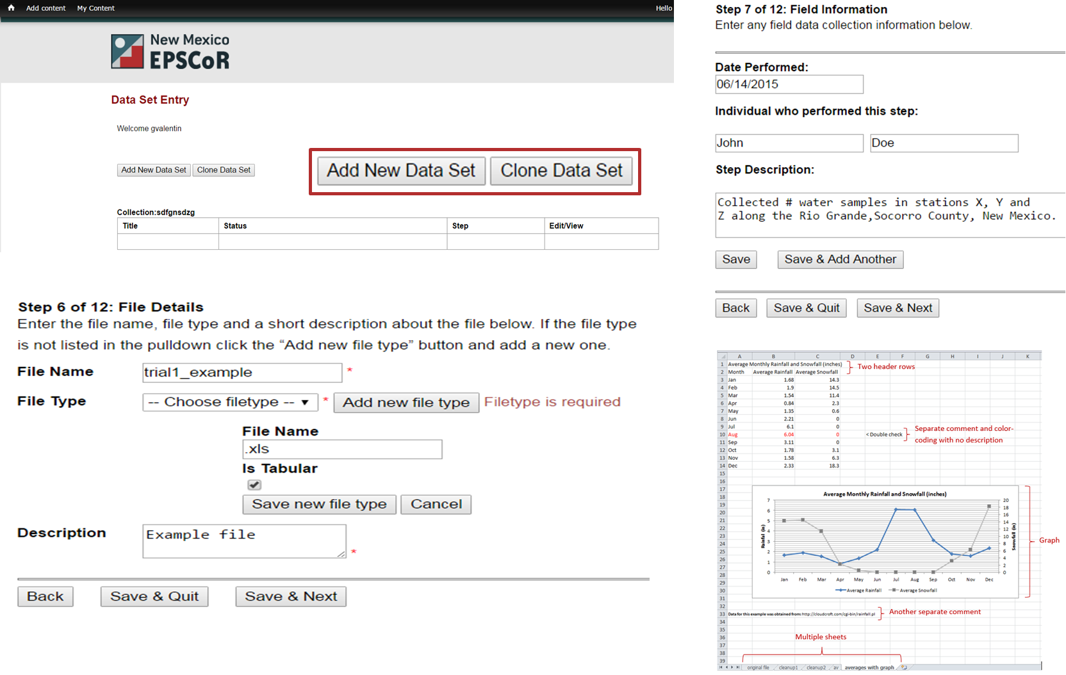
Established Program to Stimulate Competitive Research
NM EPSCoR
18 June 2019

Slide 18
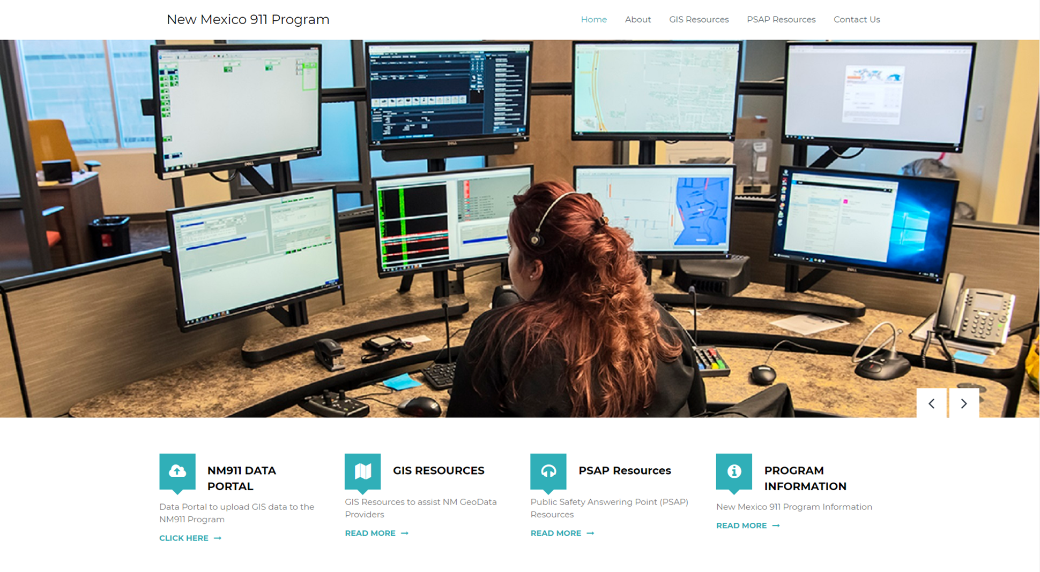
NM 911 Program
18 June 2019

Slide 19
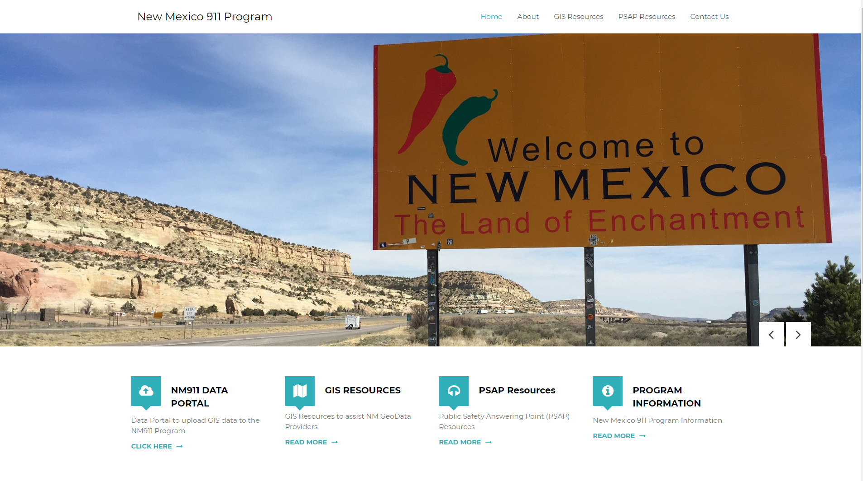
New Mexico 911 Program
18 June 2019

Slide 20
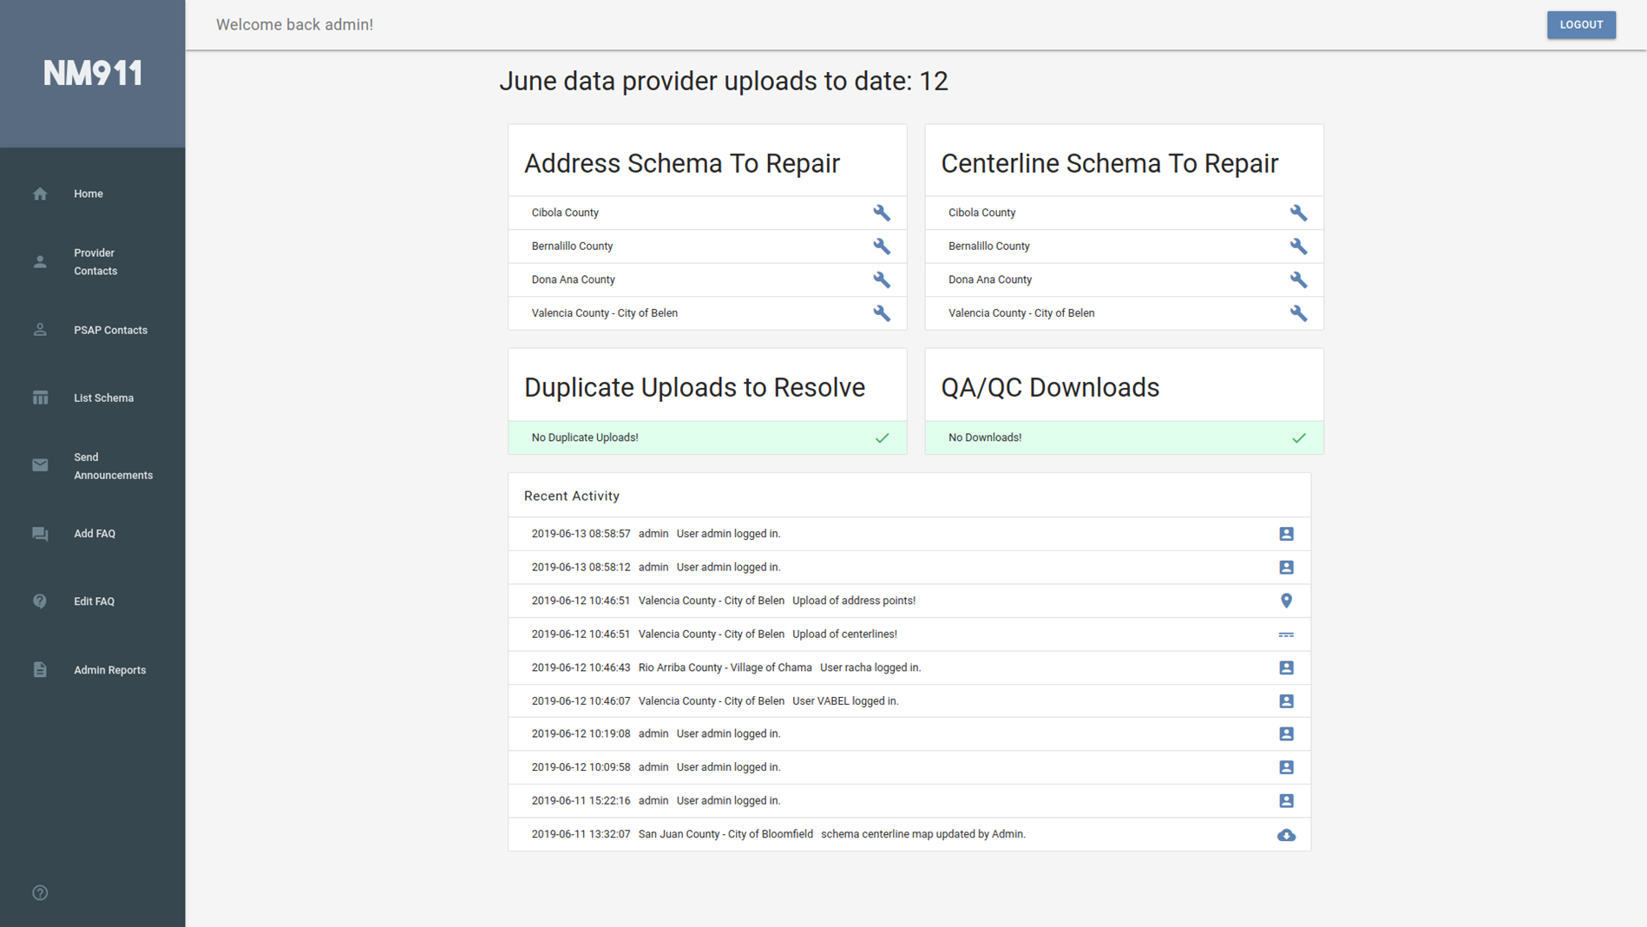
NM 911 Program
18 June 2019

Slide 21
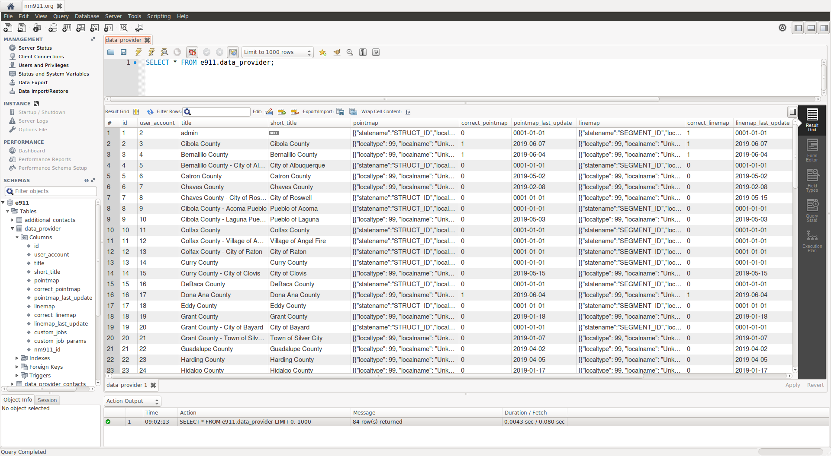
NM 911 Program
18 June 2019

Slide 22
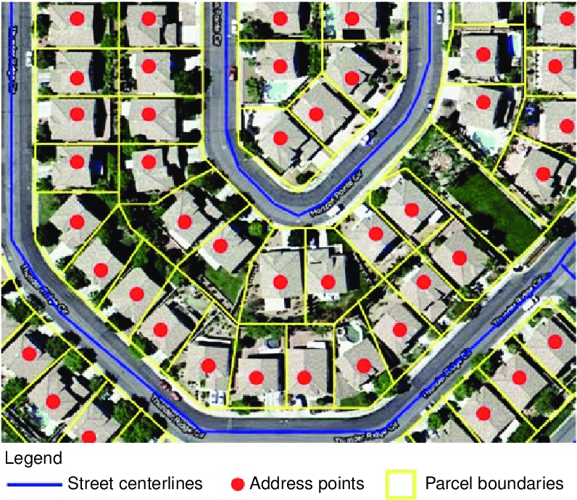
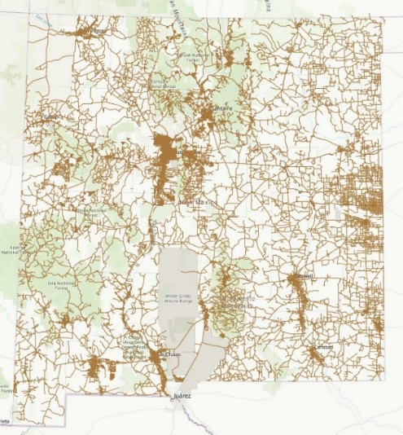
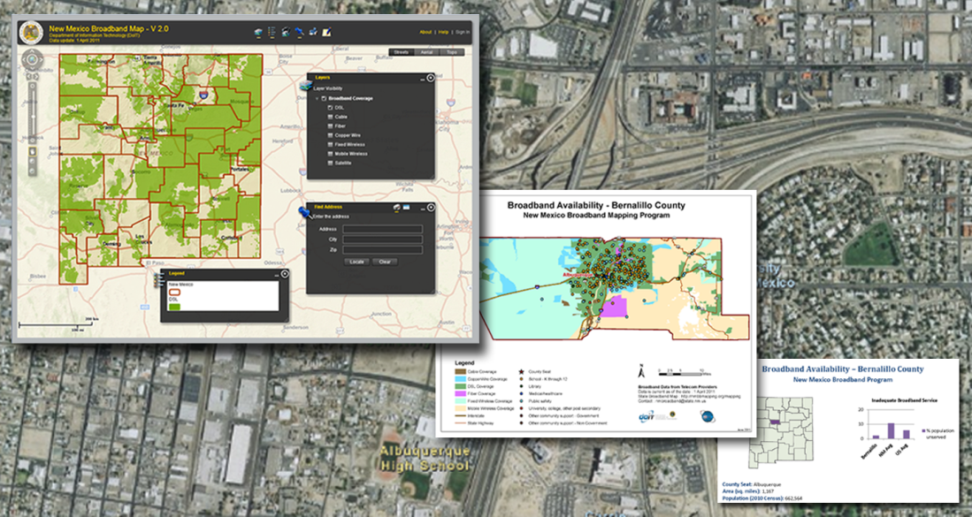
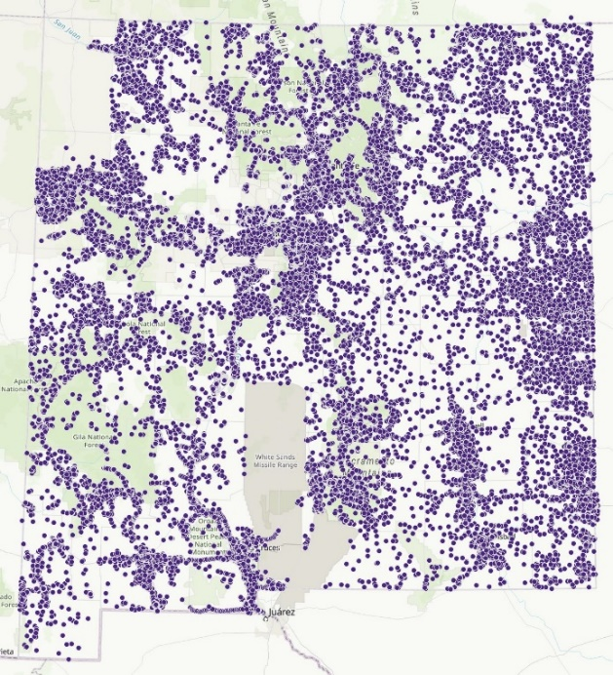
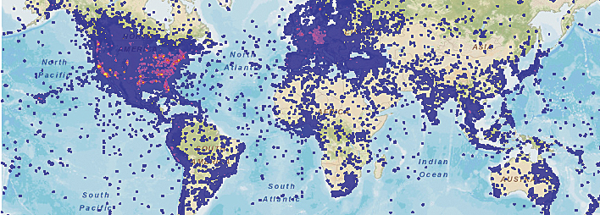
GIS BIG Data Storage and Processing
18 June 2019

Slide 23
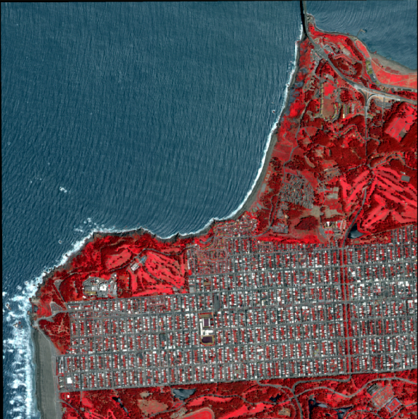
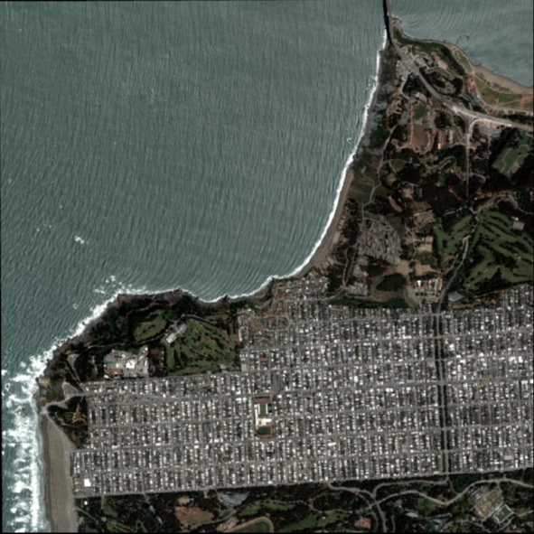
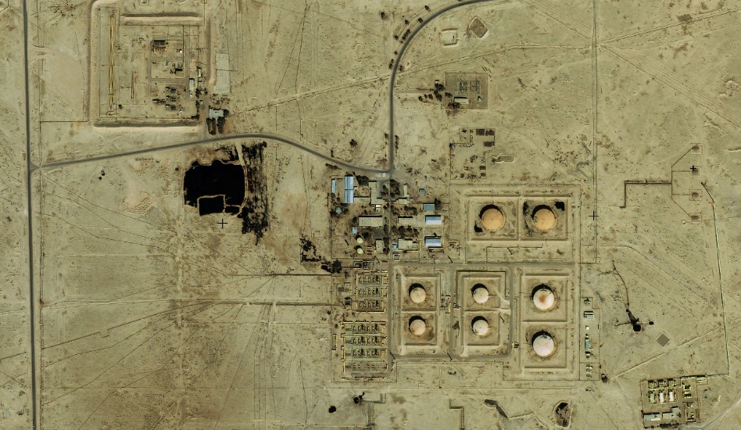
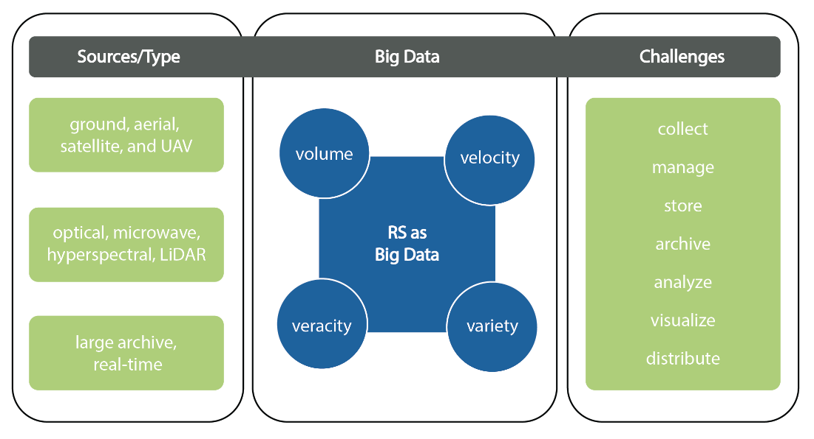
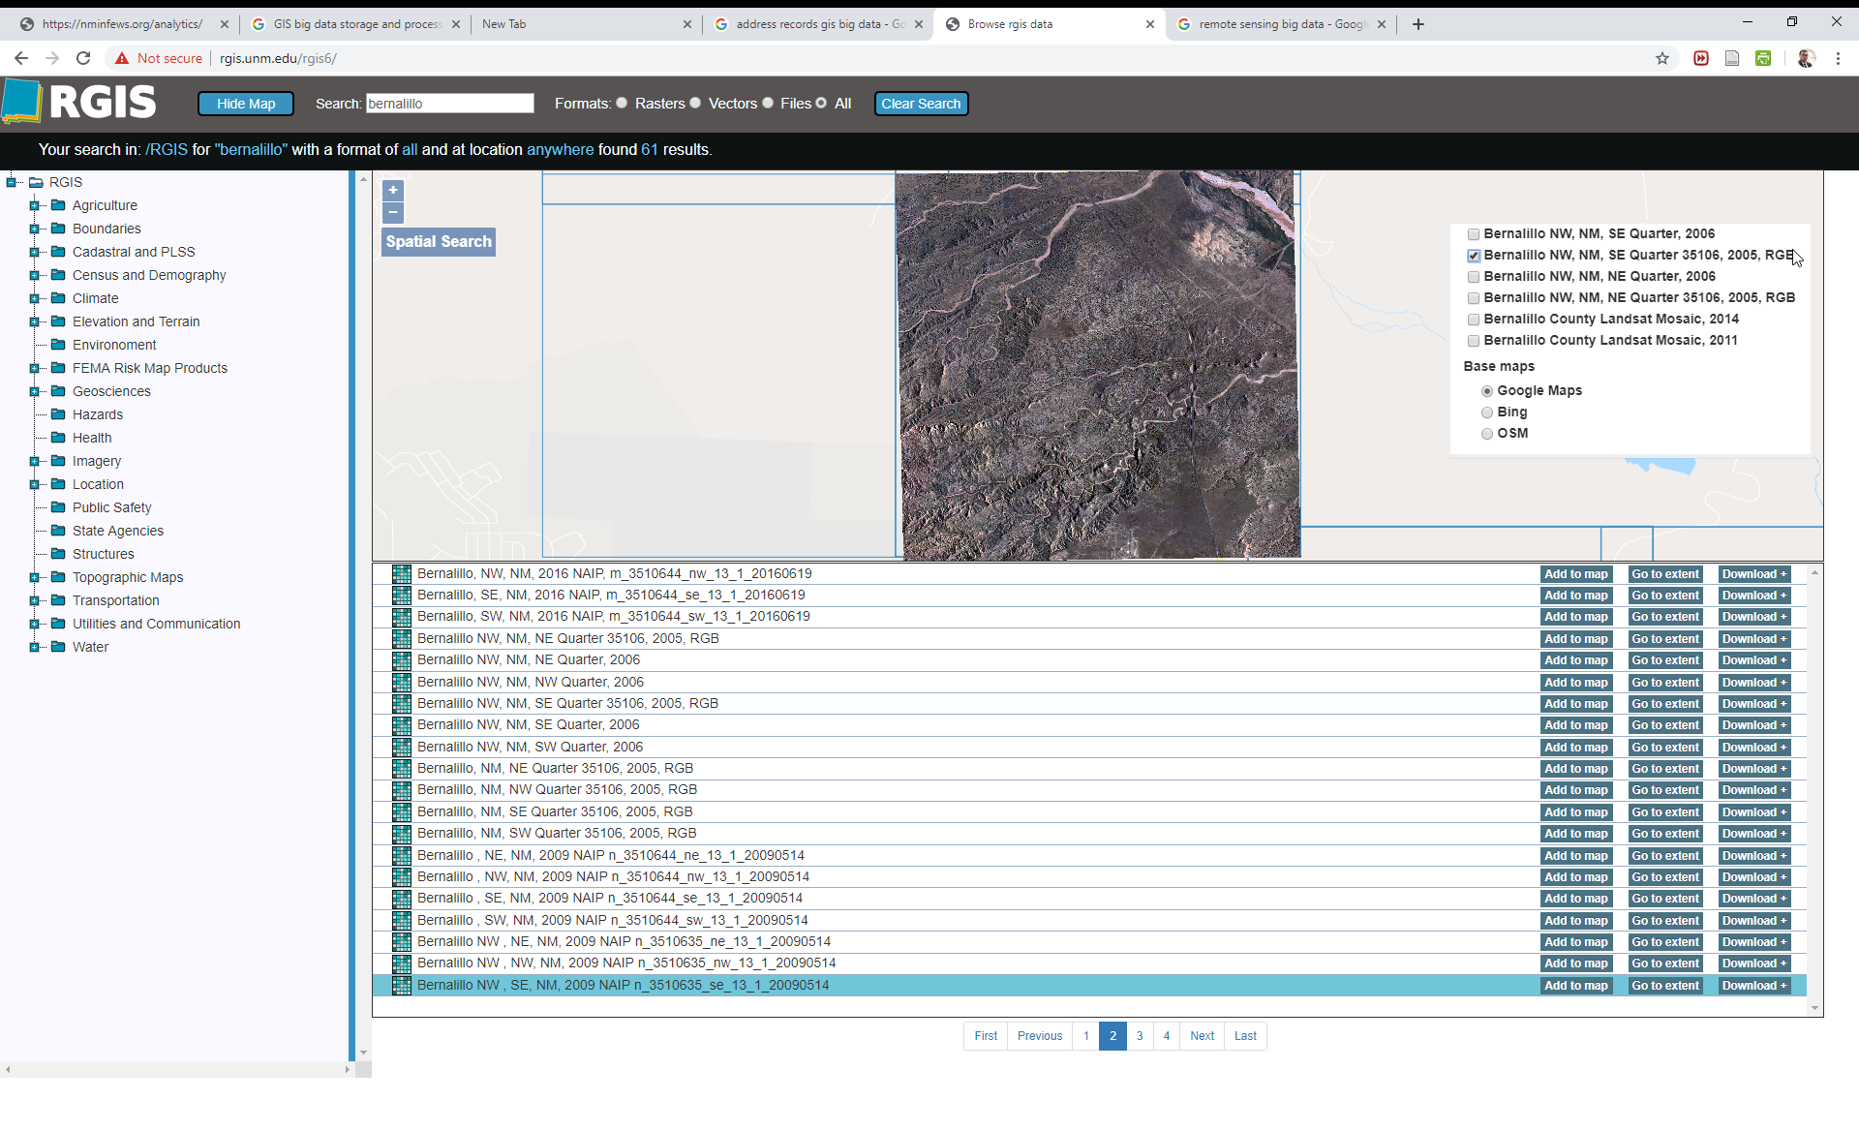
Aerial Photo and Satellite Imagery Big Data Storage and Processing
18 June 2019

Slide 24
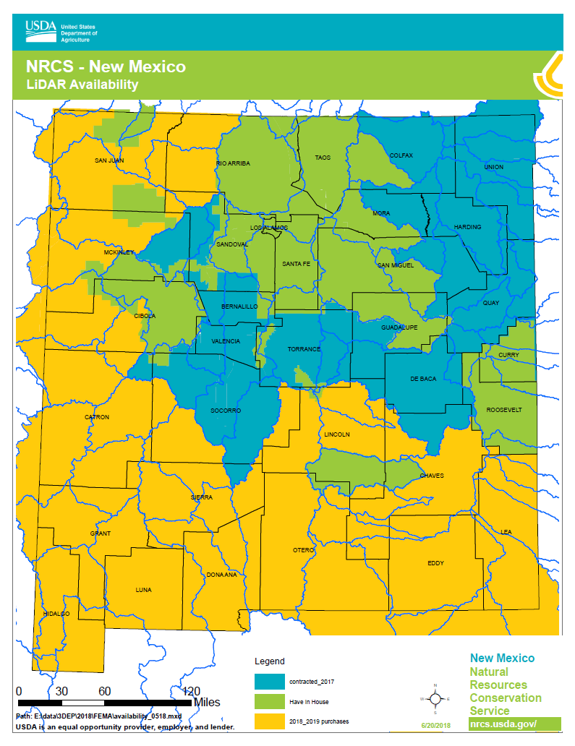
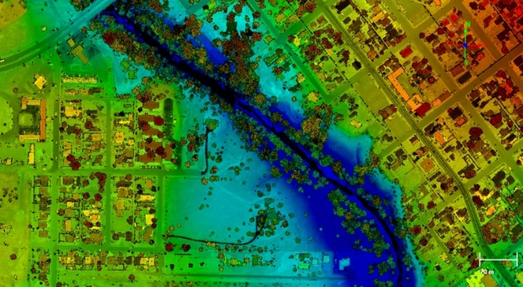
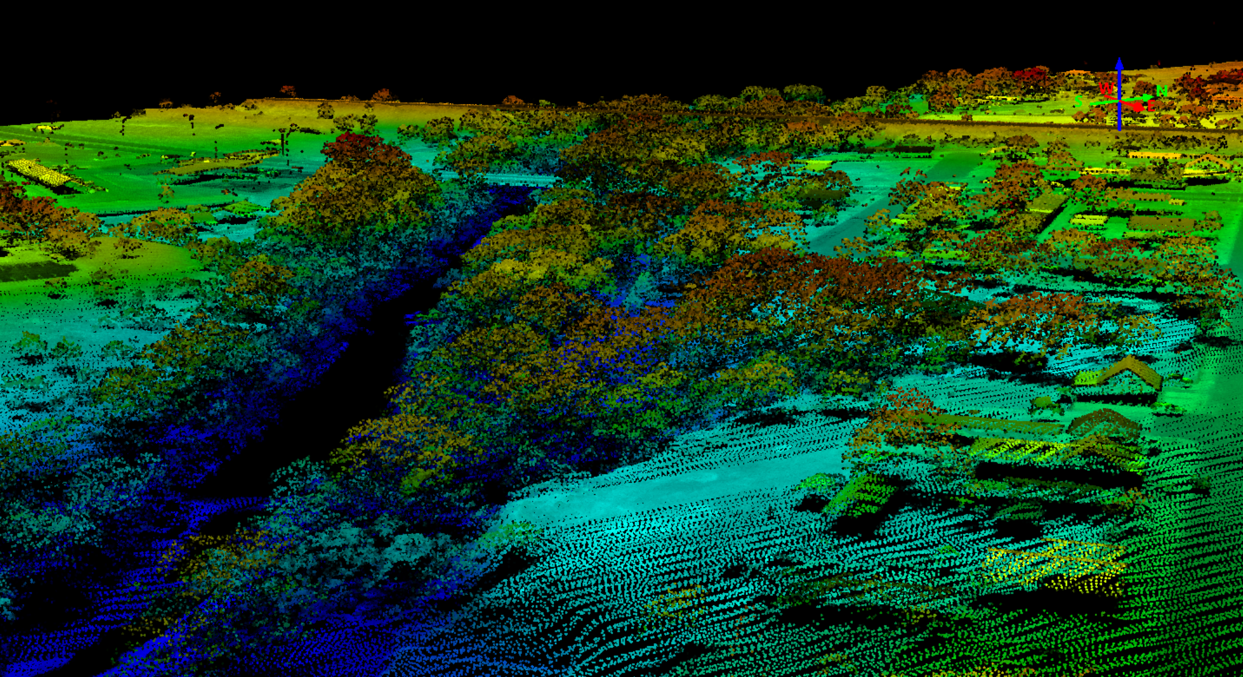
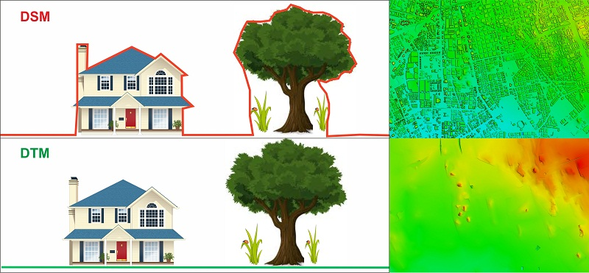
Airborne LiDAR Storage Processing and Analysis
18 June 2019

Slide 25
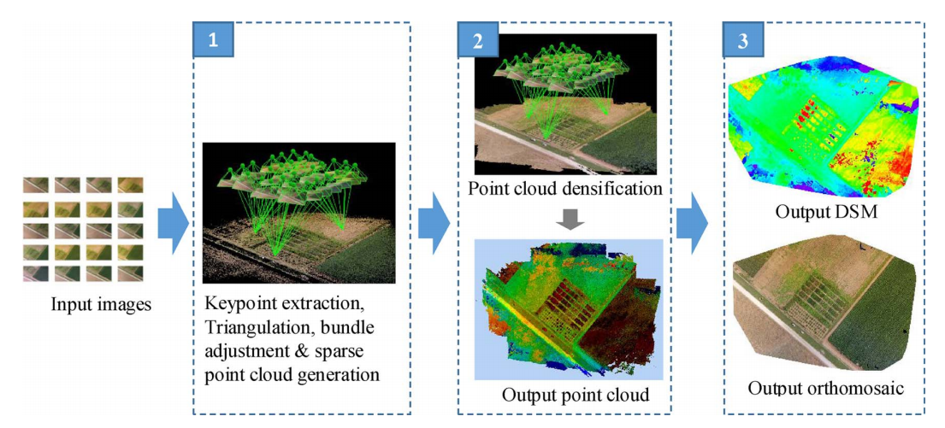
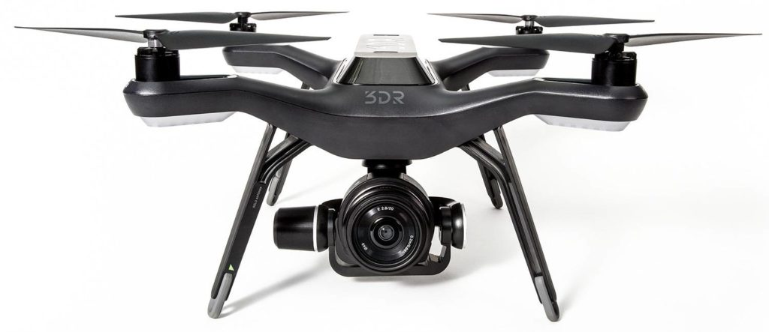
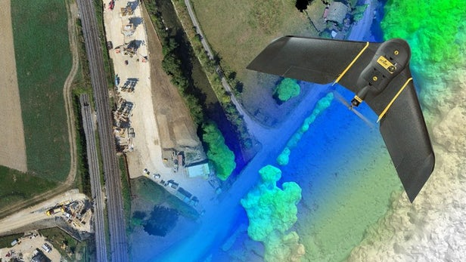
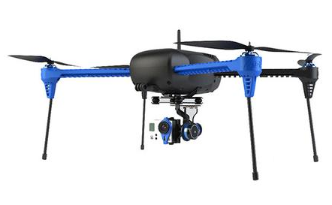
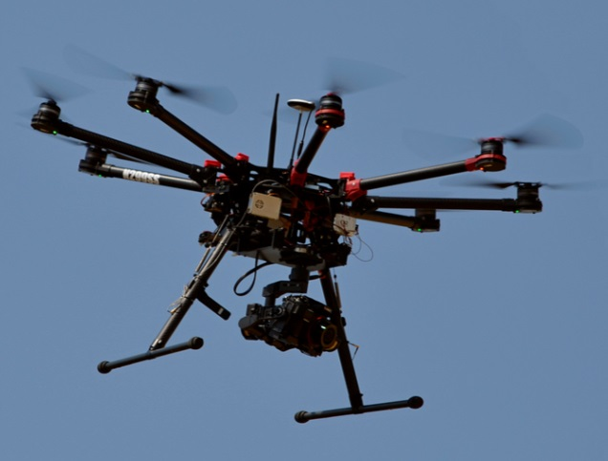
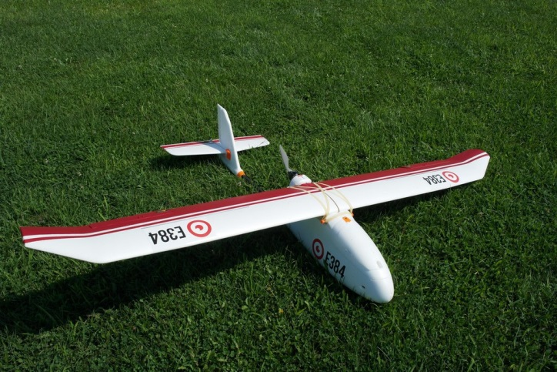
Unmanned Aerial Vehicle (UAV) Data Storage and Processing
18 June 2019

Slide 26
EDAC Contact Information
Shirley V. Baros, GISP | EDAC/RGIS Director | sbaros@edac.unm.edu 505.277.3622 x237
Dr. Su Zhang | IT and Operations Manager | szhang@edac.unm.edu 505.277.3622 x243
Brian Keller, GISP Hays Barrett, Sandeep Talasila, GISP Dr. Shawn Penman, GISP | GIS Program Manager IT DBA / Analyst Programmer NMBB / NM911 Technical Lead FEMA / DHSEM Technical Lead | bkeller@edac.unm.edu 505.277.3622 x228 hbarrett@edac.unm.edu 505.277.3622 x249 sandeep@edac.unm.edu 505.277.3622 x250 spenman@edac.unm.edu 505.277.3622 x227
Laura Gleasner | Data Manager | lgleasner@edac.unm.edu 505.277.3622 x230
18 June 2019

Slide 27
Broadband for Libraries
Connect America Funds
18 June 2019

Slide 28
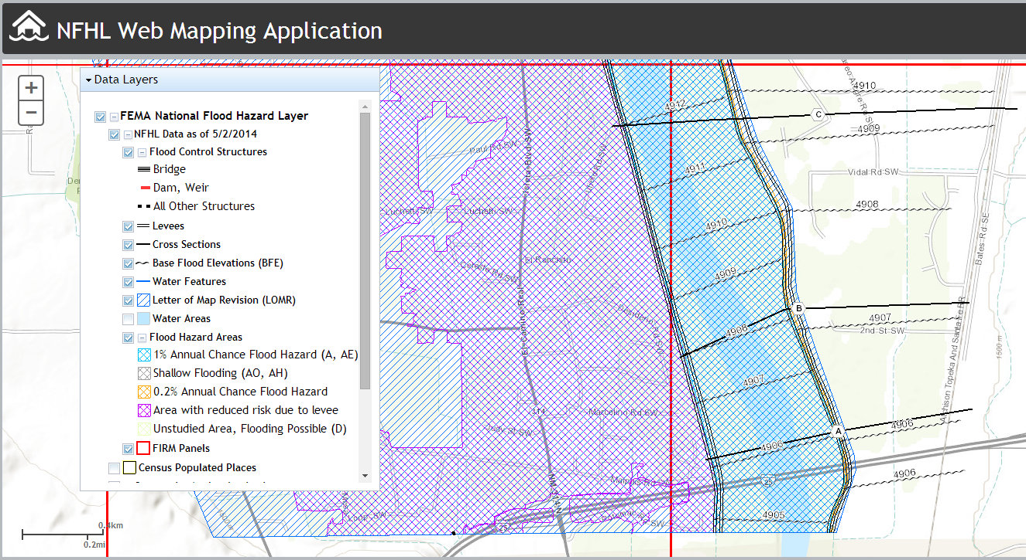
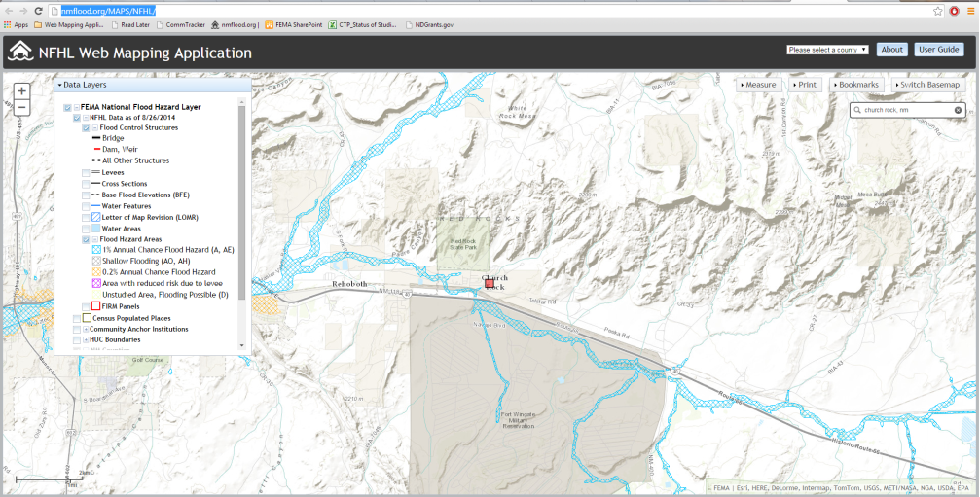
GIS / Geospatial Analysis and Technology
NM Watch: Active Wildfires
NM Flood : FEMA RiskMAP
https://NMFlood.org
https://NMWatch.org
18 June 2019

Slide 29
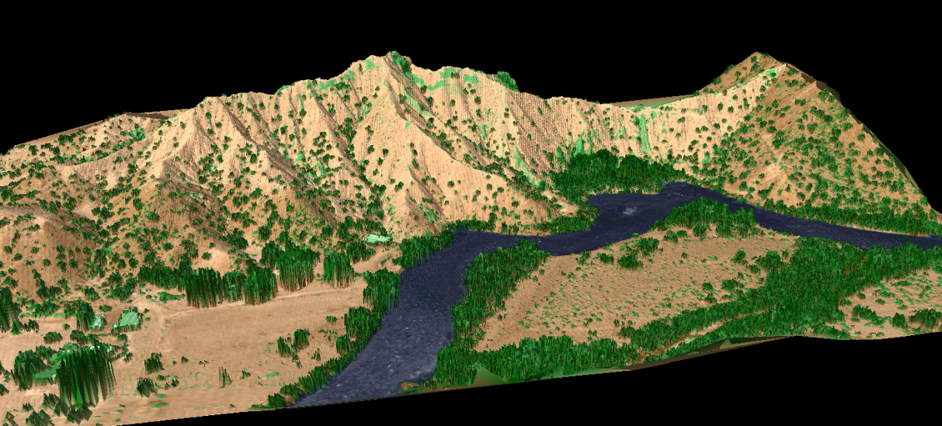
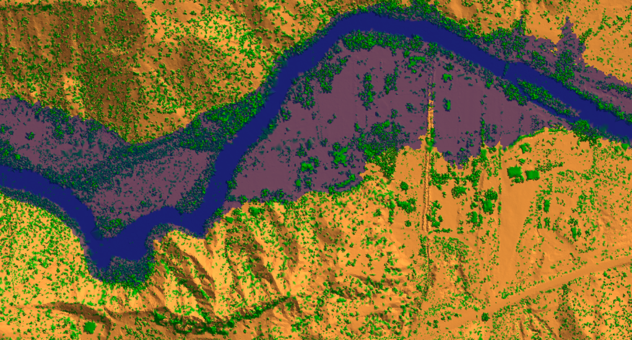
Image Processing and Analysis
Lidar Example
Multispectral Analysis Vegetation Index Land Cover/Land Use
Terrain Elevation Geologic Characterization Lidar Drone Imagery
QL2 Lidar, 2014: Planimetric View using TIN Surface
Blue: water
Purple: projected flooding of water 30 ft over river banks
QL2 Lidar, 2014: Perspective View using TIN Surface blended with Intensity Layer
Blue: water
Green: trees, shrubs, some buildings
Brown: ground points
18 June 2019

Slide 30
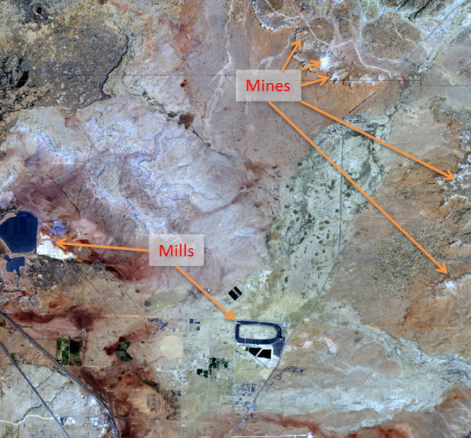
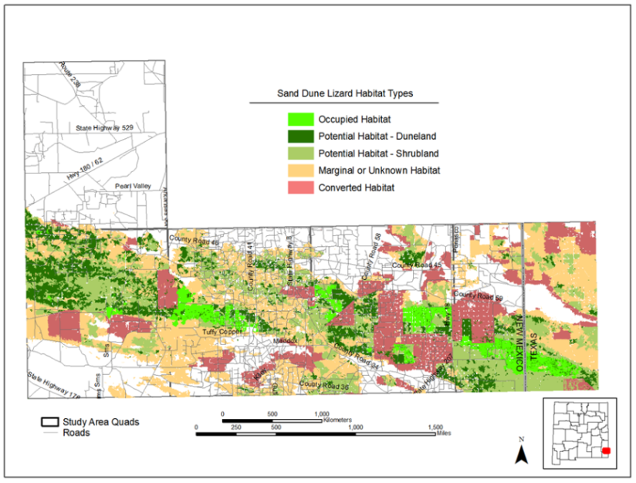
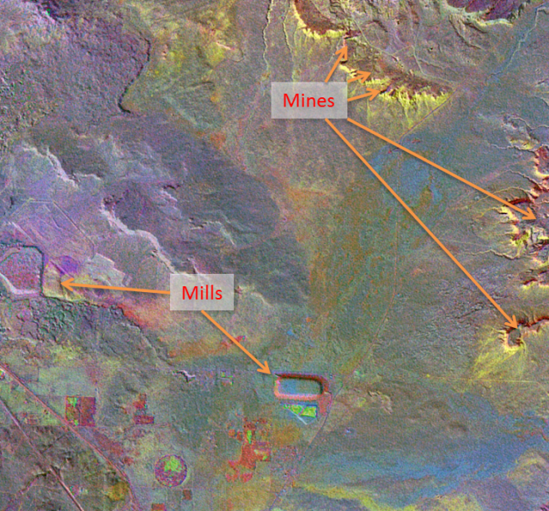
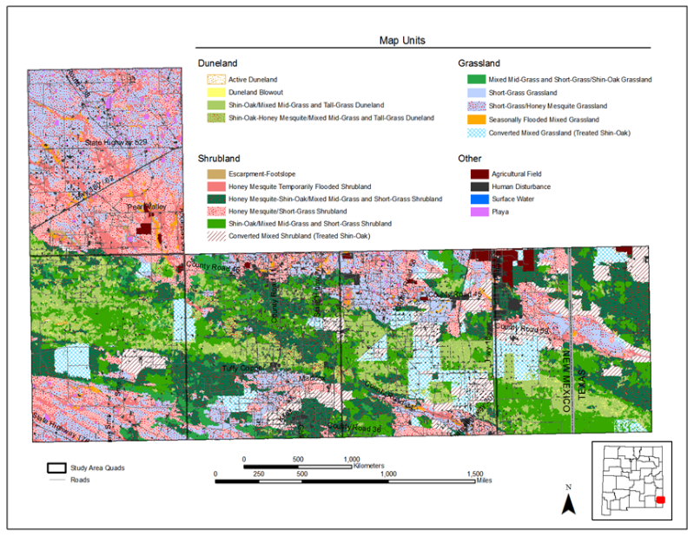
GIS / Image Processing and Analysis
Land
Cover Map
Foundation for
Habitat Map
Aster Bands
Minerals Map
Multispectral
Analysis
18 June 2019

Slide 31
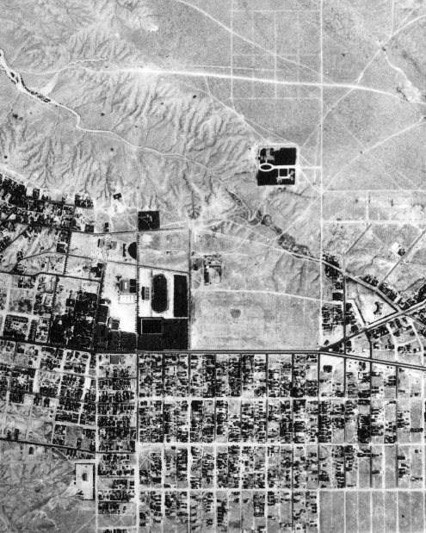
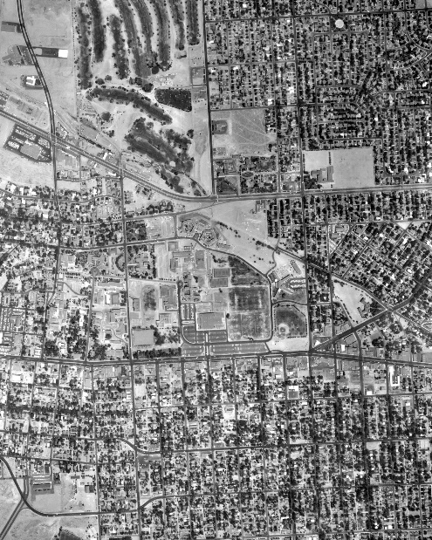
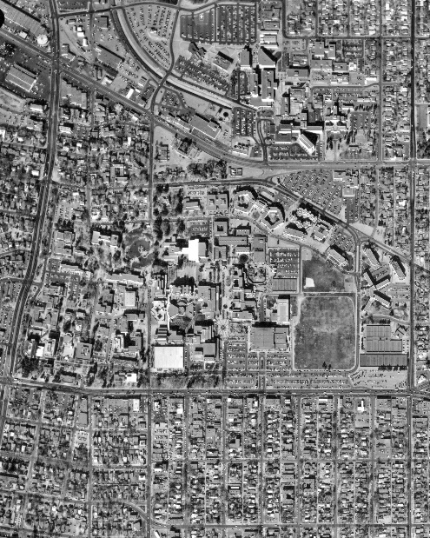
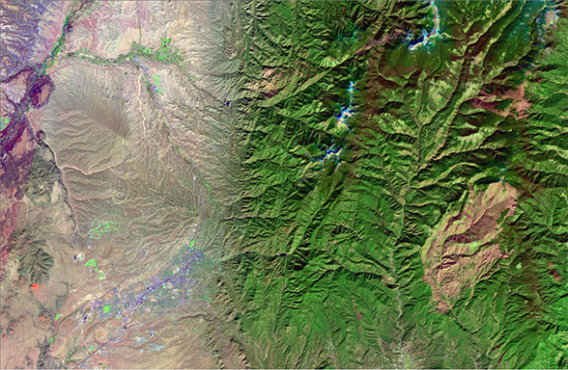
Historical Image Archive
Research Services
Geoprocessing (e.g., Geocorrection)
Custom Orders: Image, Photo, Map
UNM Service/Cost Center
USGS Business Partner
NM Natural Science Network (USGS)
1935
1964
Landsat
2010
1982
18 June 2019

Slide 32
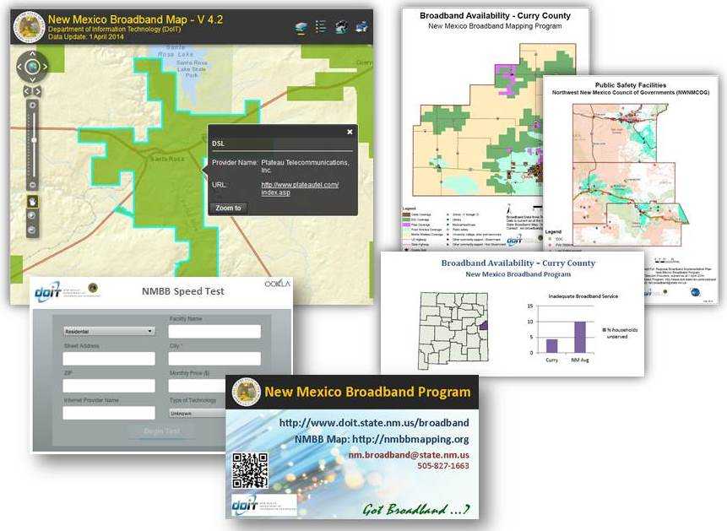
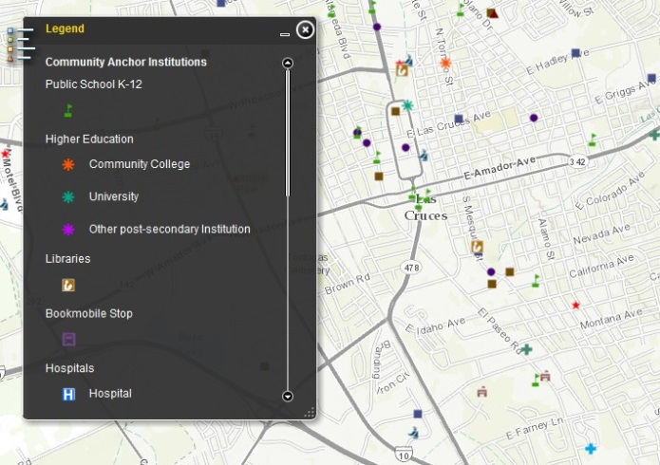
Broadband Tools / Data / Analysis and Technology
https://nmbbmapping.org/mapping/
Tools
Application Development
Web Mapping
Data Development
Data Discovery
Extraction
Processing
Integration and Delivery
Applications and Systems include:
Analysis and Modeling
Geospatial Visualization
Statistical Analysis
Data/DB Management and Hosting
NM Broadband Program
NMBBP CASA
18 June 2019

