Slide 1
New Mexico
CTP GIS Projects
Shawn L. Penman, PhD, CFM, GISP
Earth Data Analysis Center, University of New Mexico

Slide 2
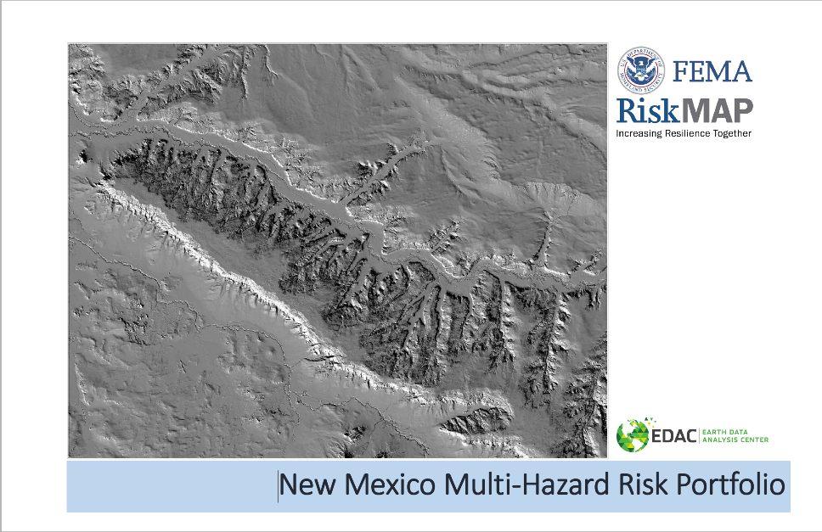
Multi-Hazard Risk Portfolio
Notes:
NM Hazard Mitigation Plan as a guide and for project inspiration, along with the Idaho CTP Risk Portfolio
NFIP Coordinator & CTP printed hard copes which have been distributed to local FPAs and Emergency Managers

Slide 3
Multi-Hazard Risk Portfolio (MHRP )
Statewide, watershed based risk assessment
Hazard Analysis by HUC-8 (85 watersheds)
Watershed Description
Lidar Availability, Counties, Communities Tribal Nations,
Flood Statistics – population, area, land ownership, CNMS, NFIP
Wildfire Statistics – wildfire risk, past wildfires, wildland urban interface, communities at risk from wildland fire, Nature Conservancy HUC-12 At-risk watershed rankings, vegetation treatment data, debris flow modeling
Landslide Statistics – rockfall susceptibility, landslide susceptibility, landslide deposit information
Flood Risk prioritization
These criteria include: Population At Risk, Area of Non-Federal Land, Essential Facilities At Risk, Dam Hazard Potential, Subject Matter Expertise
Wildfire Risk Prioritization
These criteria include: Watershed Population, Structures in the Wildland Urban Interface, Wildfire Risk Score
Landslide Risk Prioritization
rockfall susceptibility, landslide susceptibility, landslide deposit information

Slide 5
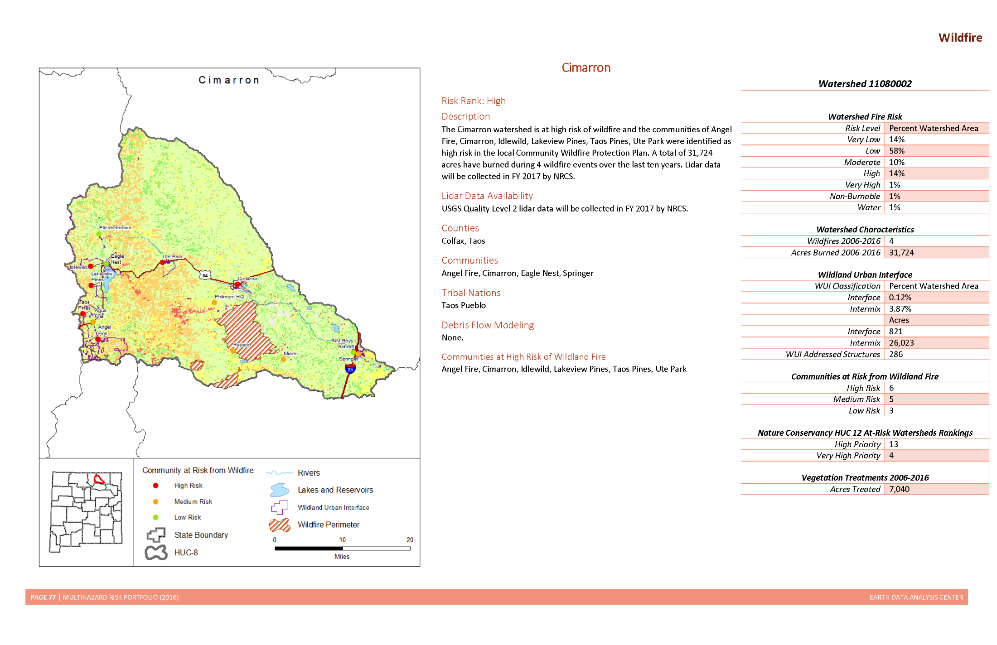
Notes:
NFIP Coordinator & CTP printed these and are distributing to communities FPA and Emergency Managers
Landslide info – Bureau of Geology Maps

Slide 6
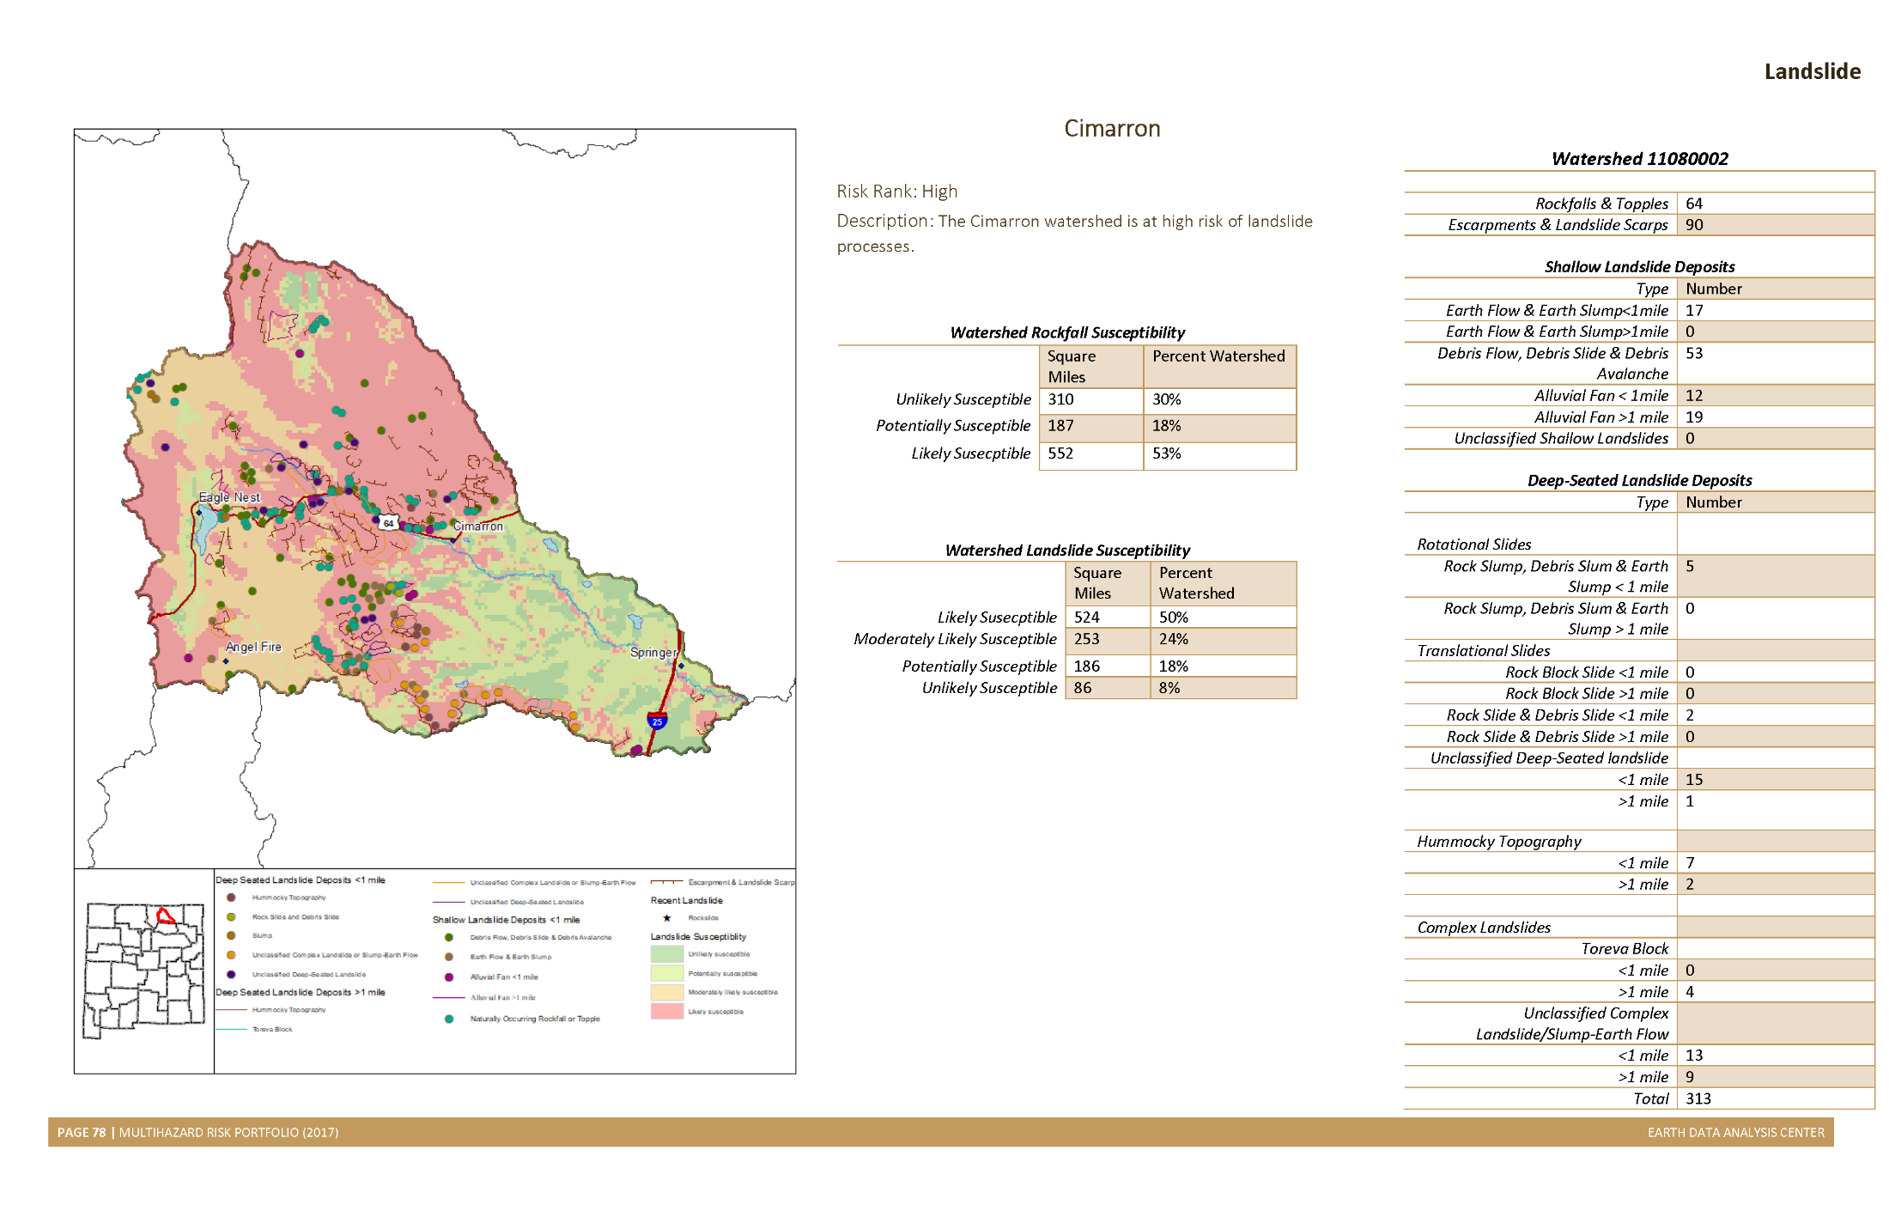
Notes:
Landslide info – Bureau of Geology Maps

Slide 7
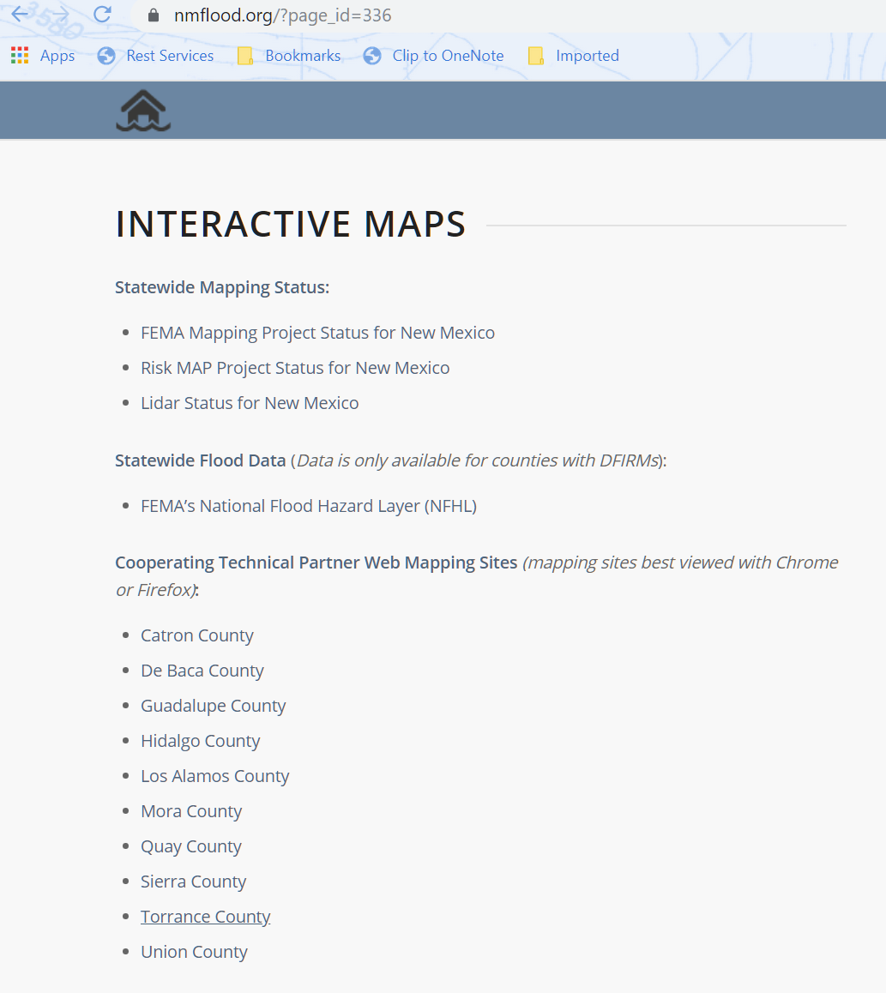
Web Maps for counties with no maps
Notes:
MapMod – 10 counties not digitized, 6 had no floodplain mapping conducted. 2 converted to by letter from HUD flood hazard boundary maps.
one has never been mapped and five have only a single community within the county that was mapped.
Scanned and digitized FIRM/FHBM data. Created Web application added Community Institutions –
schools, fire stations, libraries, community centers, etc. Low water crossing info if available.
Some counties provided parcel data.
Typically counties with no GIS software or staff.
2017 CTP Best Practices.

Slide 8
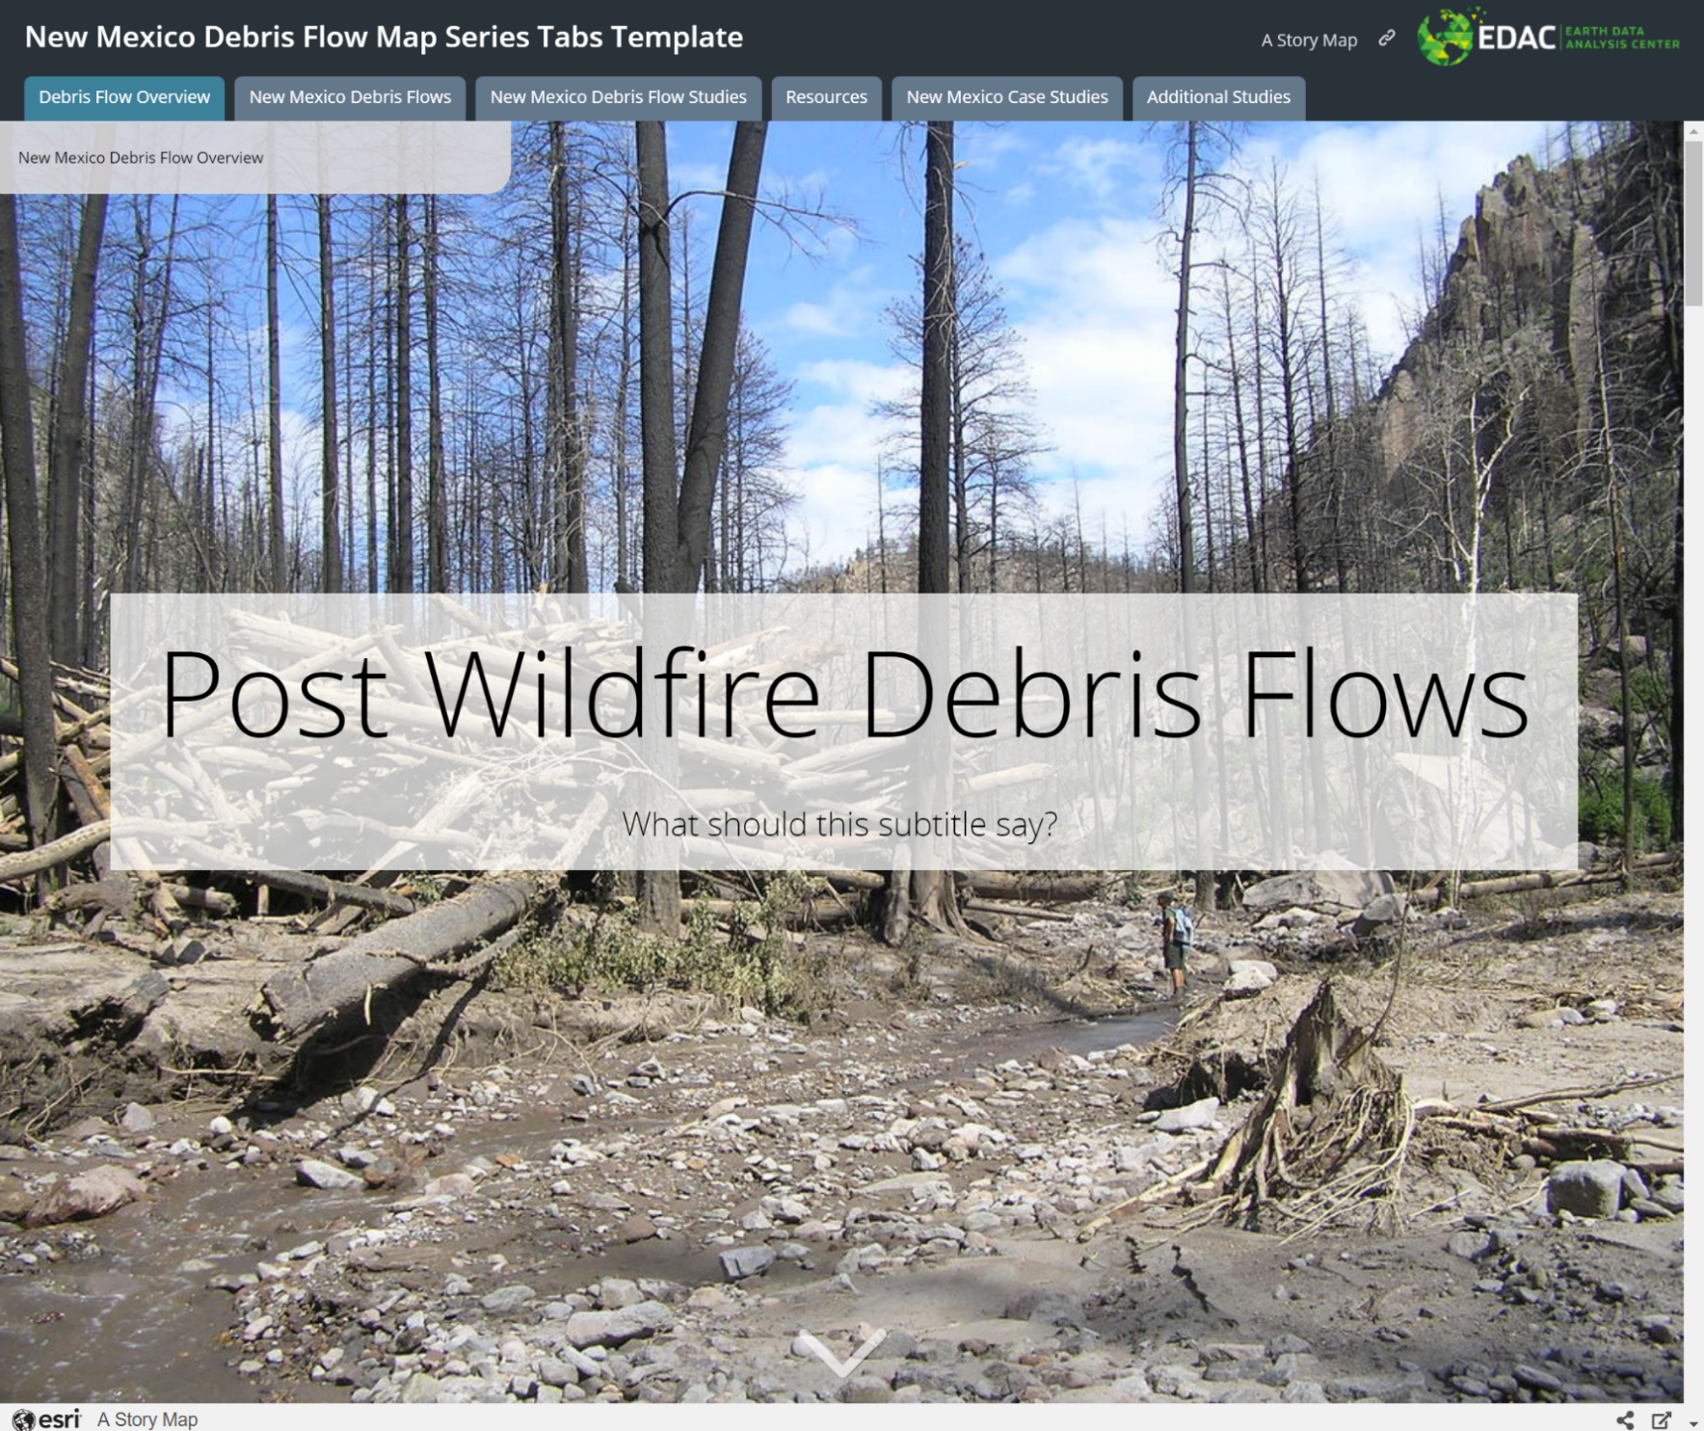
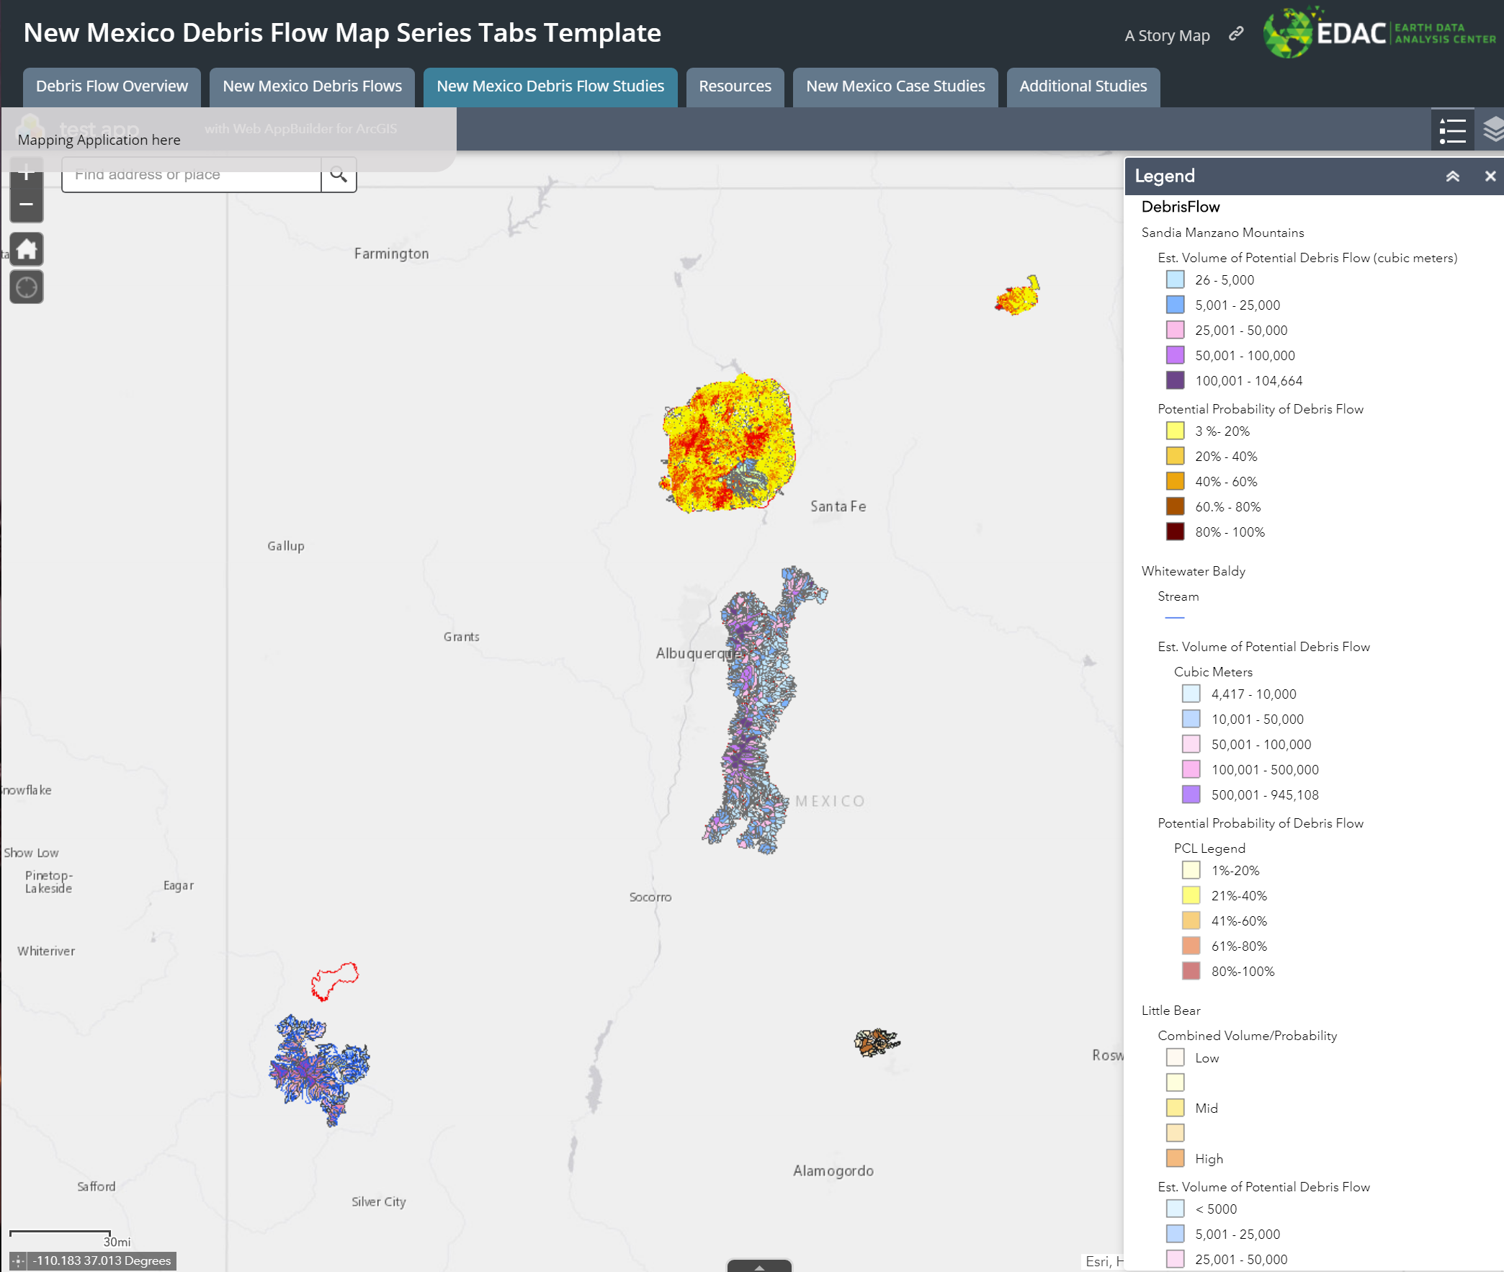
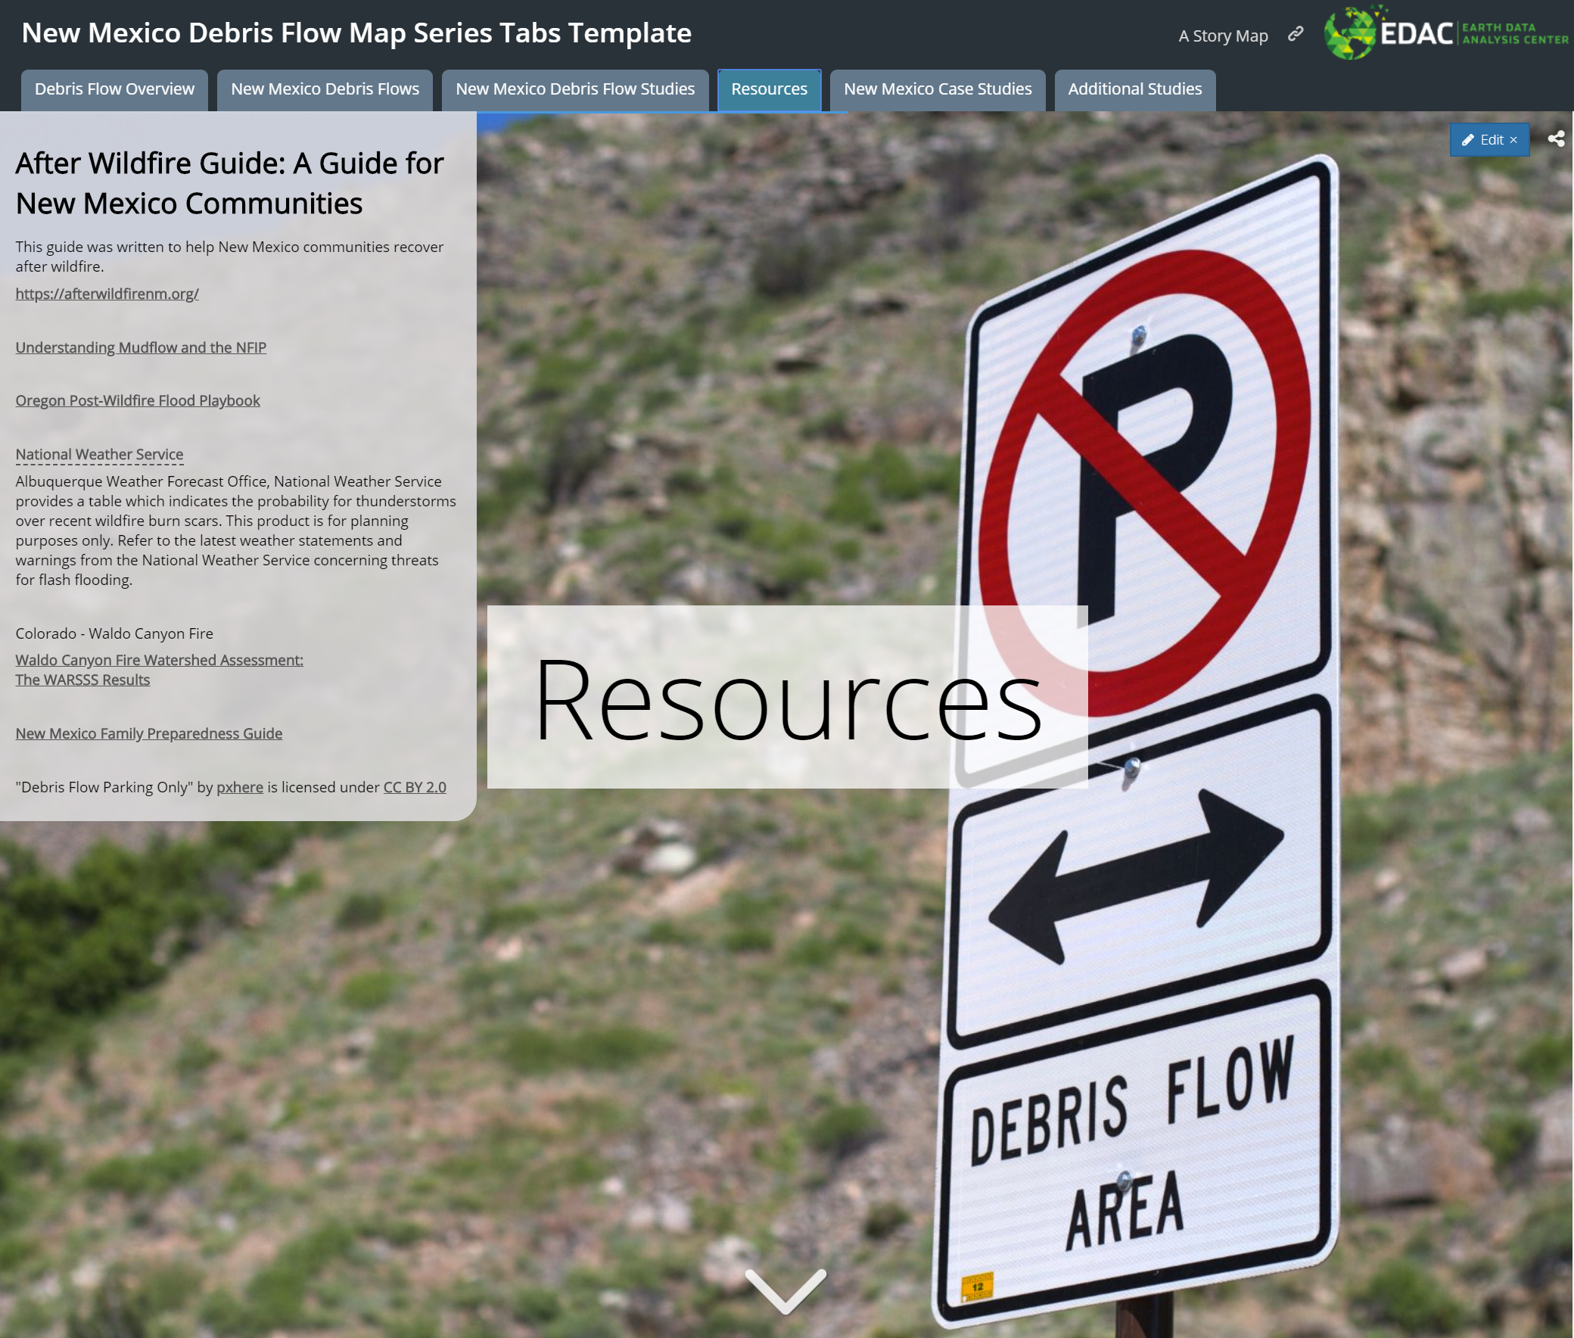
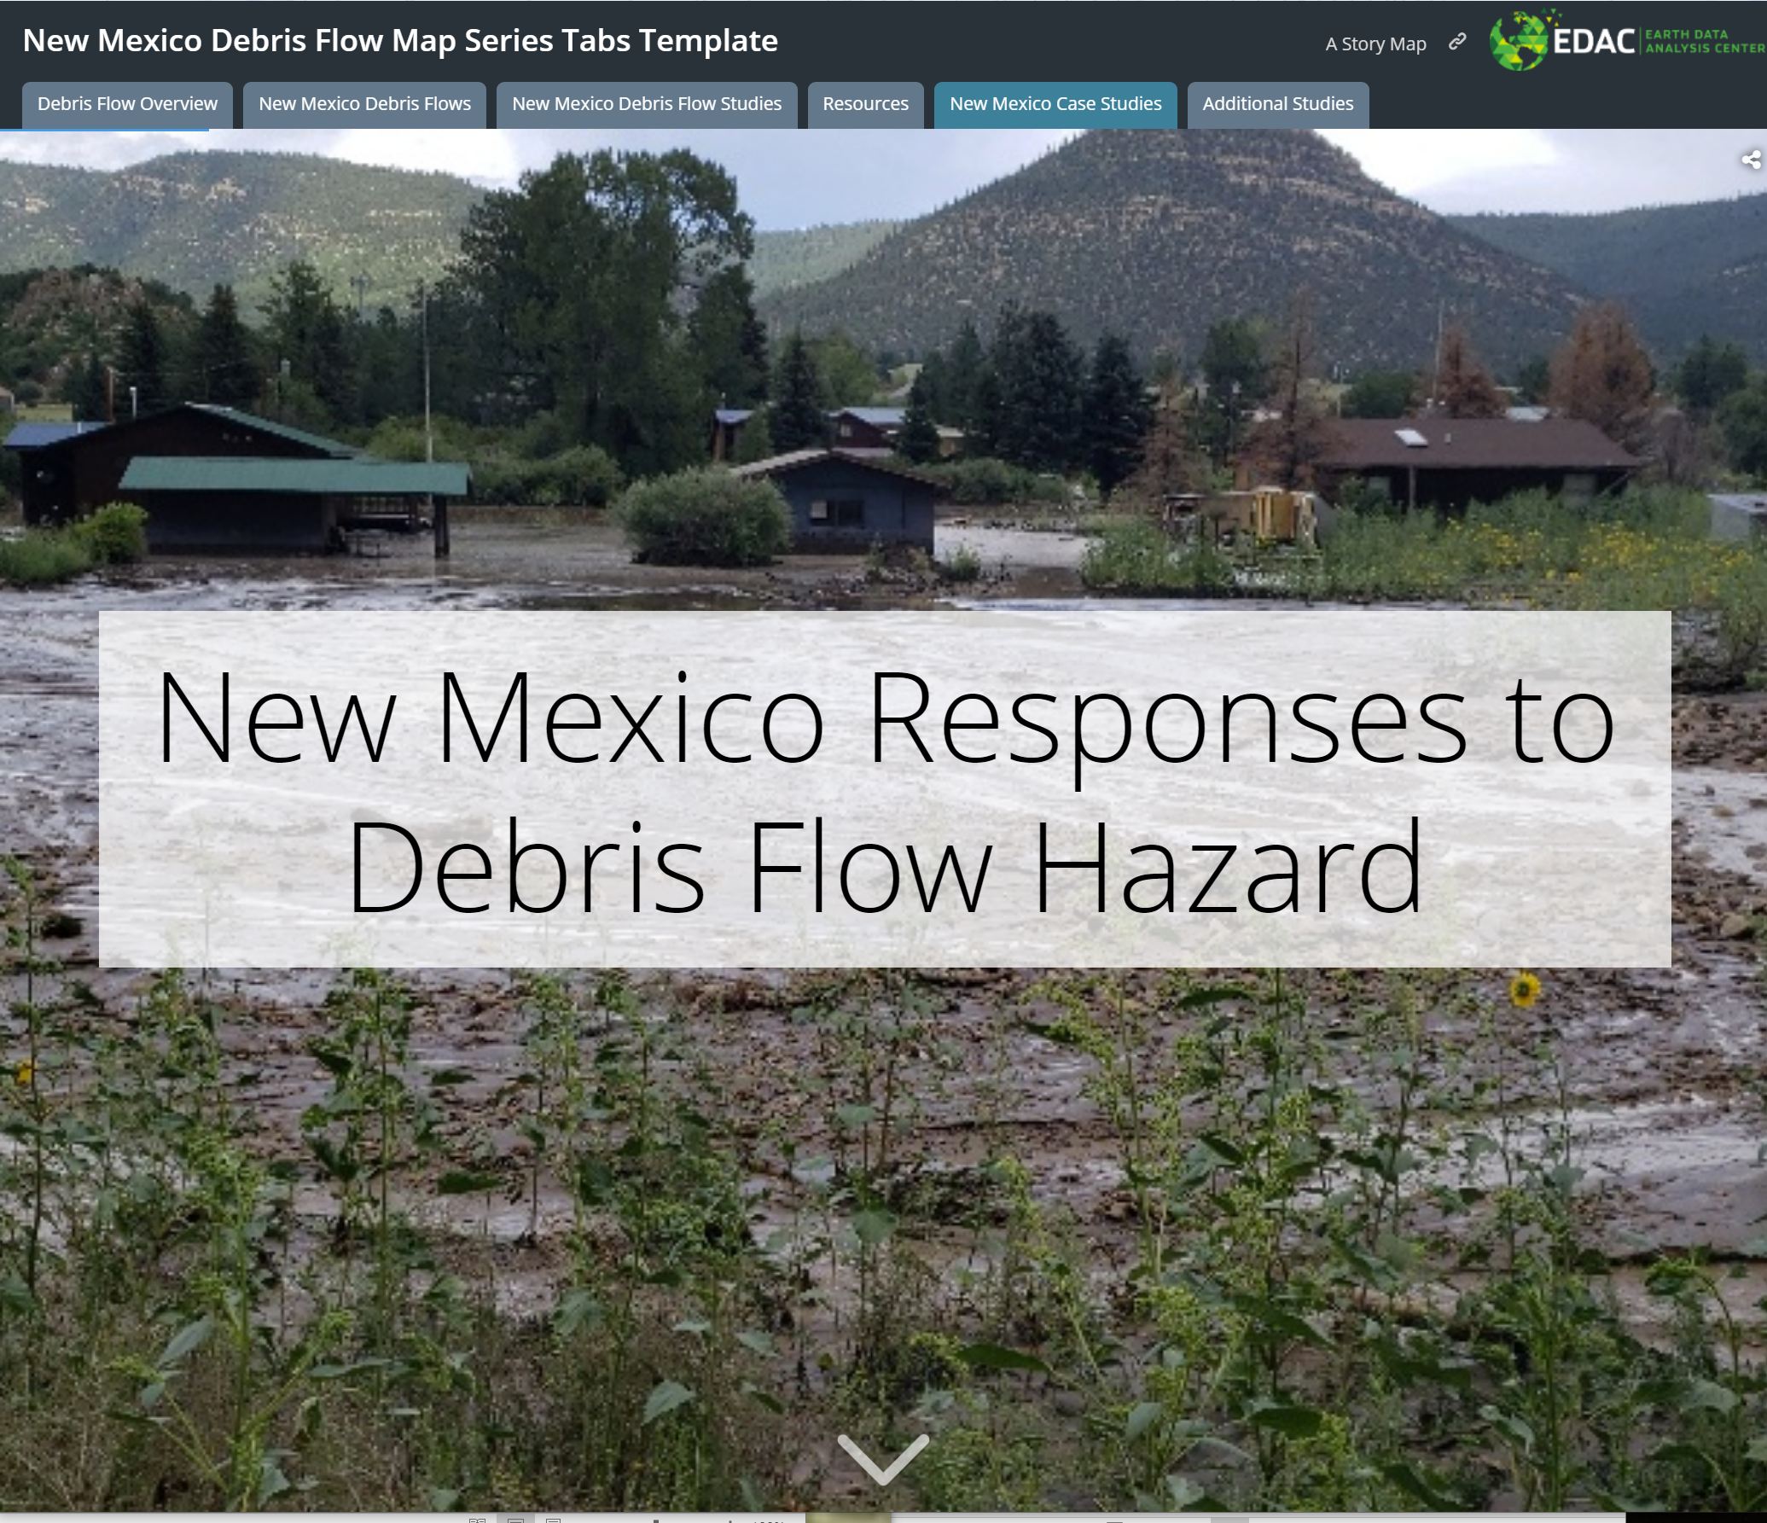
Debris Flow Application
http://arcg.is/yGjua
Notes:
Storymap
Debris Flow Overview
Debris Flows in NM
Debris Flow Studies – Interactive Map
Resources
NFIP & Debris Flows
Toolkits for Outreach & Communication
New Mexico Case Studies

Slide 9
Debris Flow Application
http://arcg.is/yGjua
Notes:
Storymap – CTP Best Practice 2015 about 2013 Flooding Storymap
Debris Flow Overview
Debris Flows in NM
Debris Flow Studies – Interactive Map
Resources
NFIP & Debris Flows
Toolkits for Outreach & Communication
New Mexico Case Studies

Slide 10
Debris Flow Application
http://arcg.is/yGjua
Notes:
Storymap – CTP Best Practice 2015 about 2013 Flooding Storymap
Debris Flow Overview
Debris Flows in NM
Debris Flow Studies – Interactive Map
Resources
NFIP & Debris Flows
Toolkits for Outreach & Communication
New Mexico Case Studies

Slide 11
Debris Flow Application
http://arcg.is/yGjua
Notes:
Storymap – CTP Best Practice 2015 about 2013 Flooding Storymap
Debris Flow Overview
Debris Flows in NM
Debris Flow Studies – Interactive Map
Resources
NFIP & Debris Flows
Toolkits for Outreach & Communication
New Mexico Case Studies

Slide 12
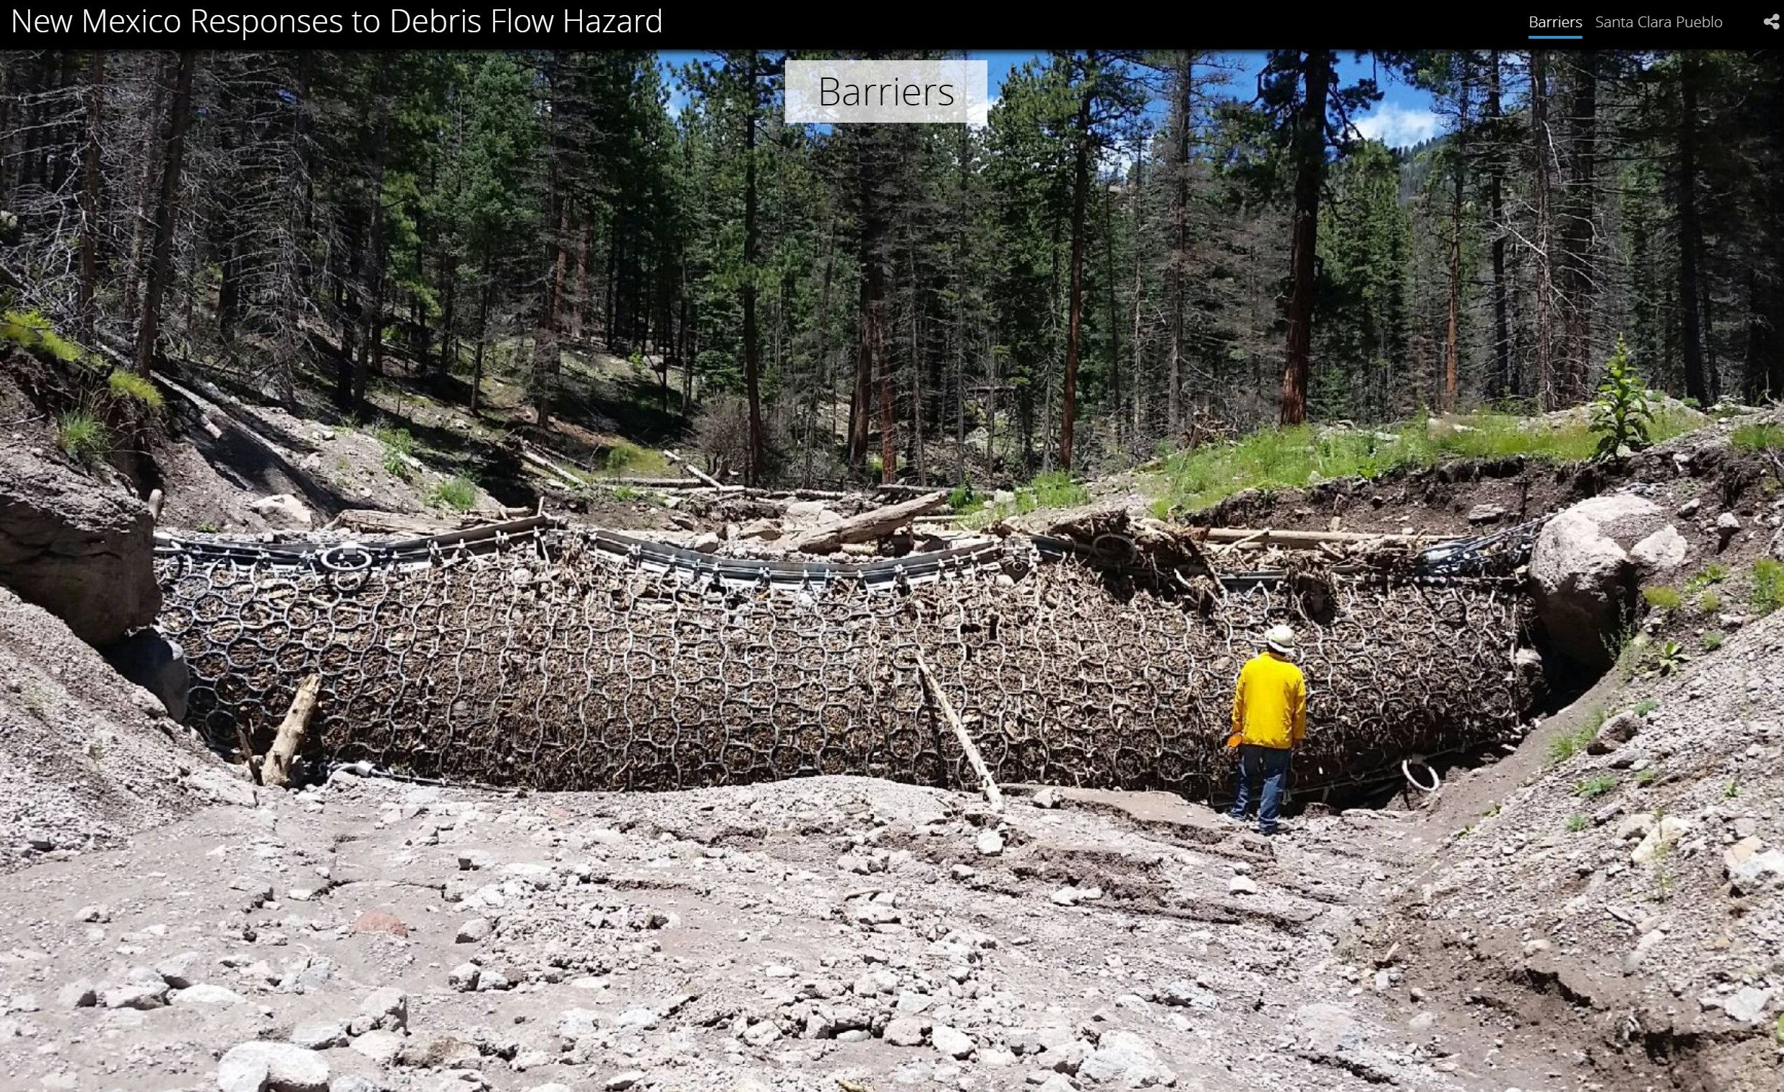
Debris Flow Application
http://arcg.is/yGjua

Slide 13
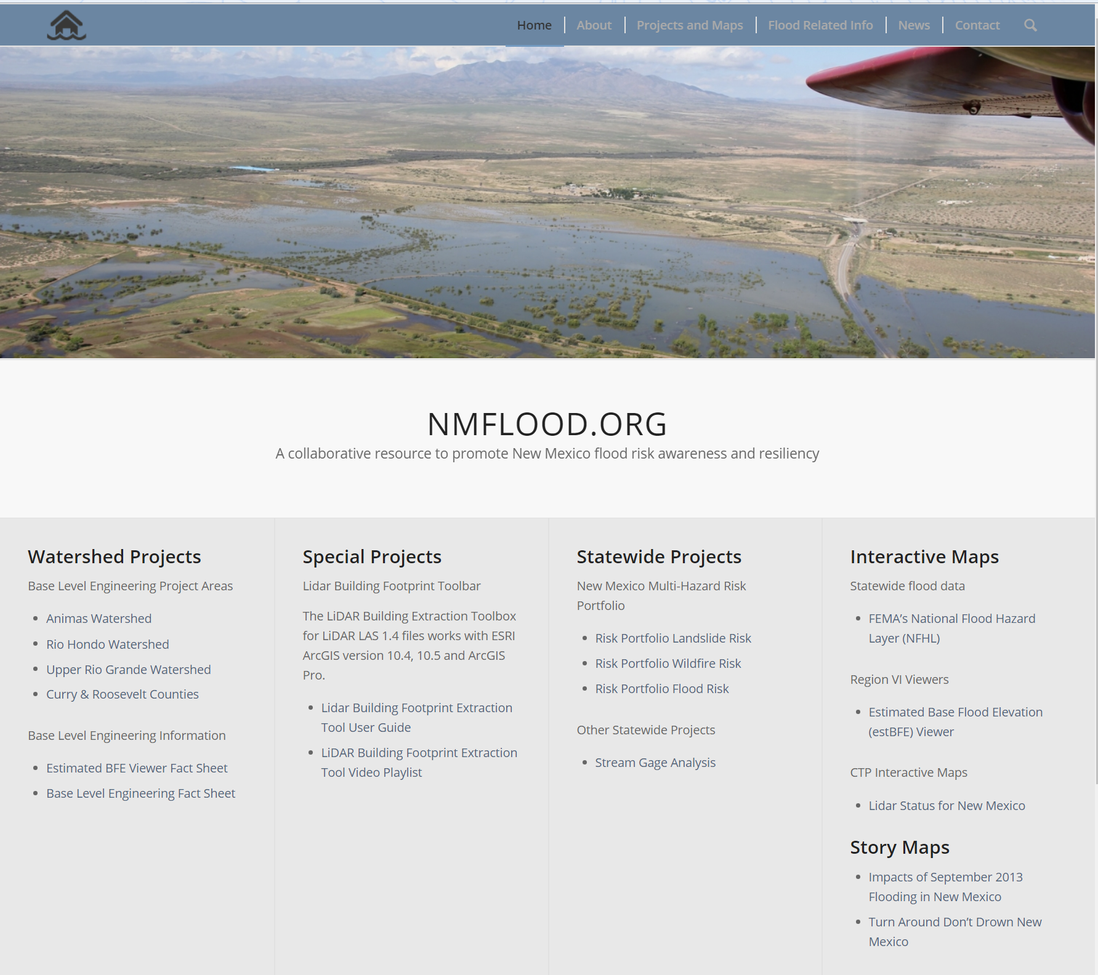
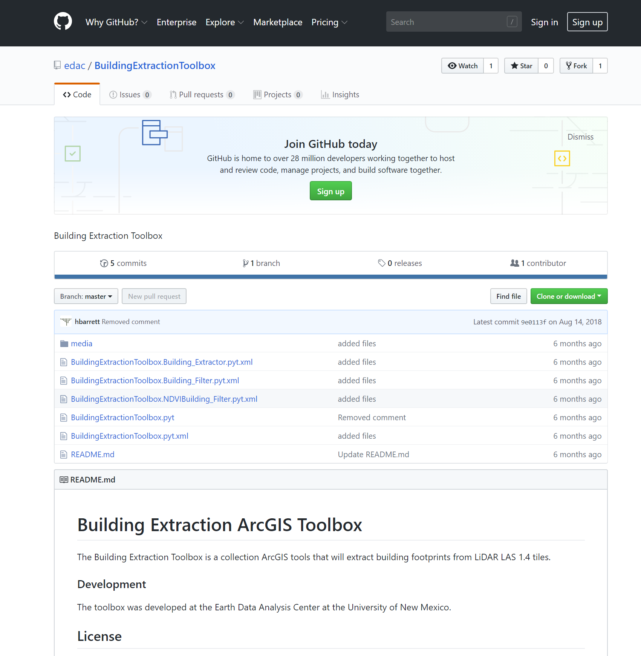
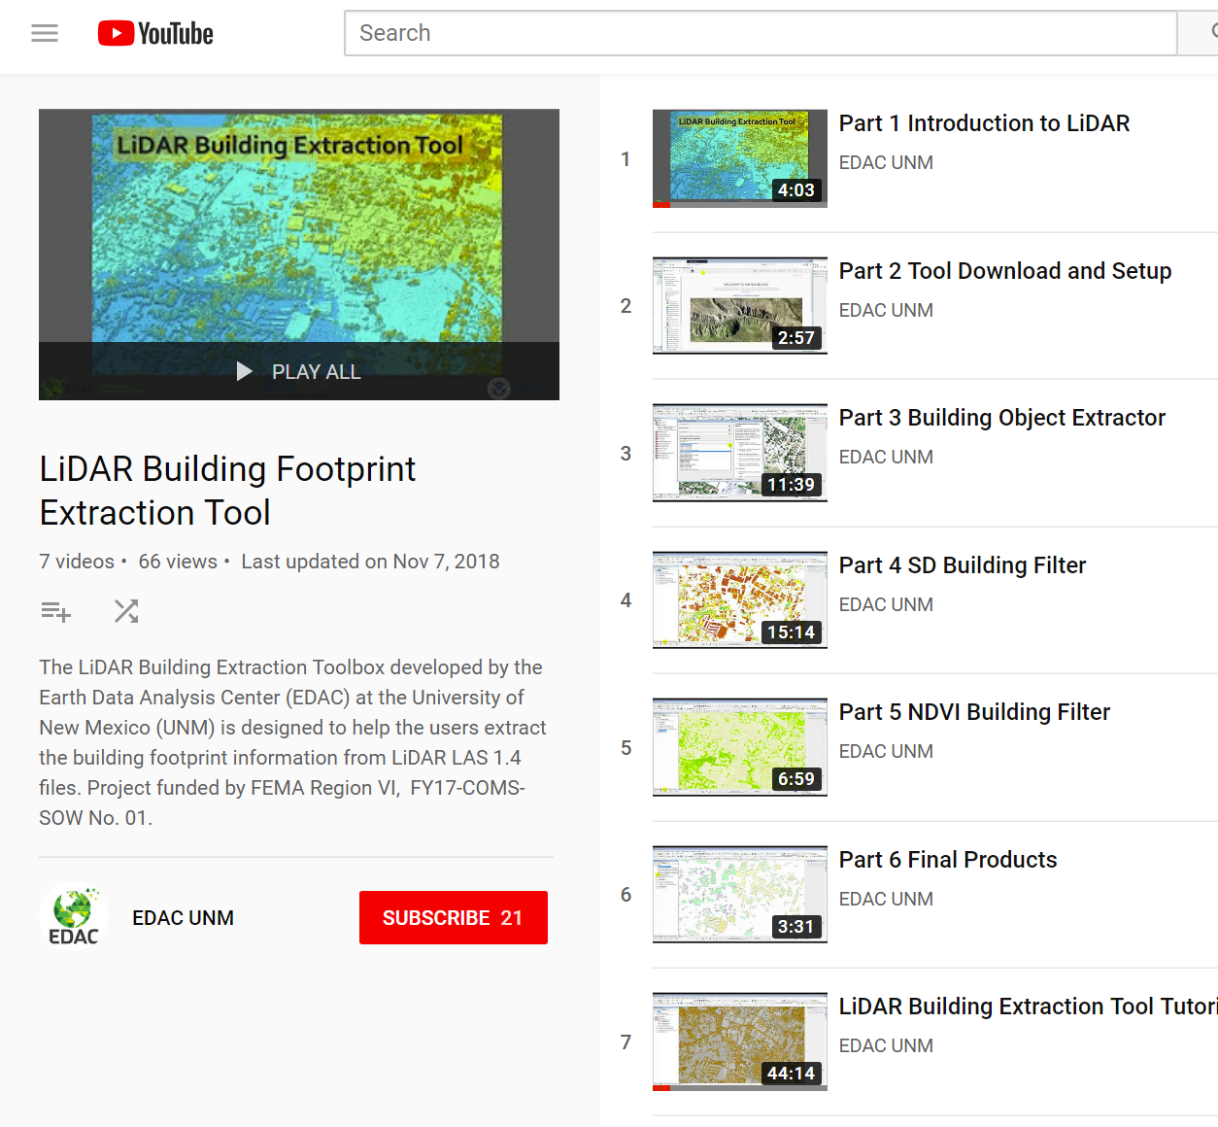
Region 6– Special Project
ArcGIS tool to extract building footprints from lidar .las files

Slide 14
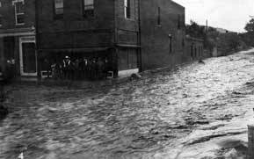
New Mexico Community Flooding Database
Collect photos and/or videos showing flooding in the State of New Mexico
Notes:
Silver City, Flooding Downtown, Image #148, Silver City Museum, 1915

Slide 15
Survey – Survey123 Form
https://arcg.is/yLnLX
Notes:
Photos, videos up to 4 minutes but one at a time

Slide 16
Encuesta en español
Survey in Spanish also

Slide 17
Flooding Web-App
Photos and videos appear in gallery, can right click and download
http://tinyurl.com/msrj844j

